Slide 1
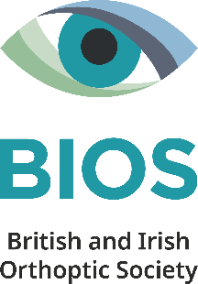
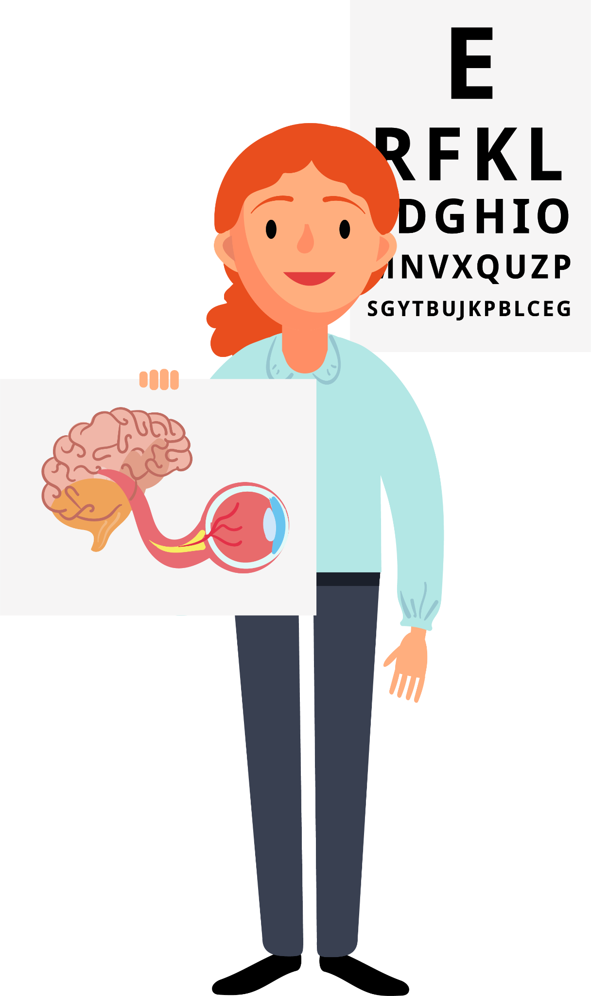

Orthoptics
Post-Graduates & Career Changers
Notes:
Hi my name is…
I am an orthoptist at ….
I’m going to give you a quick introduction to Orthoptics

Slide 2

What is Orthoptics?
Teeth?​
​
Feet?​
​
Bones?​
​
Eyes?
Notes:
Raise your hand… what is Orthoptics?
Is it related to teeth, feet, bones, or eyes?

Slide 3
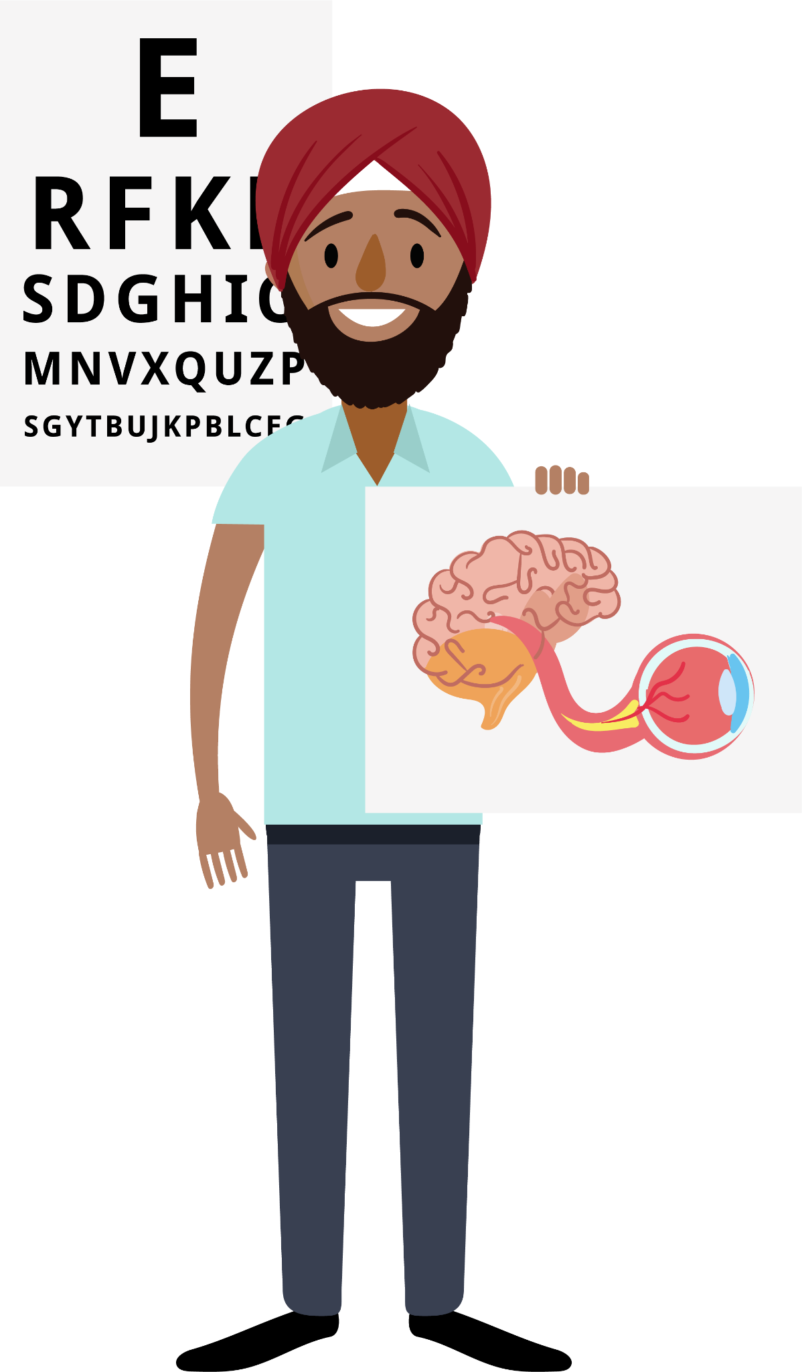
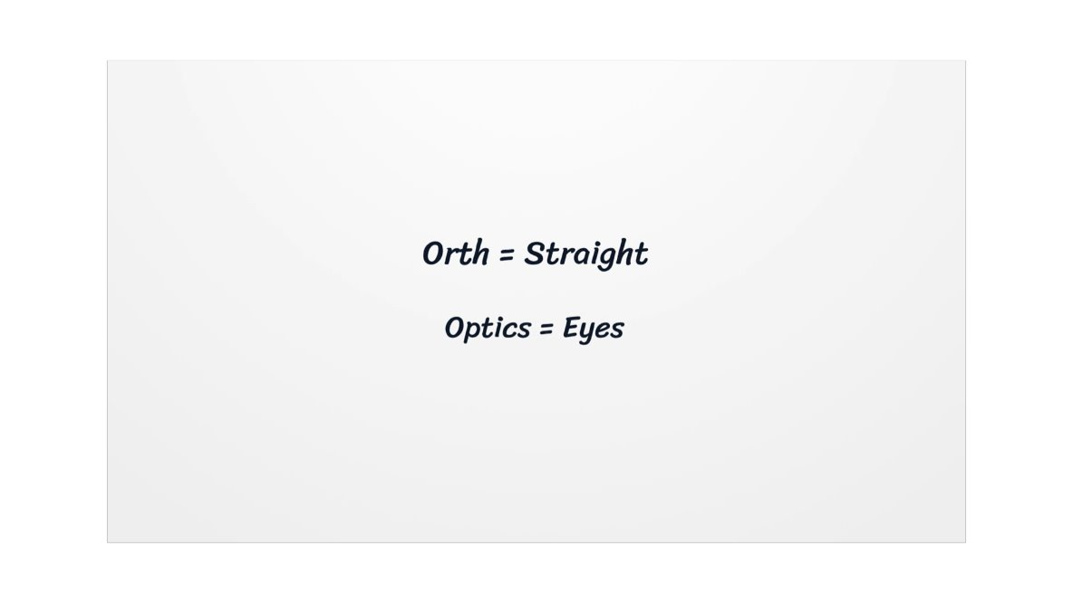
What is Orthoptics?
Teeth?​
​
Feet?​
​
Bones?​
​
Eyes!
Notes:
Orthoptics is a specialised area of Allied Health that focuses on the eyes. The term comes from Greek, meaning “straight eyes” (Orth – straight, Optic – eyes). Orthoptists specialise in how the eyes move and how they work together with the brain.

Slide 4
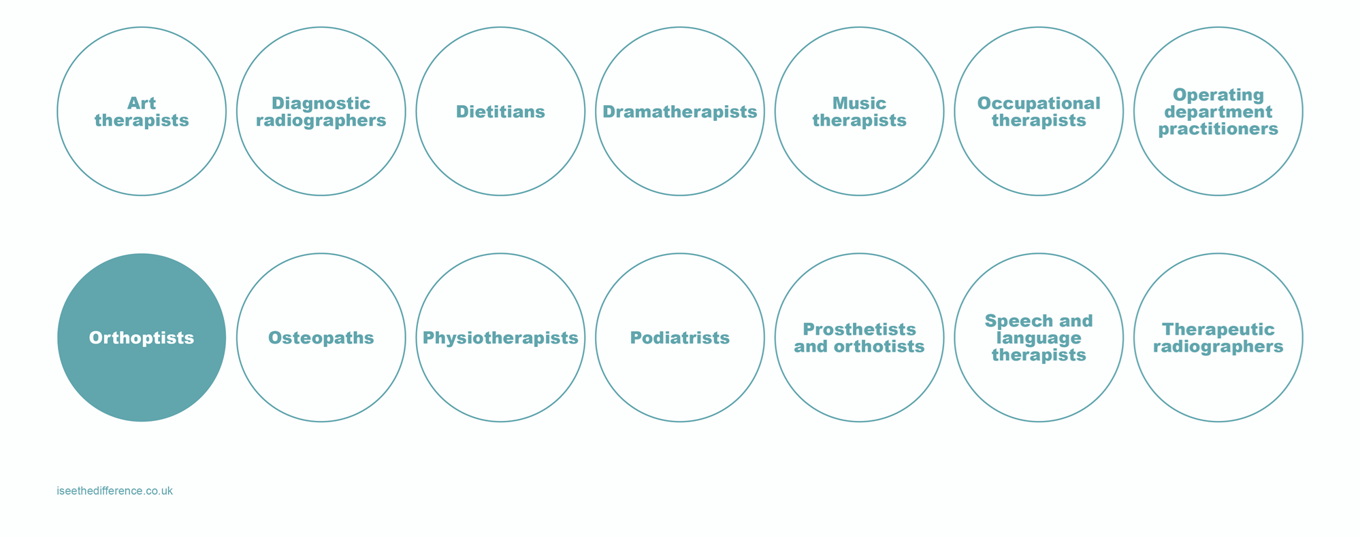
Allied Health Professions
Notes:
There are lots of health jobs, and Orthoptics is one of them. Working as an Orthoptist is really cool because you get to help people see better, which makes a big difference in their lives. It's a job that lets you meet lots of different people and helps them every day!

Slide 5
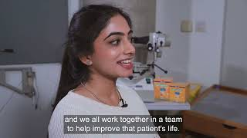
Notes:
I’m just going to show you a video here about orthoptics

Slide 6
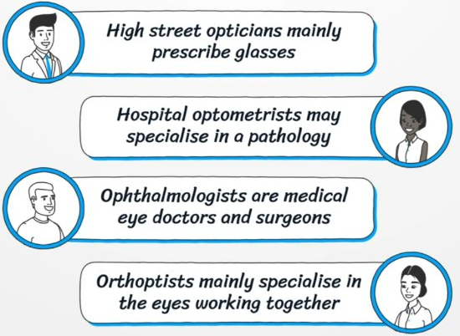
Which one are we?
There are many eye professions!
Notes:
You heard the Orthoptist mention Optometrists and Ophthalmologists. It’s easy to confuse them since all these professions start with an “O”!
High street opticians are familiar to most people, and hospital optometrists also prescribe glasses and diagnose eye diseases.
Ophthalmologists are medical doctors who specialise in treating eye conditions.
Orthoptists, however, focus on diagnosing and treating eye movement disorders and conditions like strabismus (squints) and double vision.

Slide 7
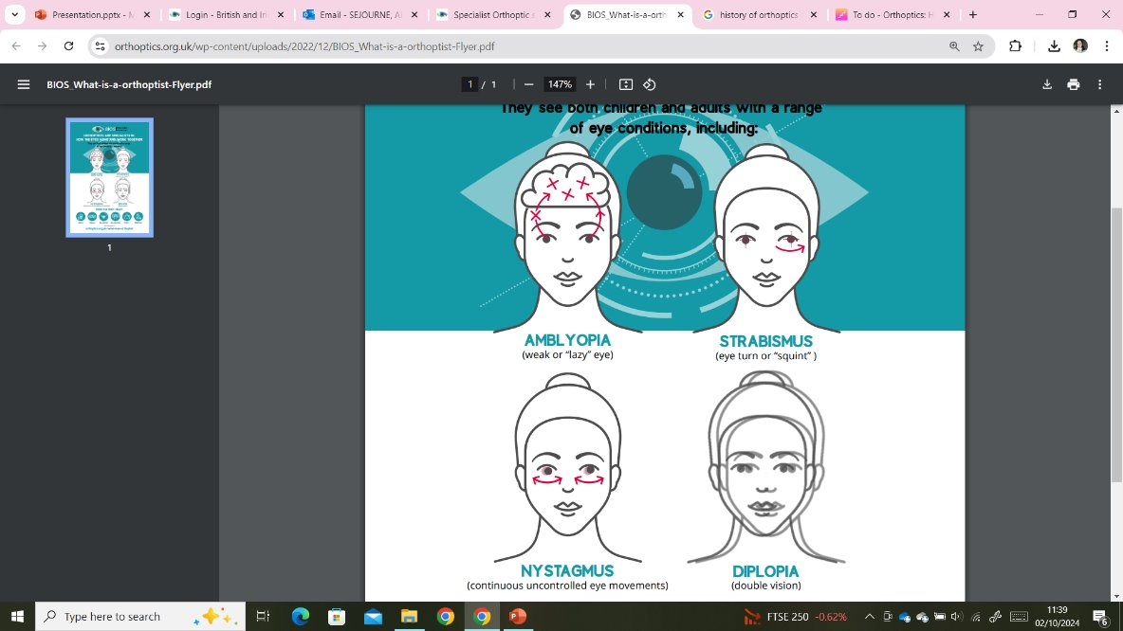
Which one are we?
Reduced vision ​
(refractive error, amblyopia)​
Nystagmus ​
(congenital, neurological)​
Strabismus​
(childhood, nerve palsies, trauma,
Grave's Orbitopathy, MG)​
Field defects ​
(stroke, brain tumours, IIH)
Notes:
As mentioned in the video Orthoptists have an extremely varied caseload. Typically, their work with babies and children involves the management and treatment of reduced vision development and misaligned eyes or a squint. With adults, they will manage and treat a range of conditions leading to double vision or visual field defects. In the UK the majority of orthoptists work in eye clinics in NHS hospitals. Some orthoptists also work in community clinics, specialist centres for children with disabilities or carry out vision screening in schools.

Slide 8

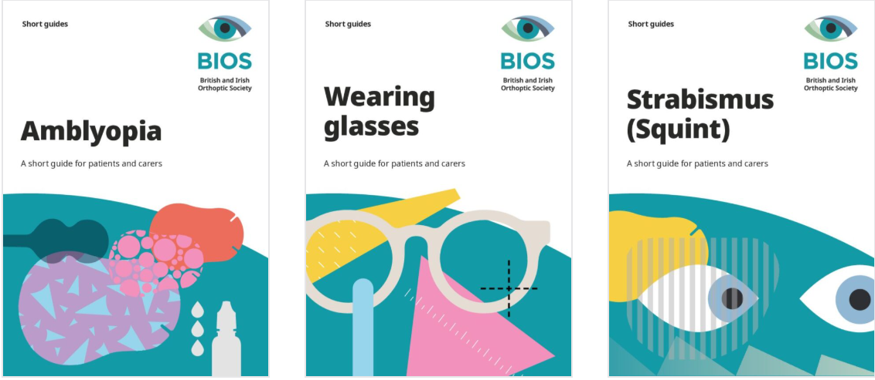

What do you think?
What do you think happens when a young child develops strabismus (a turn in the eye)?
Notes:
Imagine a child has strabismus (where one of their eyes turns). What do you think they might experience?
Would they see double?
Would their vision be different from someone with straight eyes?
How would we help them?
If they have strabismus, they don’t see double because the brain ignores the turned eye. This can lead to weak vision in that eye. Orthoptists might treat this with patching (covering one eye) or special eye drops. This forces the weak eye to be used and get stronger, and magically grow vision! If this happened to an adult, they would get double vision and their vision would be the same as before as their vision has already developed.
For more information about wearing glasses, strabismus and amblyopia, follow BIOS #WePatch campaign.

Slide 9
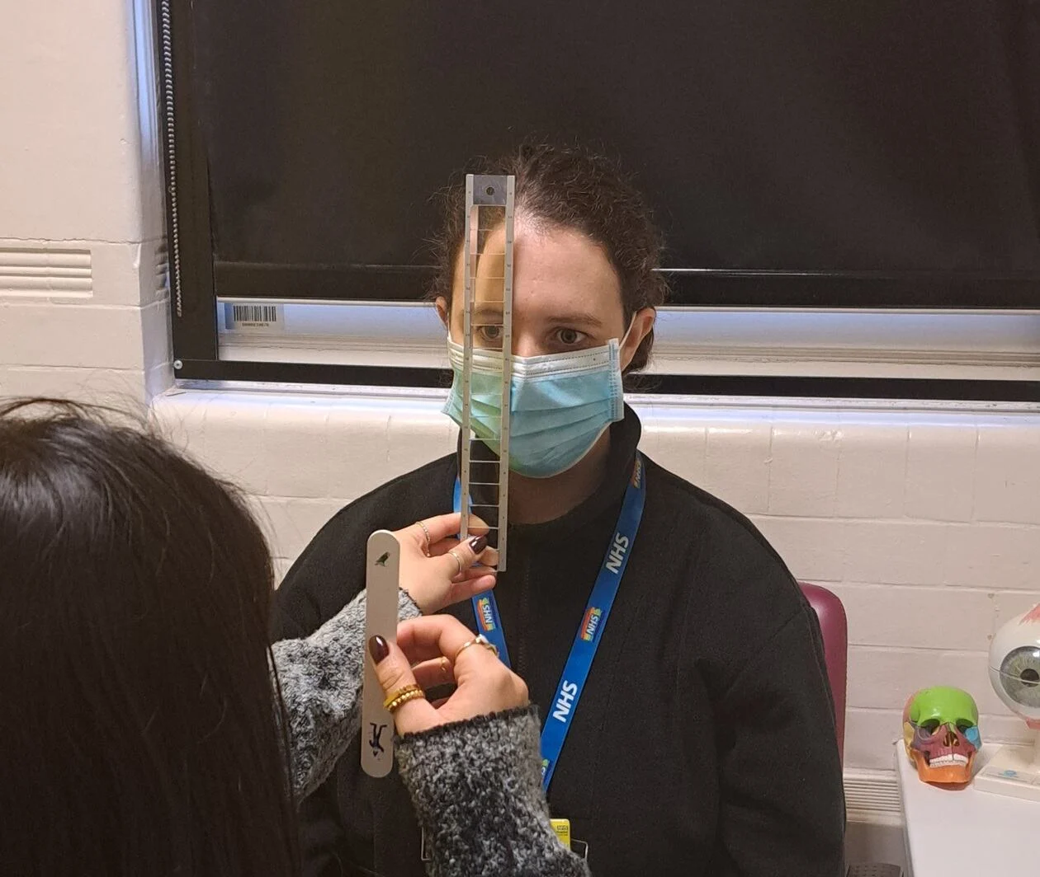
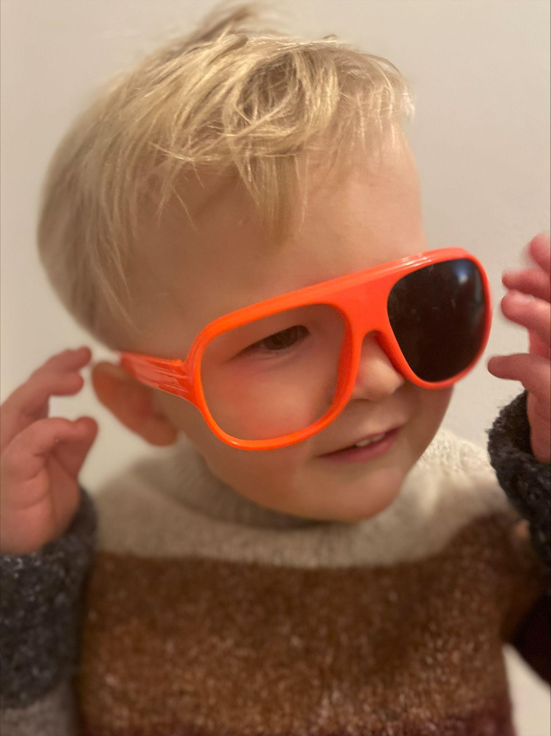
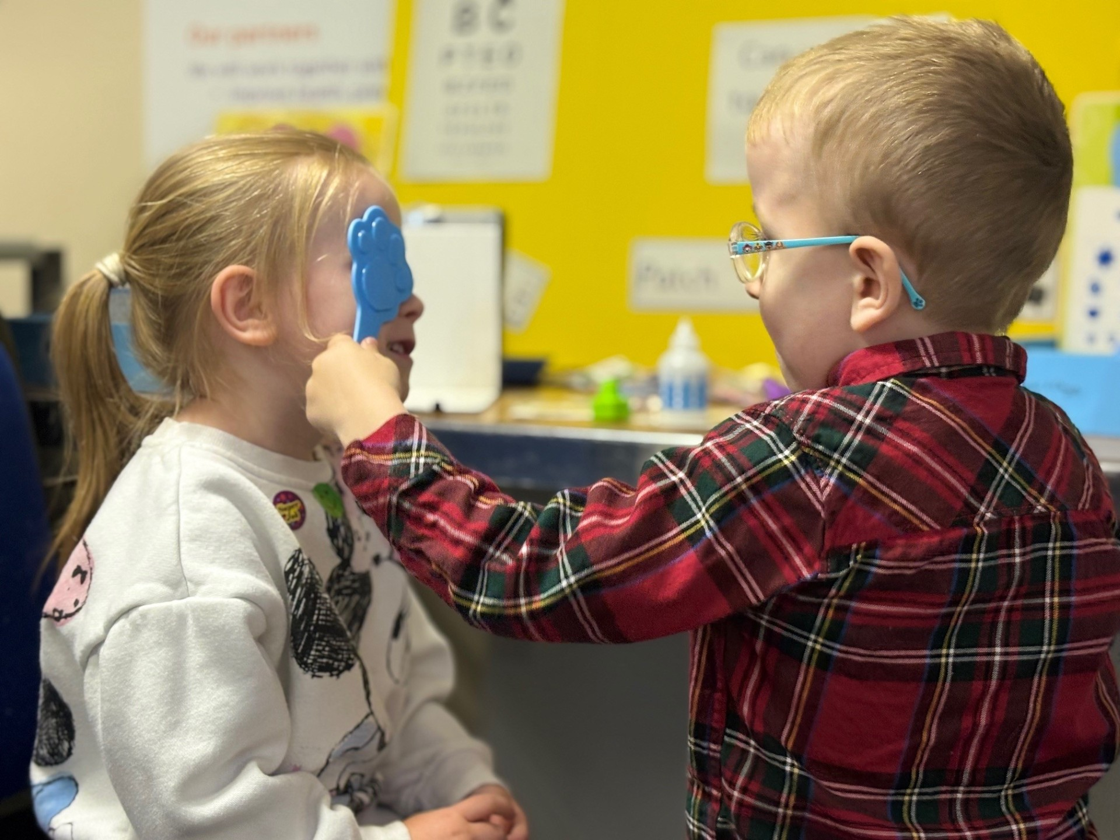
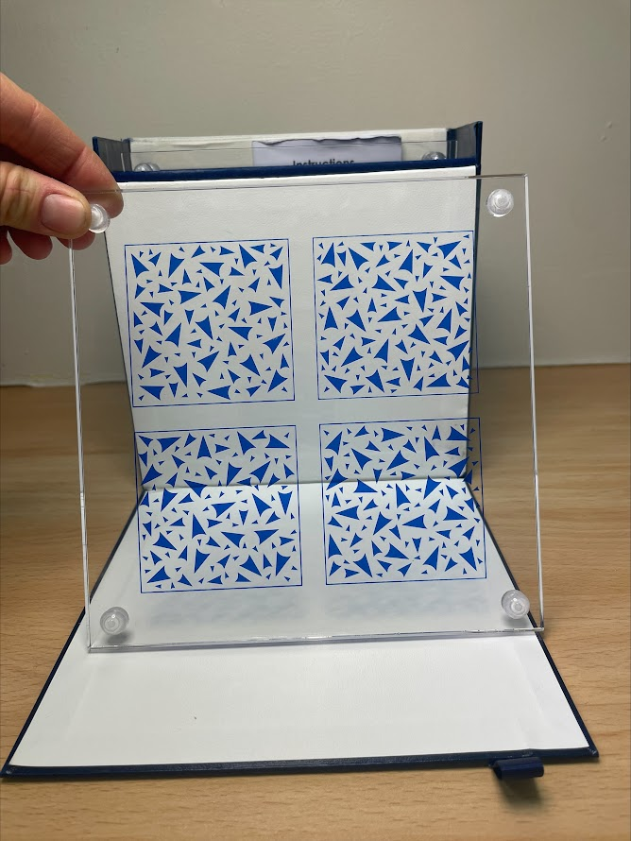
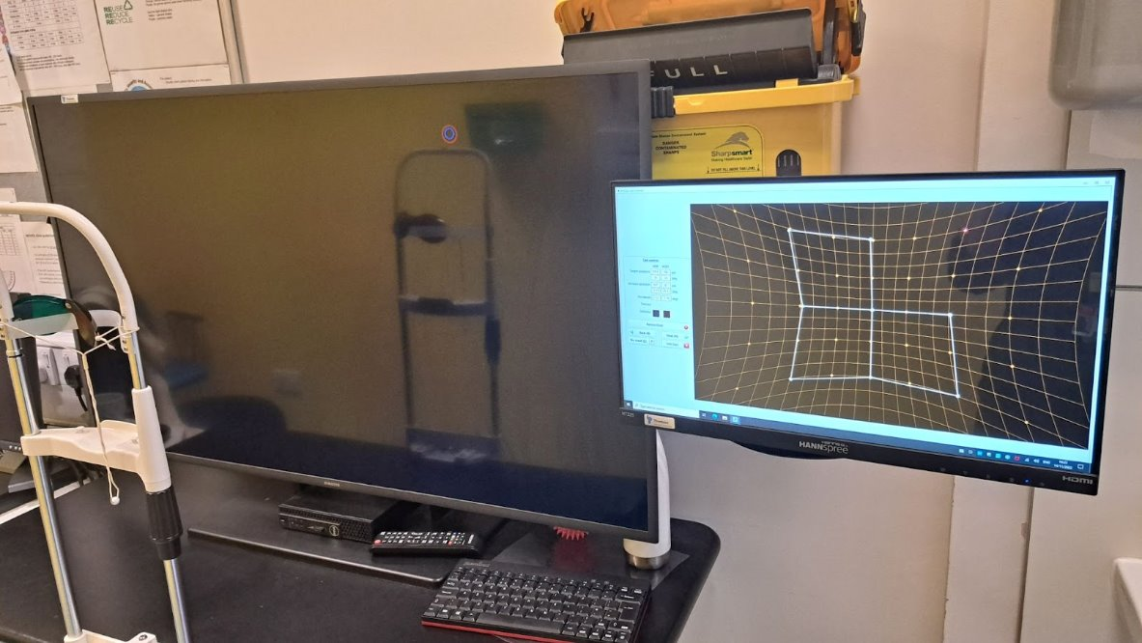
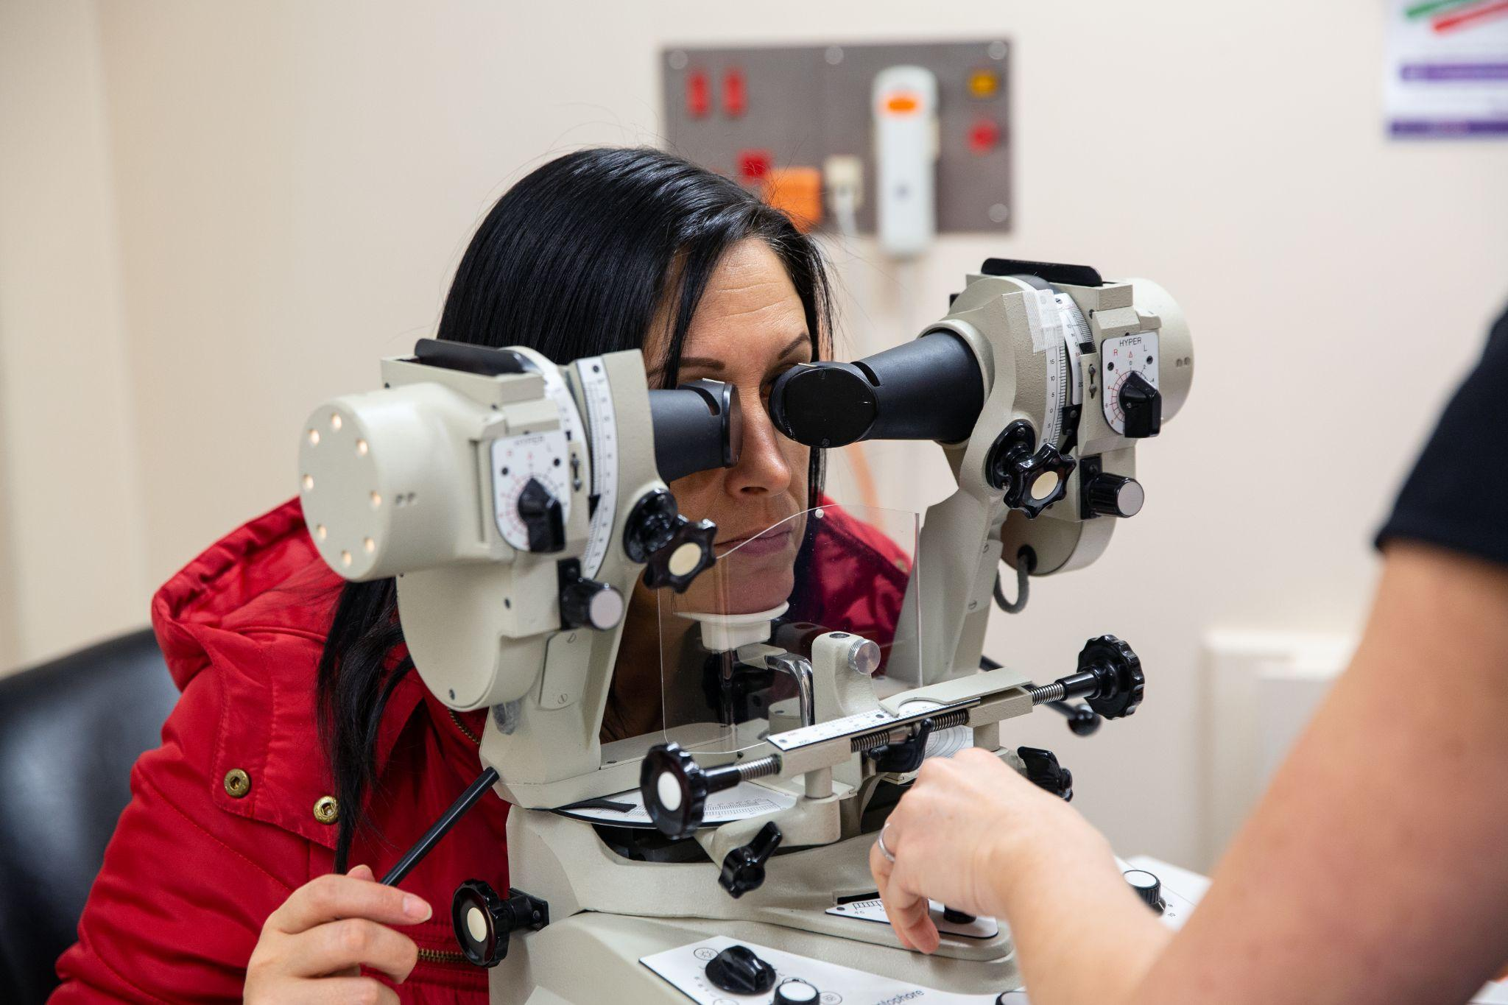
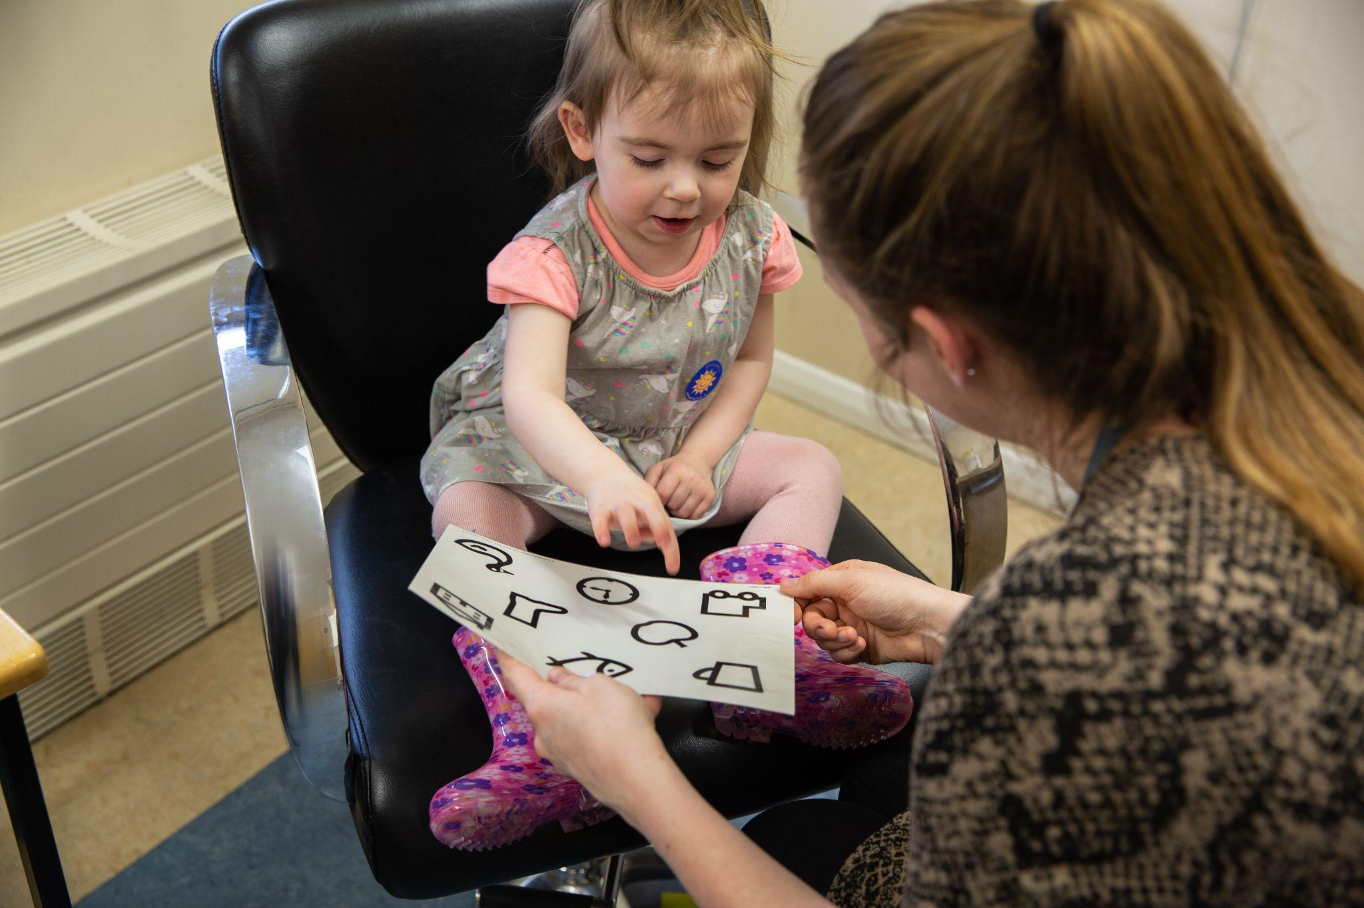
Orthoptic Testing
Notes:
This is a small example of some of the tests an orthoptist might use in clinic to assess eye movements and 3D vision, as well as vision testing in some of our younger patients.
One aspect of orthoptics which is exciting is adapting these tests for each patient’s abilities to understand how they see the world, which helps form an accurate diagnosis and treatment plan.

Slide 10
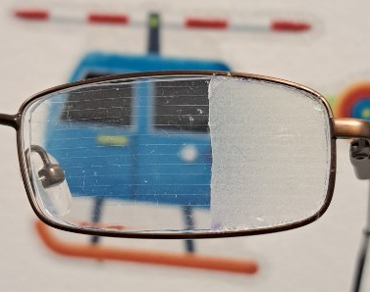
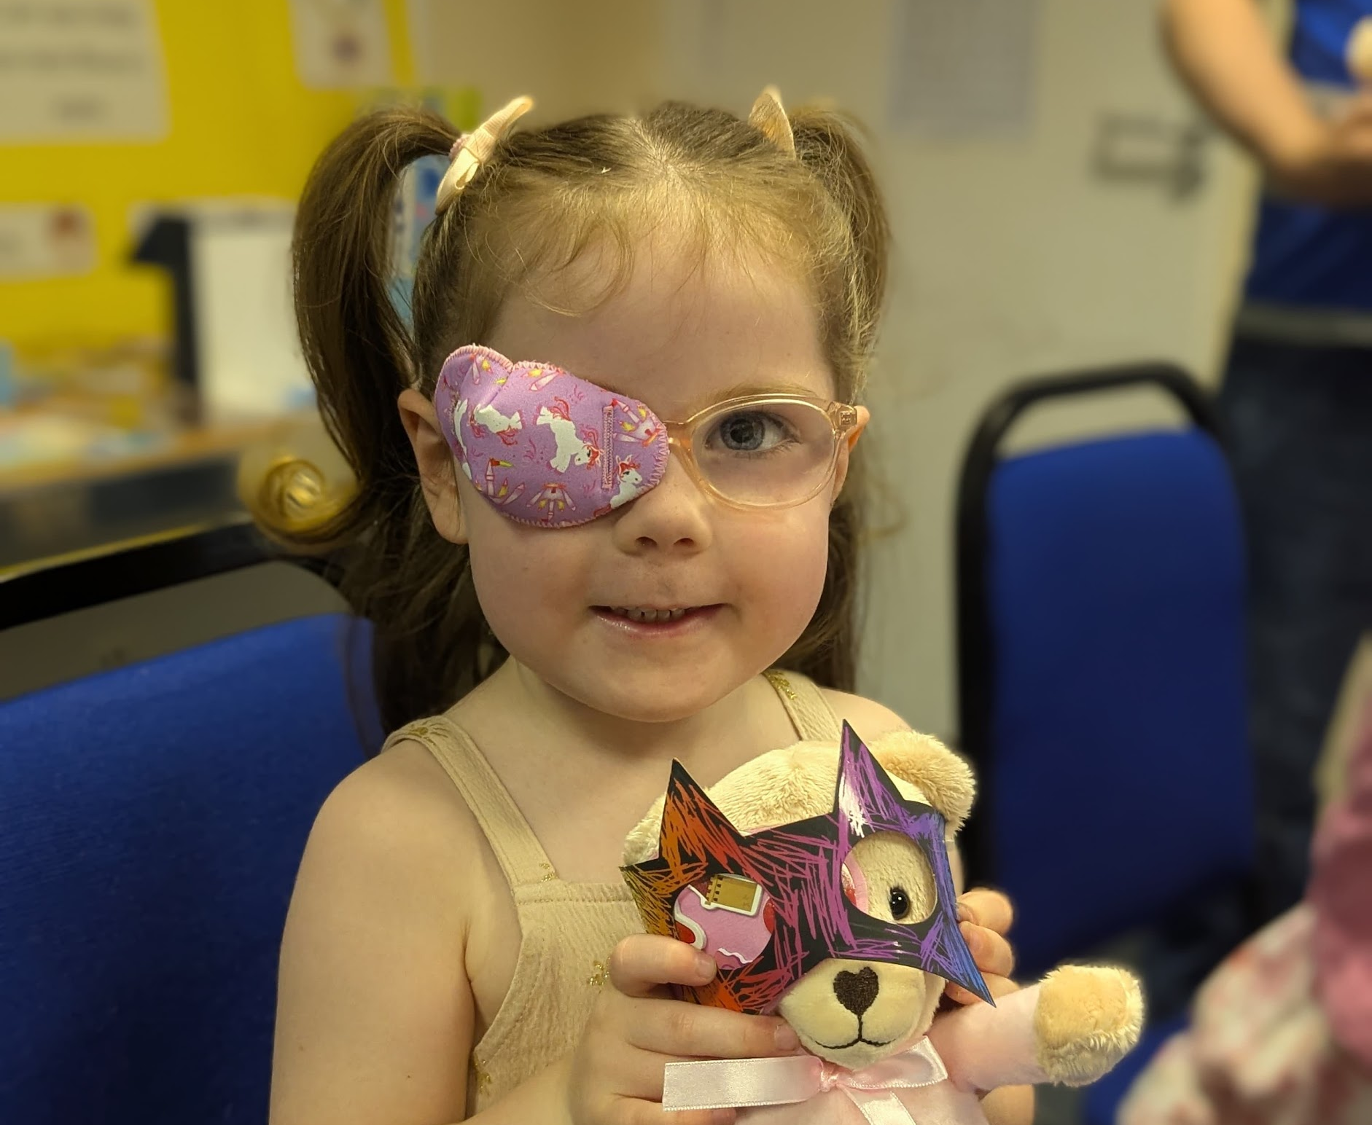
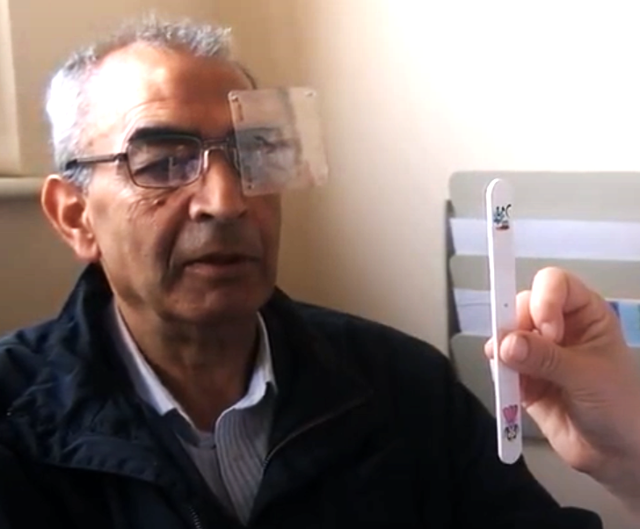


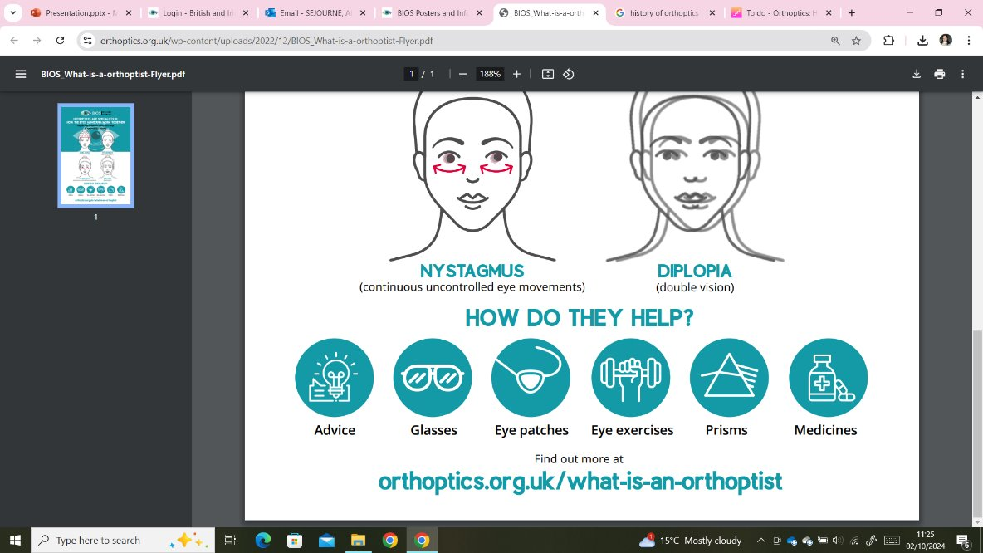
Orthoptic Treatment
Notes:
Here are a few examples of management plans Orthoptists use. For instance, a child may undergo patching treatment to improve vision in their weaker eye, or an adult with double vision may benefit from prism lenses or occlusion to manage the condition. We might also recommend eye exercises to alleviate symptoms.

Slide 11
What is Orthoptics?
Summary
An Orthoptist is the expert in diagnosis and management of eye movement systems and sensory adaptations of the brain to visual experience. They might treat a child’s vision by giving eye patching or eye drops, and might manage symptoms of double vision in an adult with exercises or prisms. An Orthoptist is able to identify a complex neurological problem just by testing eye movements!
No two days are the same and they work closely with other eye care professionals as part of a multidisciplinary team.
Notes:
I hope that’s given you a good introduction to Orthoptics. Take a moment to read through this summary.
Does anyone have any questions so far?

Slide 12
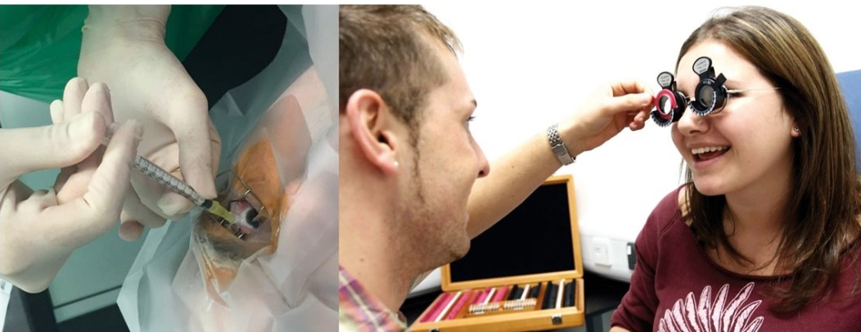
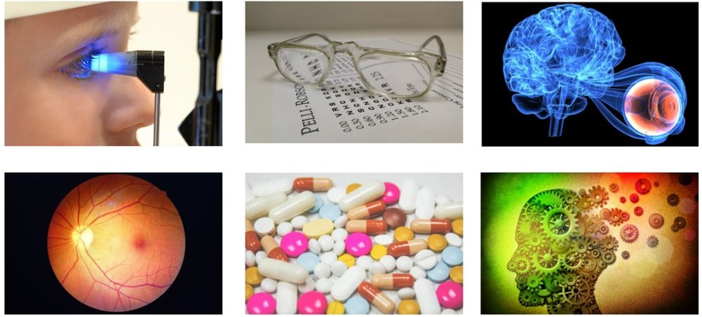
Orthoptic Careers
Core Orthoptics
Medical Exemptions​
Advanced Clinical Practice ​
Healthcare Management and Leadership​
Secondments and Fellowships​
Teaching and Research​
Extended Roles:
Neuro-ophthalmology, Medical Retina, Glaucoma, Low Vision, Special Educational Needs, School Screening etc.
Notes:
What we’ve discussed so far is considered core Orthoptics, but there are also many opportunities to specialise and grow your career. With increasing demand in ophthalmology, you can specialise in areas like neuro-ophthalmology, medical retina, glaucoma, low vision, and special educational needs. You can even reach advanced clinical practice, where you work at the same level as specialised doctors in clinics. There are also roles in healthcare management, leadership, research, teaching, and even international work. The variety of options means there’s always room to grow and develop within Orthoptics.

Slide 13
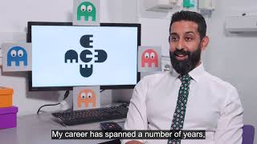
Notes:
See this video on Orthoptic Careers

Slide 14
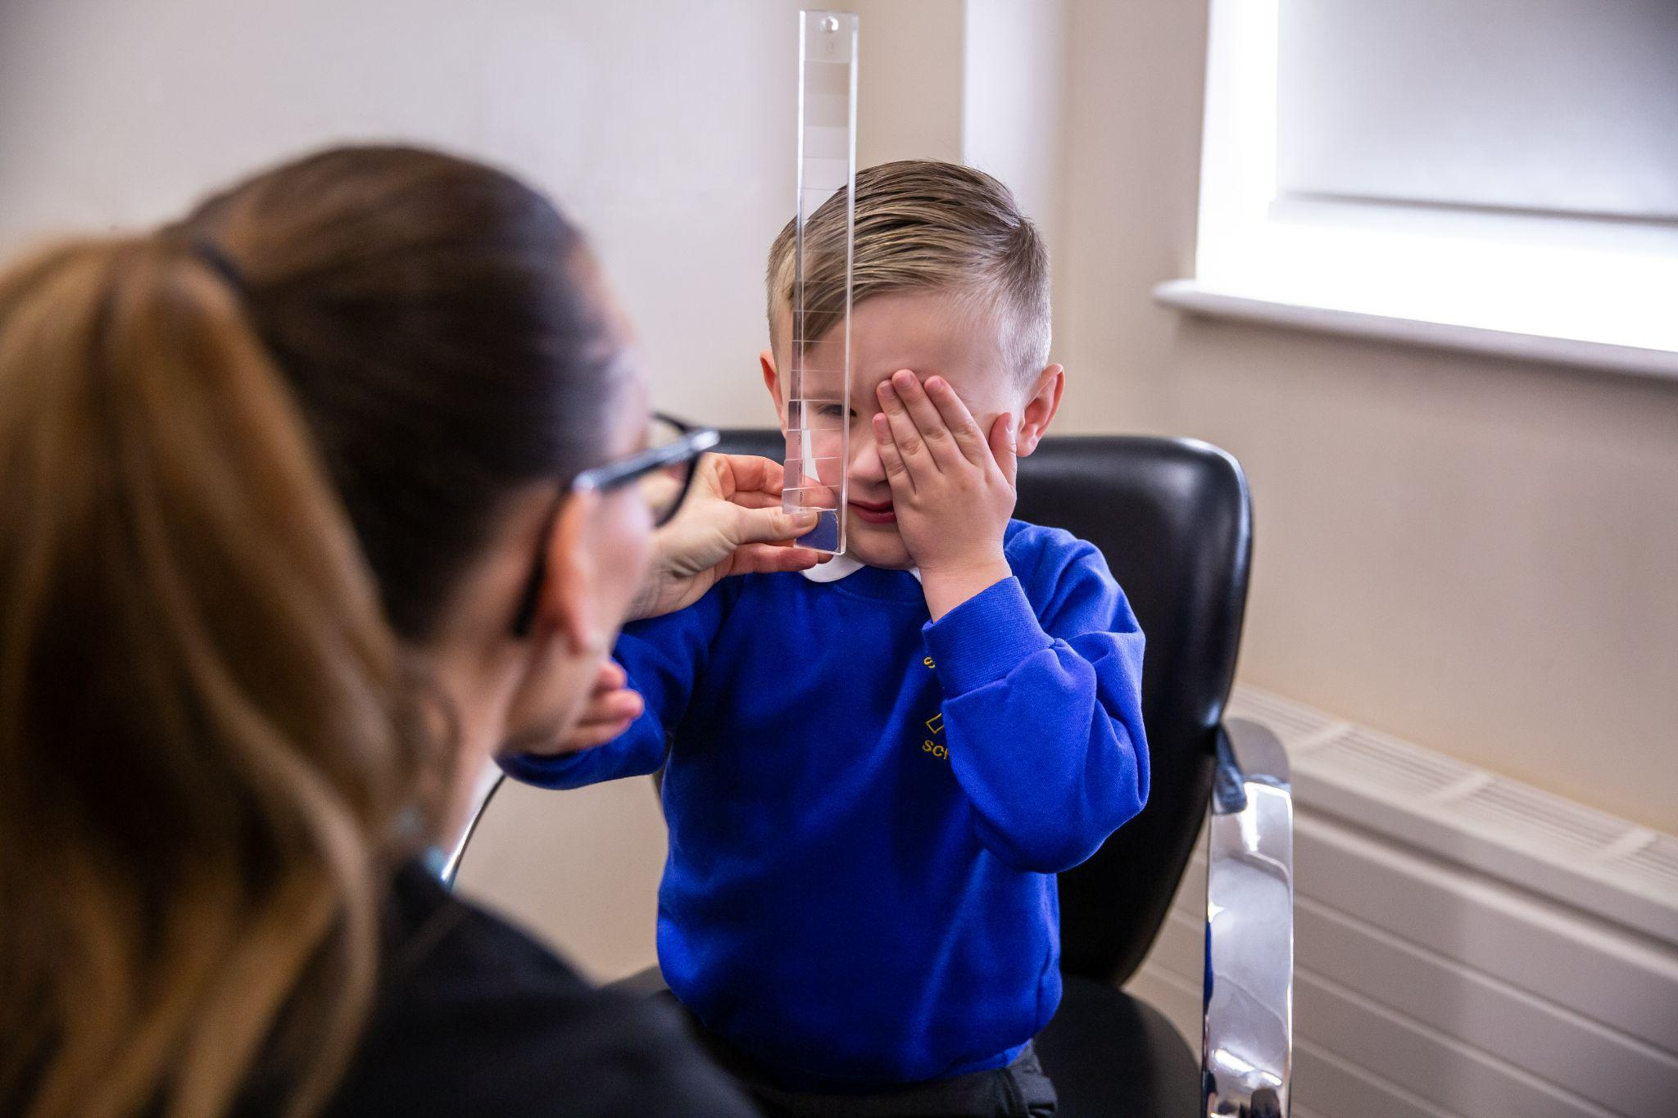
Transferable skills
Good communicator and enjoy helping people
Problem solving and decision making
Works well under time pressure
Able to think outside the box and adaptable
Organised and patient
Able to work well as part of a team
Teaching and learning
Notes:
The skills you bring to Orthoptics will shape your career. Whether you’re a detail-oriented person or have excellent communication skills, these attributes will guide where you excel in Orthoptics. If you think this sounds like a career for you, it could be the perfect fit!

Slide 15




Routes into Orthoptics
Undergraduate or postgraduate degrees
Option of foundation year prior to undergraduate degree
at Liverpool and Sheffield University for mature students
Apprenticeship route is due to become available next year
You could be eligible for a training grant of £5,000 each year of study from the government Learning Support Fund
Notes:
Here are some of the institutions offering undergraduate and postgraduate courses in Orthoptics.
University of Liverpool and Sheffield offer 3-year undergraduate courses.
GCU offers a 4-year undergraduate course.
UCL and Liverpool offer 2-year pre-registration postgraduate courses for those who have already completed a degree.
Some universities, like Sheffield and Liverpool, offer foundation years to help mature students transition into the course.
There is also an Orthoptic apprenticeship route in the pipeline.
Given the high demand for Orthoptists in the NHS, there’s a learning support fund available to eligible students each year.

Slide 16

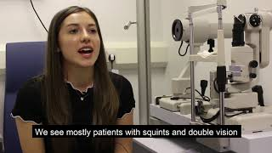
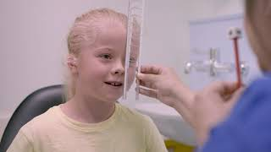
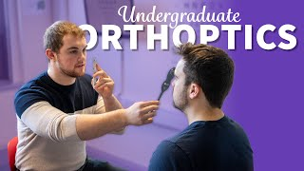
University of Liverpool
Glasgow Caledonian University
University College London
University of Sheffield
Notes:
Here are some videos from the universities that offer Orthoptics courses.

Slide 17
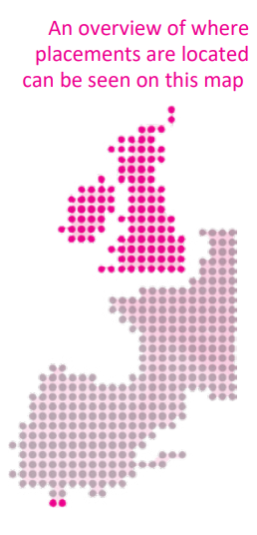
Placements
The course includes three placements per year across UK, Ireland and Gibraltar, each lasting approximately four weeks.
Travel and accommodation costs are covered.
Additionally, you'll participate in clinical sessions at the university, guided by tutors throughout your studies.
This hands-on approach ensures you graduate with practical experience, fully prepared to start your career immediately.
Notes:
Placements and clinical teaching are key to your training. You’ll visit three departments across the UK each year, gaining hands-on experience with real clinicians and patients. The placements are aligned with your modules to ensure practical, clinical learning.

Slide 18
Entry Requirements
A-Level ABB to BBC
BTEC Level 3 Extended Diploma: DDD to DDM
Access to HE Diploma: 60 credits overall in a relevant subjects
Scottish Highers: BBBC
GCSE Requirements: minimum of 5 GCSEs at grade 4 (C) or above
Postgraduate courses require 2:2 Bachelor’s degree in a relevant discipline, or overseas equivalent
Notes:
If you're considering a career change or looking to study Orthoptics at the postgraduate level, universities understand that you may come from diverse professional backgrounds. Each university has its specific entry criteria, but they often take into account relevant work experience, transferable skills, and academic qualifications.
There is flexibility for those with relevant clinical or healthcare experience. Even if your previous career wasn’t in healthcare, your skills may still be applicable.
Don't hesitate to contact universities directly for more information or to discuss how your background might fit into the programme.

Slide 19
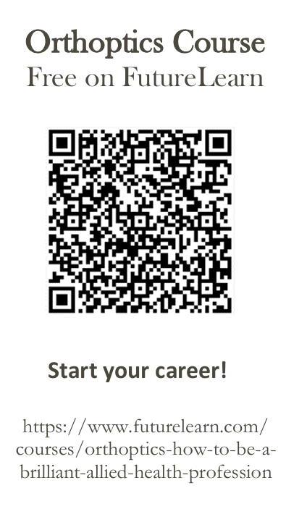
Want to find out more?
Visit our website: https://www.orthoptics.org.uk/
Contact us: Visibilityleads@orthoptics.org.uk
Contact your local orthoptic department for discussion or shadowing opportunities
Complete our free online FutureLearn course
Attend University open days
https://www.orthoptics.org.uk/become-an-orthoptist/study-orthoptics/
Notes:
If you’re keen to learn more, we offer a free 3-week Orthoptics course on FutureLearn, which will look great on your CV and personal statement. We also encourage you to shadow local Orthoptists and attend open days at universities. Visit the BIOS website or contact us for further details.

Slide 20
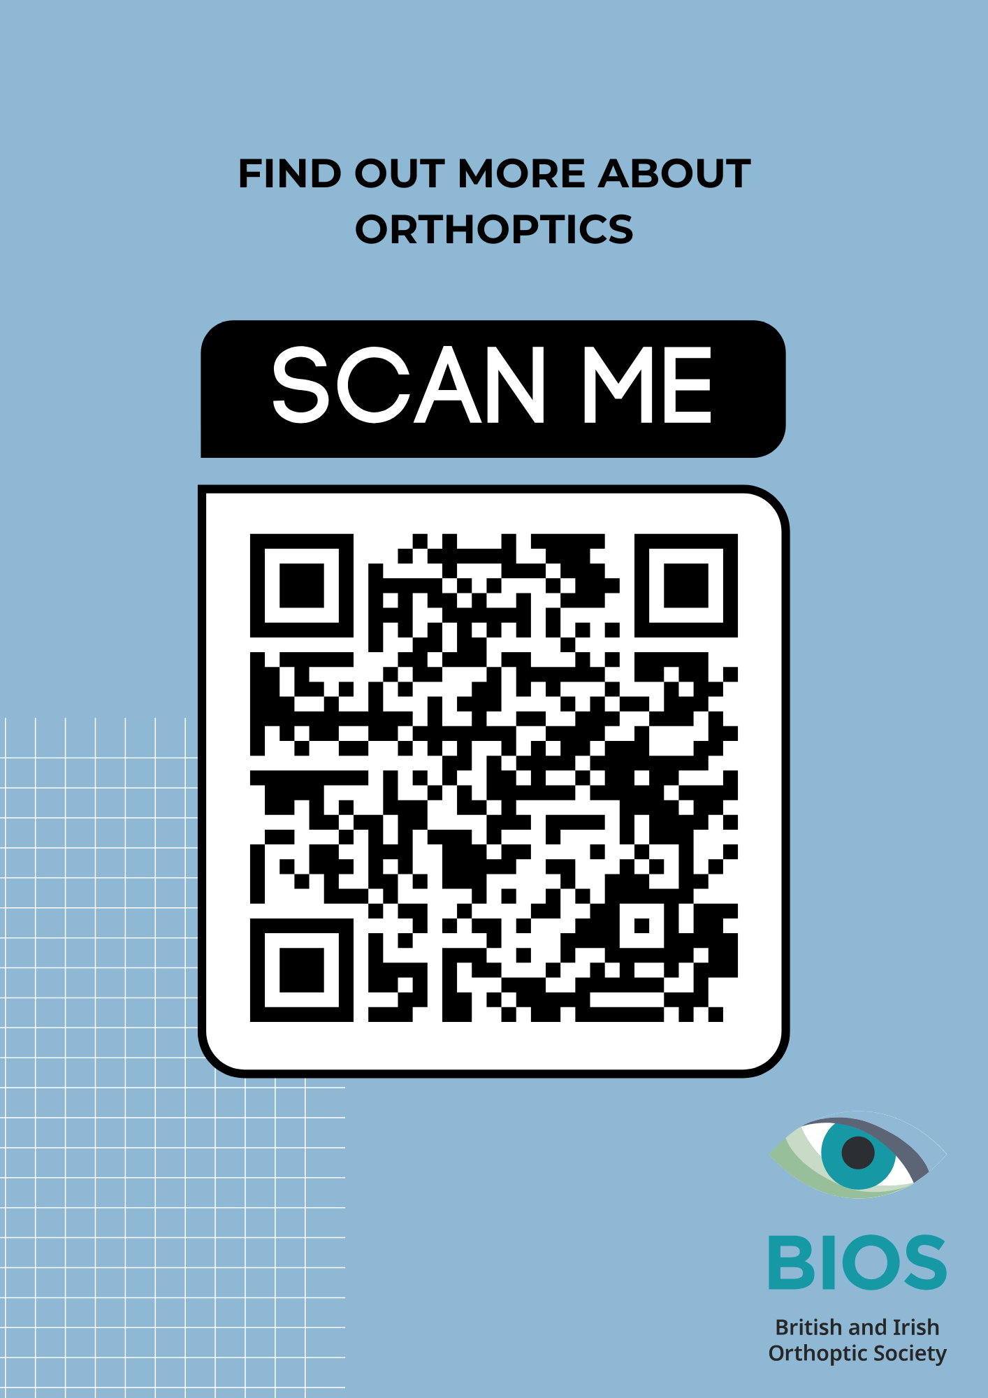
Contact: visibilityleads@orthoptics.org.uk
Thank you.
Notes:
Thank you!
Please scan this QR code to visit the BIOS page for further information.
Any questions?

