Slide 1
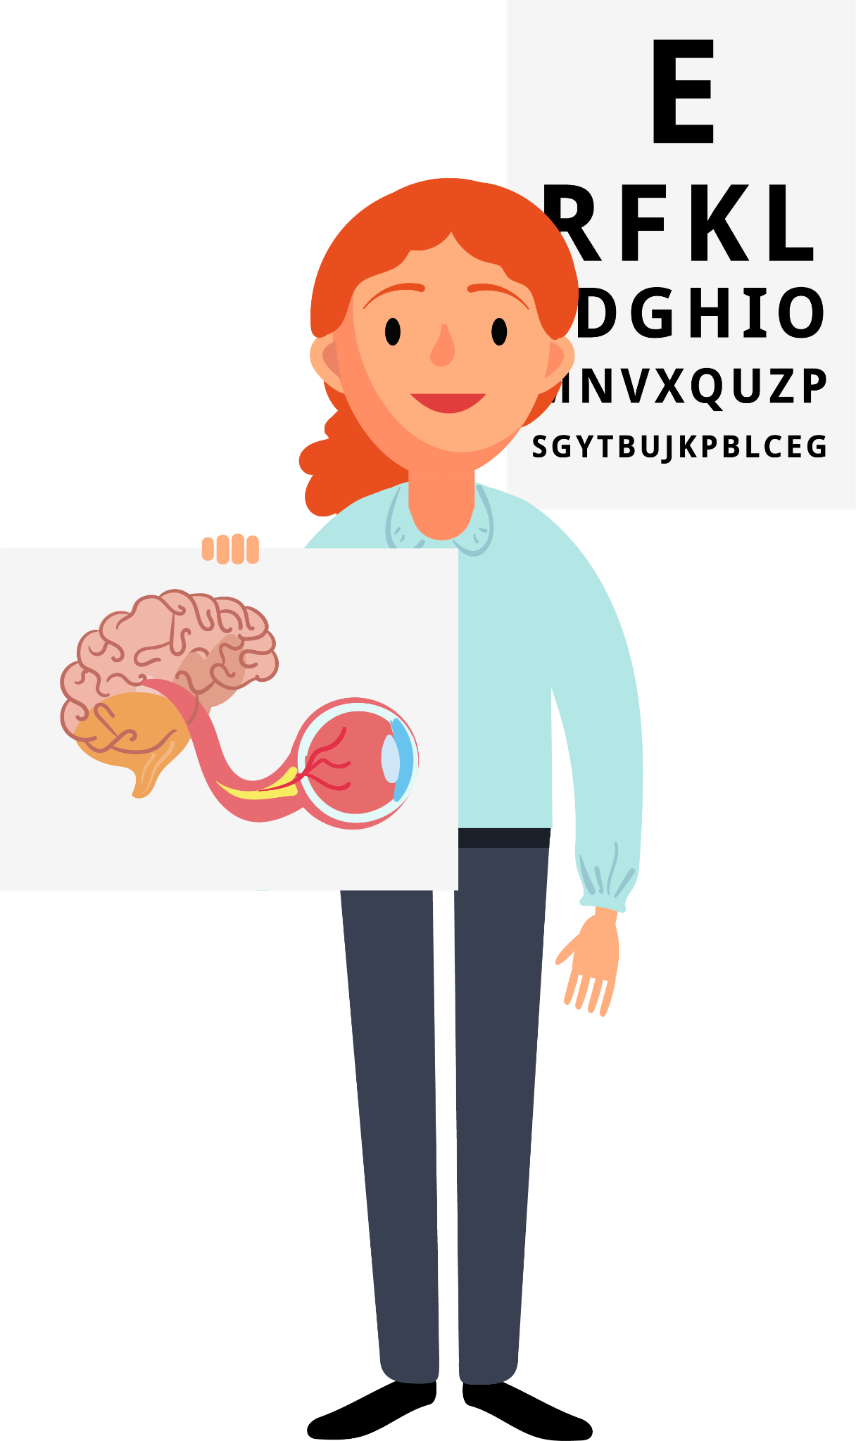
Orthoptics
Key Stage 3
Notes:
Hi! My name is… And this is our mascot Orb (short for Orblith) A glowing, spherical object or entity that projects or absorbs light I’m an Orthoptist at… Today, I’m going to tell you about a super interesting job called Orthoptics!

Slide 2
What is Orthoptics?
Teeth?​
​
Feet?​
​
Bones?​
​
Eyes?
Notes:
Raise your hand… what is Orthoptics? Is it related to teeth, feet, bones, or eyes?

Slide 3
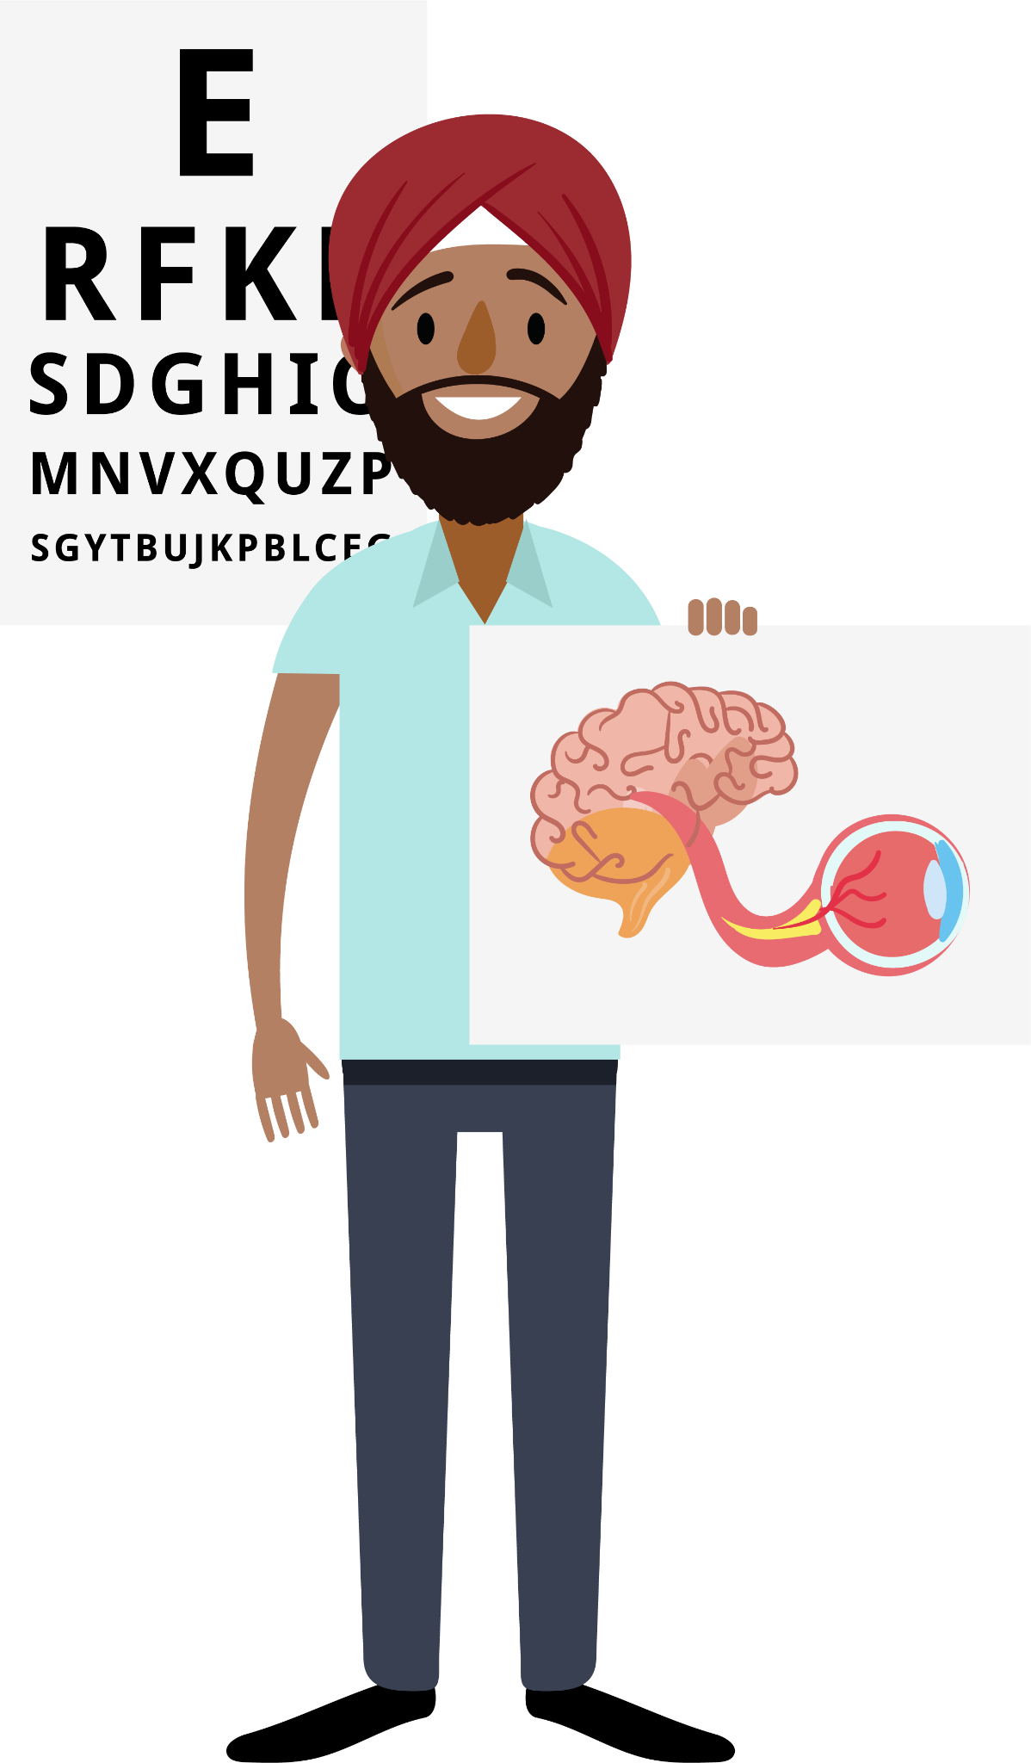
What is Orthoptics?
Teeth?​
​
Feet?​
​
Bones?​
​
Eyes!
Notes:
Orthoptics is a specialised area of Allied Health that focuses on the eyes. The term comes from Greek, meaning “straight eyes” (Orth – straight, Optic – eyes). Orthoptists specialise in how the eyes move and how they work together with the brain.

Slide 4
Allied Health Professions
Notes:
There are lots of health jobs, and Orthoptics is one of them. Working as an Orthoptist is really cool because you get to help people see better, which makes a big difference in their lives. It's a job that lets you meet lots of different people and helps them every day!

Slide 5
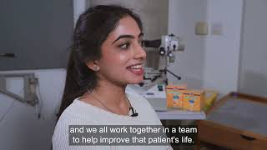
Notes:
I’m just going to show you a video here about orthoptics

Slide 6
Which one are we?
There are many eye professions!
Notes:
You heard the Orthoptist mention Optometrists and Ophthalmologists. It’s easy to confuse them since all these professions start with an “O”!
High street opticians are familiar to most people, and hospital optometrists also prescribe glasses and diagnose eye diseases.
Ophthalmologists are medical doctors who specialise in treating eye conditions.
Orthoptists, however, focus on diagnosing and treating eye movement disorders and conditions like strabismus (squints) and double vision..

Slide 7
Which one are we?
Reduced vision ​ (refractive error, amblyopia)​
Nystagmus ​ (congenital, neurological)​
Strabismus​ (childhood, nerve palsies, trauma, Grave's Orbitopathy, MG)​
Field defects ​ (stroke, brain tumours, IIH)
Notes:
Orthoptists help babies, children, and adults. For babies and children, they help with problems like strabismus (eye misalignment) or if their vision is not developing properly. For adults, they treat double vision, visual field problems or eye movement problems. These can all have lots of causes and it is the orthoptist job to find out why and help fix it!
Orthoptists mostly work in hospitals but sometimes work in schools or special clinics too!

Slide 8
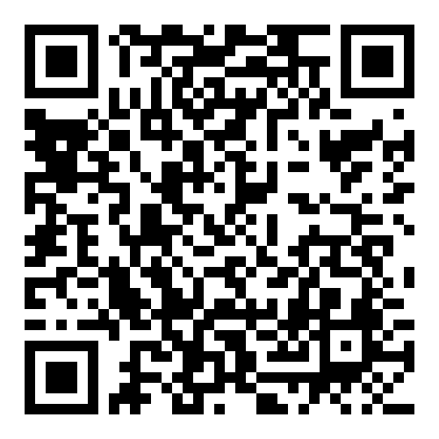
What do you think?
What do you think happens when a young child develops strabismus (a turn in the eye)?
Notes:
Imagine a child has strabismus (where one of their eyes turns). What do you think they might experience?
Would they see double?
Would their vision be different from someone with straight eyes?
How would we help them?
If they have strabismus, they don’t see double because the brain ignores the turned eye. This can lead to weak vision in that eye. Orthoptists might treat this with patching (covering one eye) or special eye drops. This forces the weak eye to be used and get stronger, and magically grow vision! If this happened to an adult, they would get double vision and their vision would be the same as before as their vision has already developed.
For more information about wearing glasses, strabismus and amblyopia, follow BIOS #WePatch campaign.

Slide 9
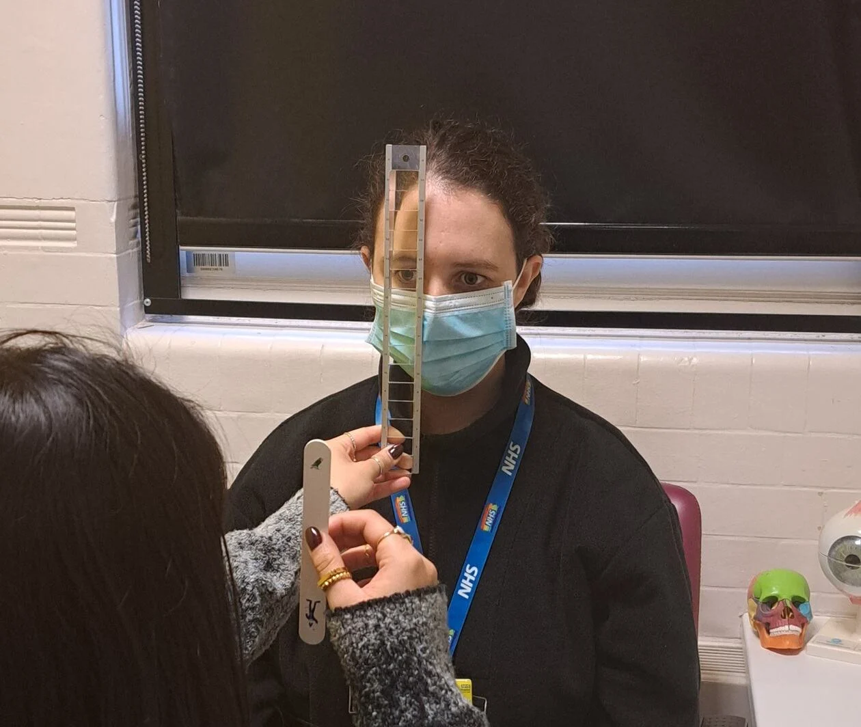
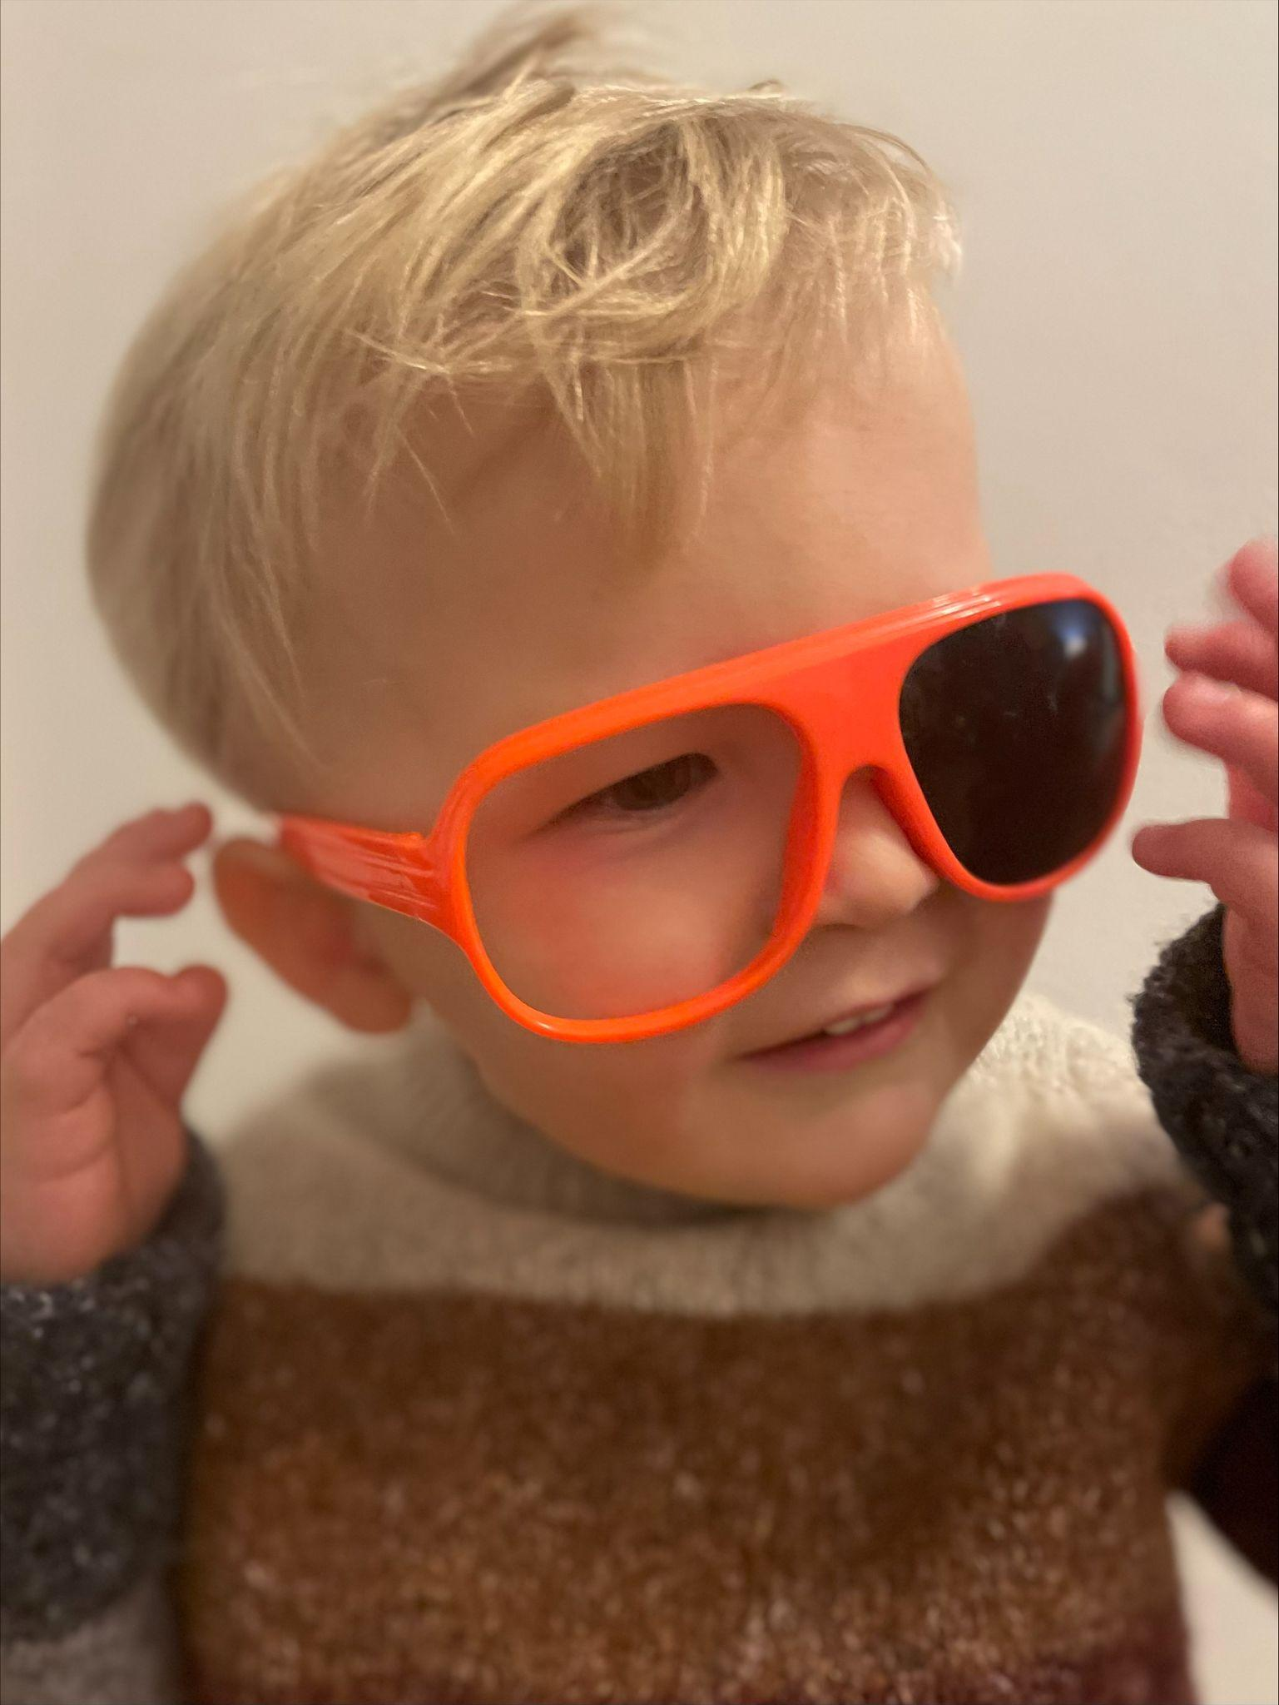
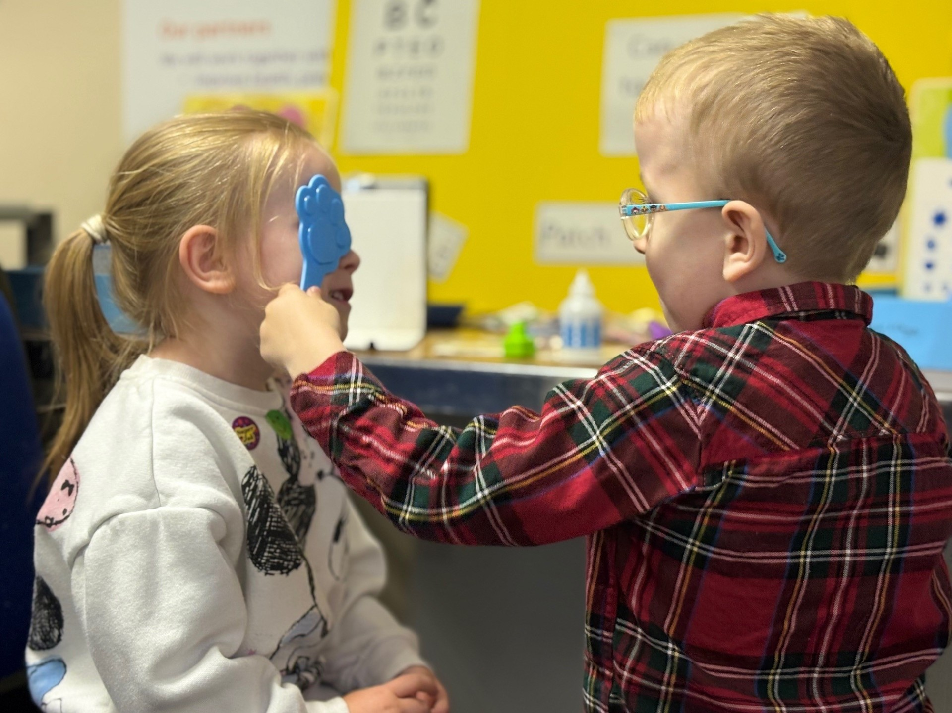
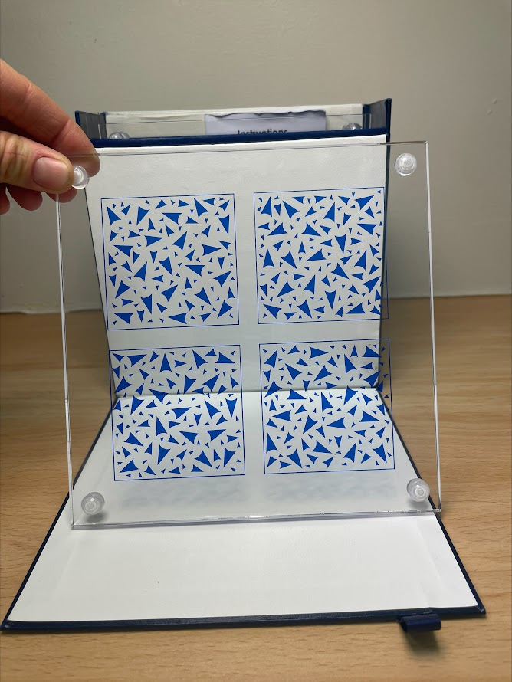
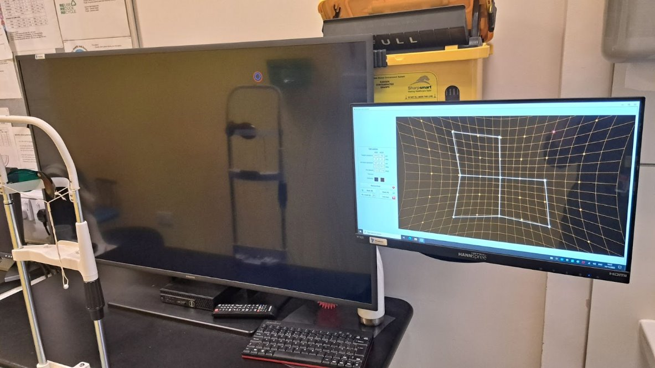
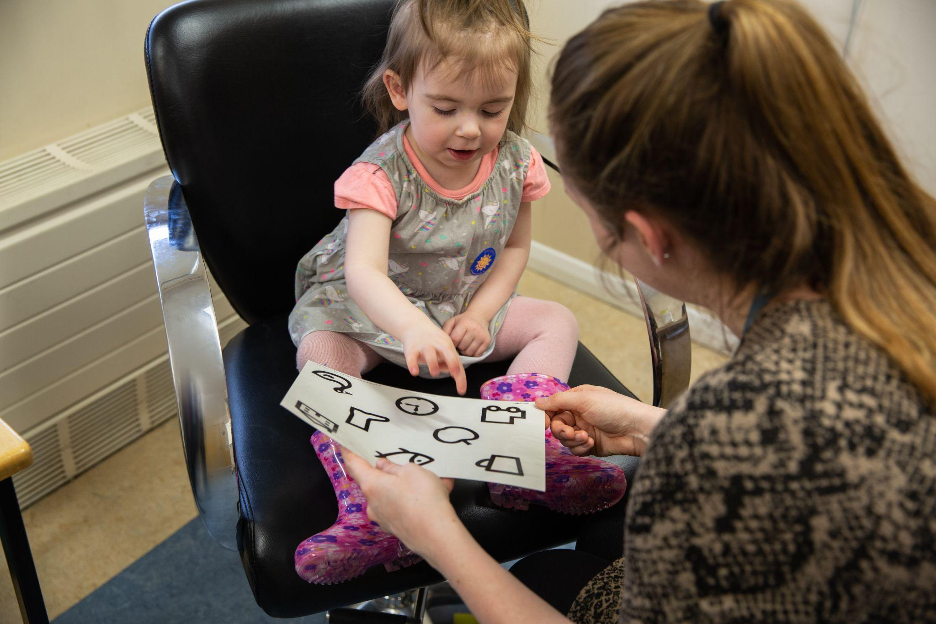
Orthoptic Testing
Notes:
Orthoptists use special tests to check how well someone’s eyes are working together. These tests help them understand how to treat problems and help people see better. Some of these include 3D vision games!

Slide 10
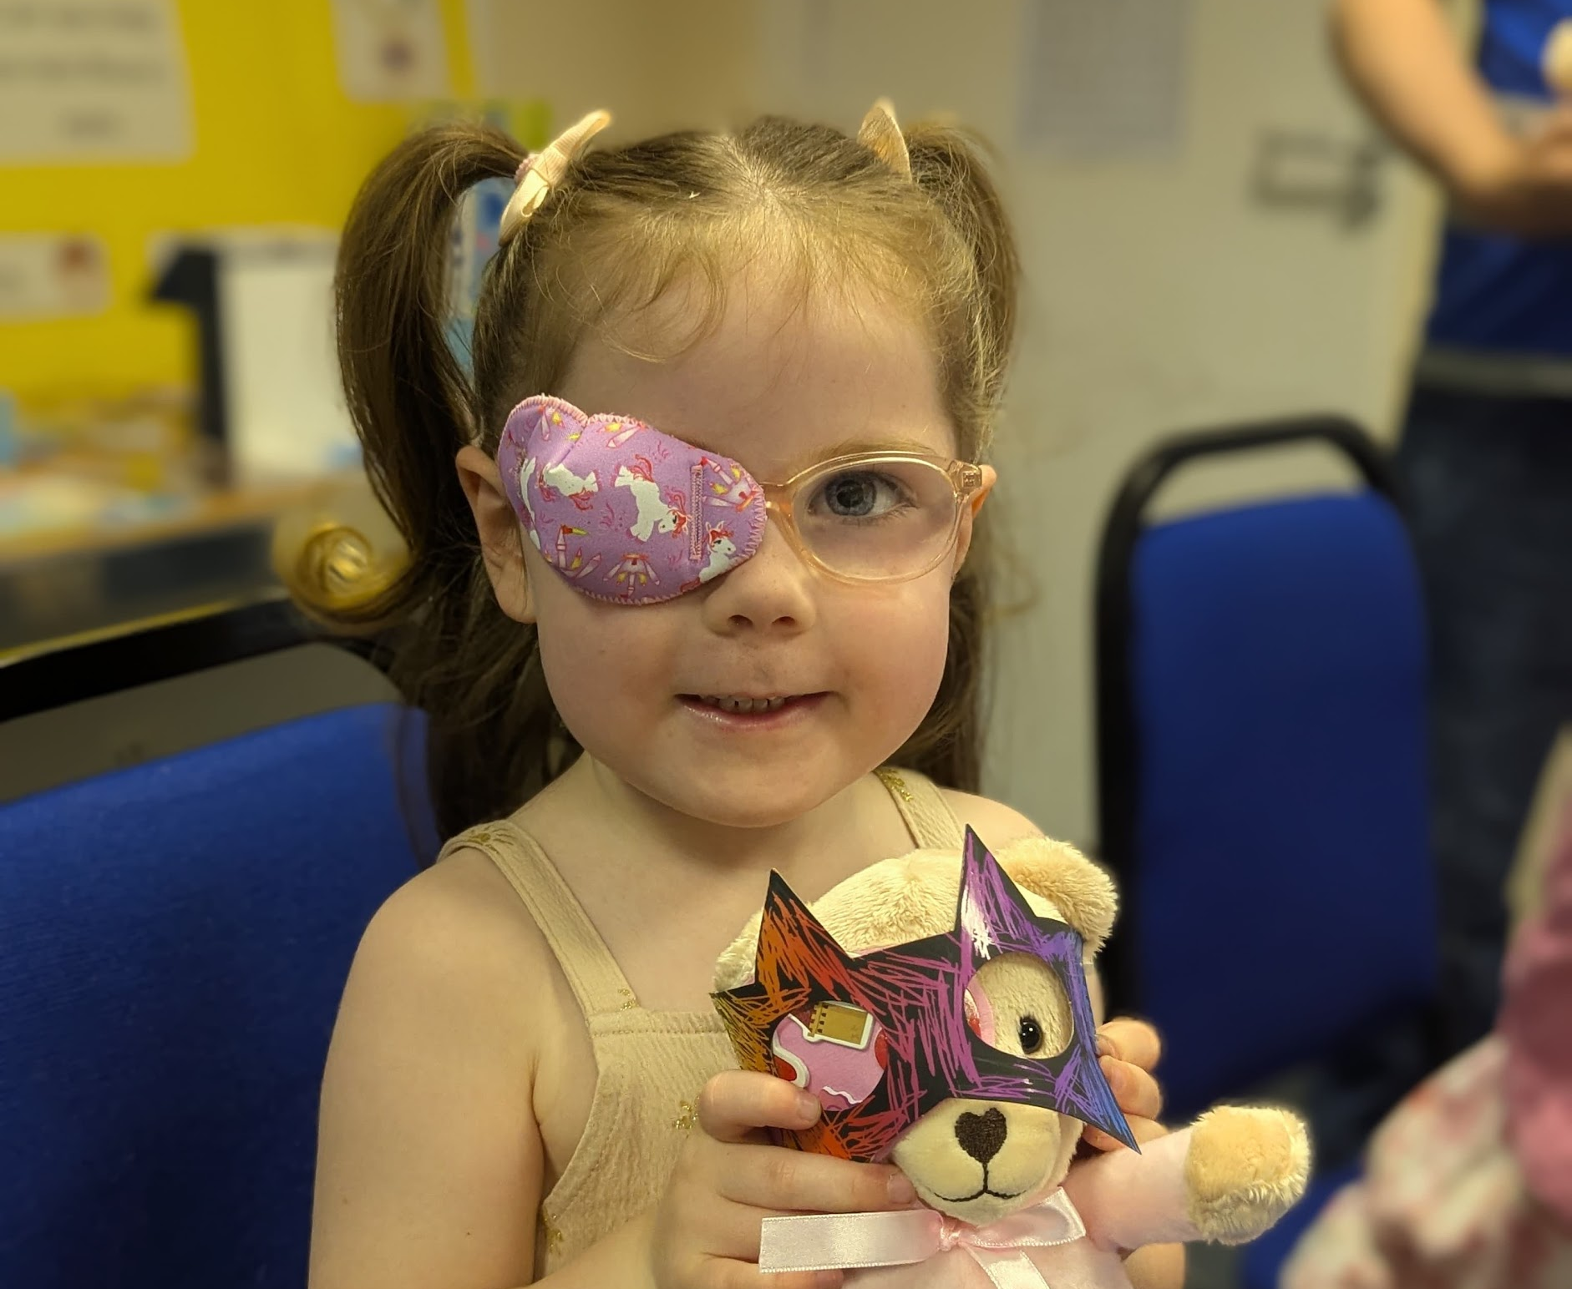
Orthoptic Treatment
Notes:
Here are some ways Orthoptists help people:
Patching a child’s eye to make it stronger.
Prisms (which bend light) can be stuck onto glasses to fix double vision.
Eye exercises to make your eye muscles stronger.

Slide 11
What is Orthoptics?
Summary
An Orthoptist is the expert in diagnosis and management of eye movement systems and sensory adaptations of the brain to visual experience. They might treat a child’s vision by giving eye patching or eye drops, and might manage symptoms of double vision in an adult with exercises or prisms. An Orthoptist is able to identify a complex neurological problem just by testing eye movements!
No two days are the same and they work closely with other eye care professionals as part of a multidisciplinary team.
Notes:
That’s a quick look at what Orthoptics is all about! Does anyone have any questions so far?

Slide 12
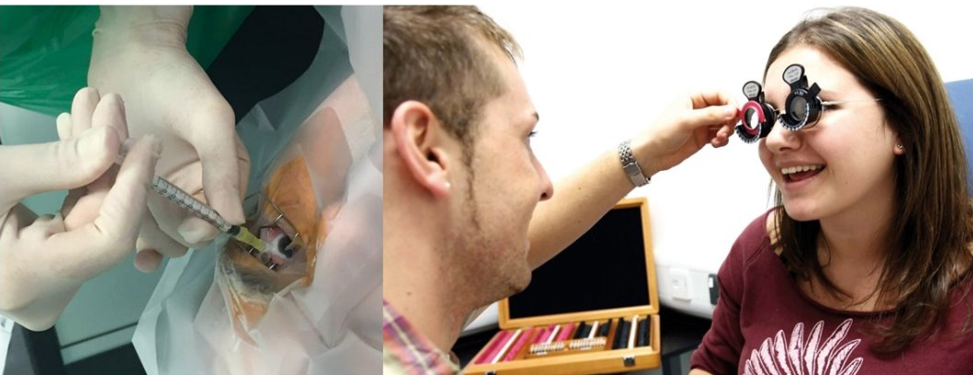
Orthoptic Careers
Core Orthoptics
Medical Exemptions​
Advanced Clinical Practice ​
Healthcare Management and Leadership​
Secondments and Fellowships​
Teaching and Research​
Extended Roles: Neuro-ophthalmology, Medical Retina, Glaucoma, Low Vision, Special Educational Needs, School Screening etc.
Notes:
What we have discussed so far is usually referred to as core orthoptics, however, Orthoptists are also further specialising and extending their skills within the eye world.
As an Orthoptist, there are lots of exciting paths you can take. You can help people with different eye problems, and even train to do the same work as a specialist doctor and give medicines. You can work in hospitals, schools, or even work in other countries. With orthoptics, you can become a teacher, researcher or lead a team. There are always new things to learn and ways to grow in this job, so it’s never boring!

Slide 13
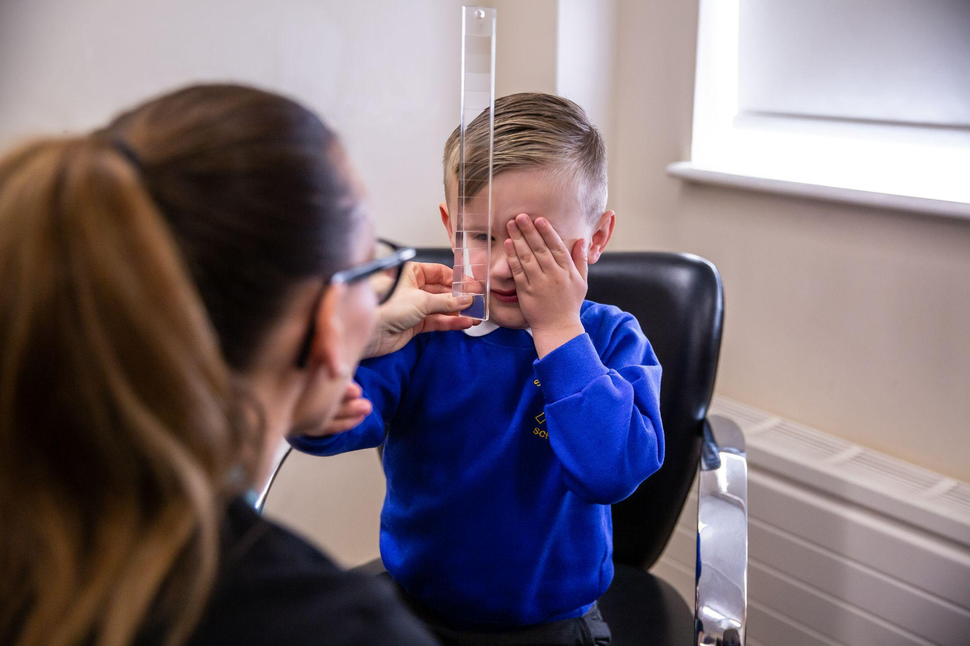
Transferable skills
Problem-solving
Being good with people
Being curious about science
Notes:
If you like helping people, working with science, and solving problems, this could be the perfect job for you!

Slide 14
How do you become an Orthoptist?
Work hard in subjects like science
Have an interest in how the body works
There are different ways to train and start your career in Orthoptics, like going to University, or even learning on the job
Notes:
To become an Orthoptist, you need to finish school and get good grades, especially in subjects like science. Having an interest in how the body works and helping people is really important. Once you’ve done well in school, there are different ways to train and start your career in Orthoptics, like going to University, or even learning on the job.

Slide 15
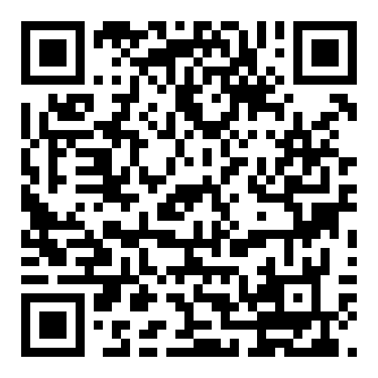
Contact: visibilityleads@orthoptics.org.uk
Thank you.
How do I become an Orthoptist?
Notes:
Thank you! Scan this QR code to find out more about becoming an Orthoptist. Any questions?

