Slide 1
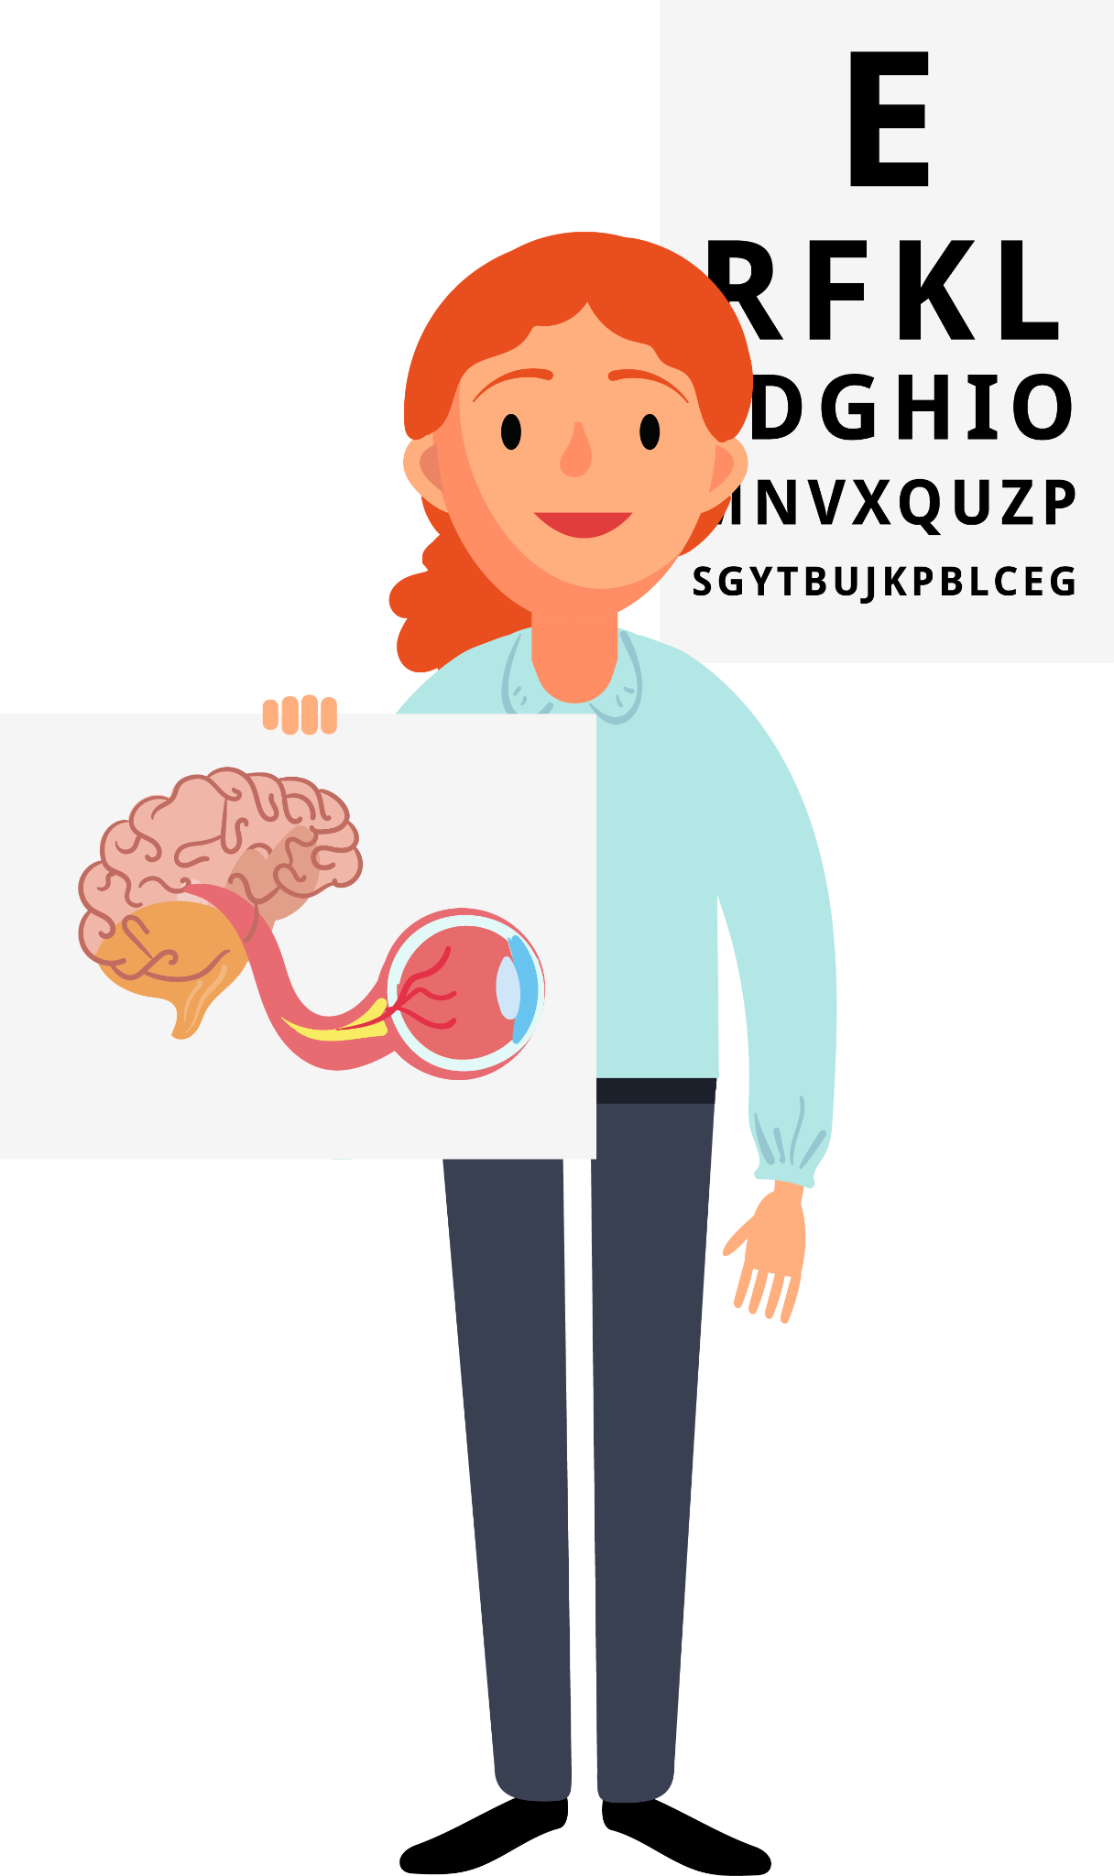
Orthoptics
Colleagues: What is Orthoptics and recruitment challenges
Notes:
Hi my name is…
I am an orthoptist at ….
I’m going to give you a quick introduction to Orthoptics

Slide 2
What is Orthoptics?
Teeth?​
​
Feet?​
​
Bones?​
​
Eyes?
Notes:
Raise your hand… what is Orthoptics? Is it related to teeth, feet, bones, or eyes?

Slide 3
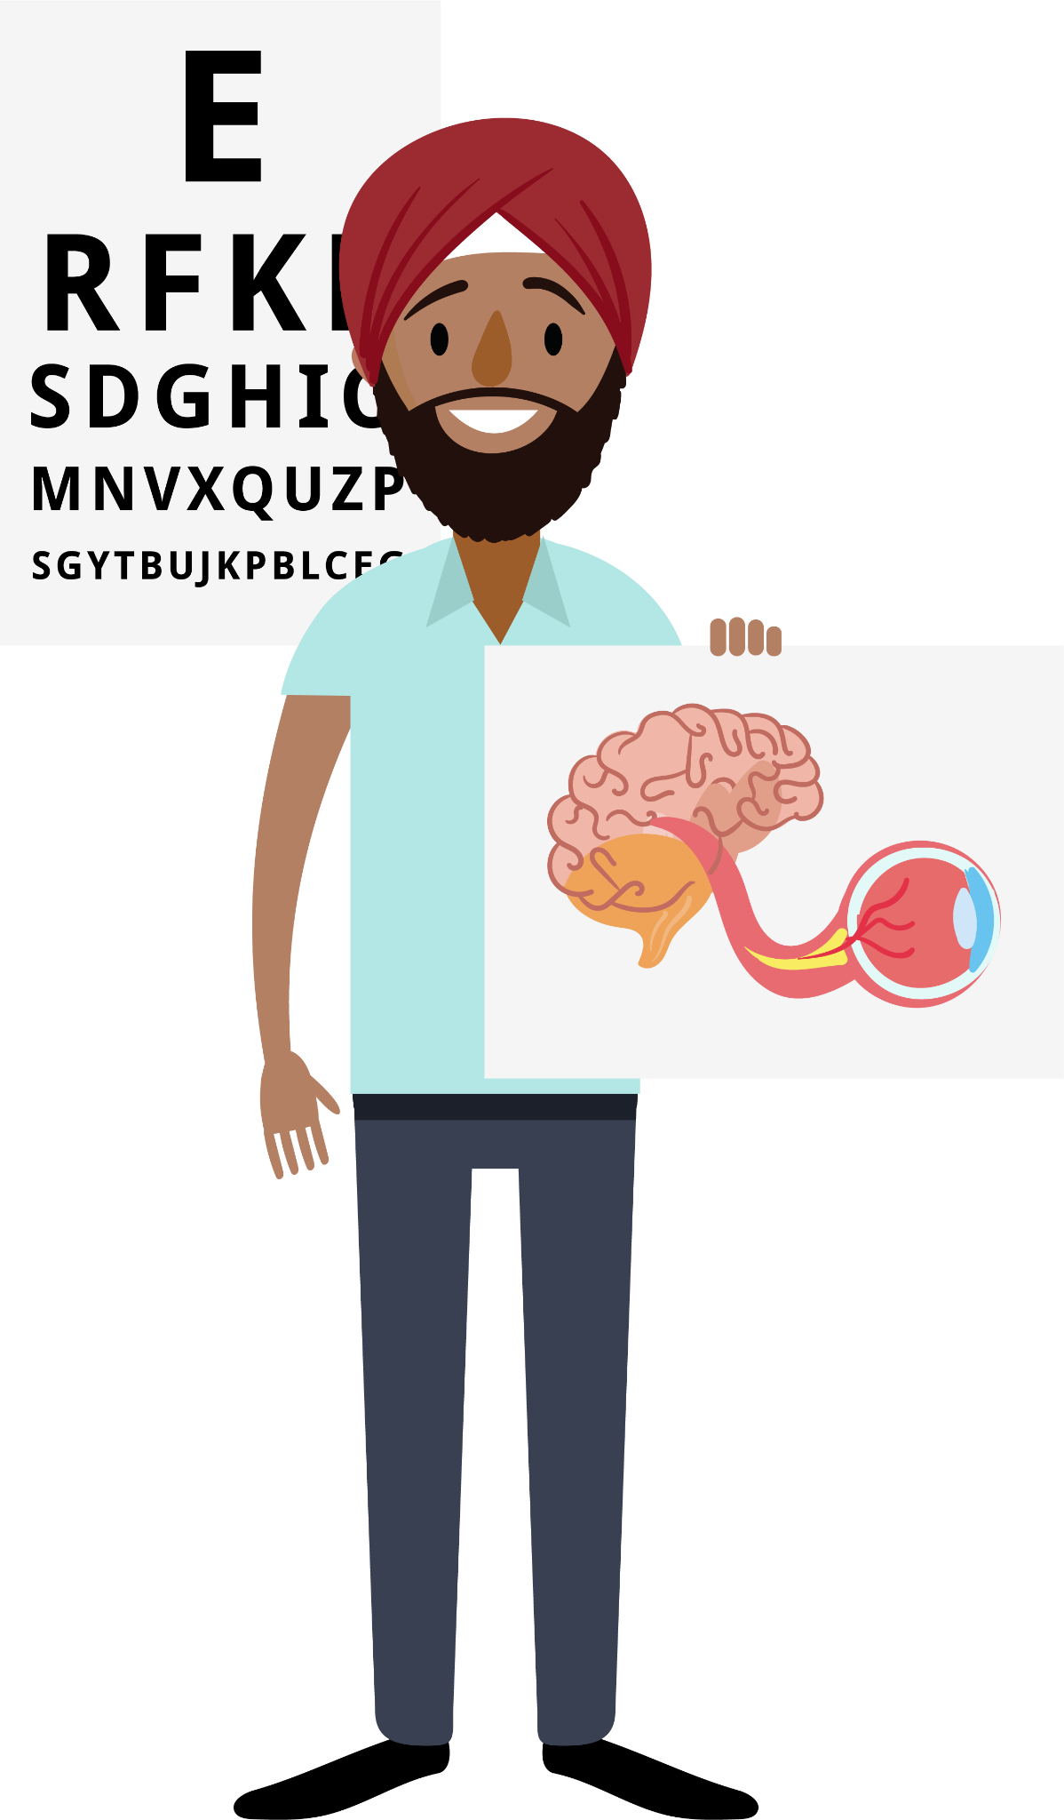
What is Orthoptics?
Teeth?​
​
Feet?​
​
Bones?​
​
Eyes!
Notes:
Orthoptics is a specialised area of Allied Health that focuses on the eyes. The term comes from Greek, meaning “straight eyes” (Orth – straight, Optic – eyes). Orthoptists specialise in how the eyes move and how they work together with the brain.

Slide 4
Allied Health Professions
Notes:
There are 14 Allied Health Professions, each playing a vital role in patient care, and Orthoptics is one of them. Working in this field is incredibly rewarding—every day brings new challenges and opportunities to make a real difference. Orthoptics is a career that keeps you engaged, inspired, and motivated, knowing that the work you do directly improves patients' lives. As an Allied Health Professional, you build meaningful connections with patients, witness their progress, and contribute to their well-being in a truly impactful way.

Slide 5
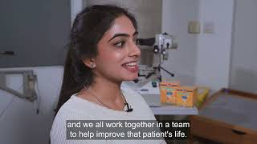
Notes:
I’m just going to show you a video here about orthoptics

Slide 6
Which one are we?
There are many eye professions!
Notes:
You heard the Orthoptist mention Optometrists and Ophthalmologists. It’s easy to confuse them since all these professions start with an “O”!
High street opticians are familiar to most people, and hospital optometrists also prescribe glasses and diagnose eye diseases.
Ophthalmologists are medical doctors who specialise in treating eye conditions.
Orthoptists, however, focus on diagnosing and treating eye movement disorders and conditions like strabismus (squints) and double vision..

Slide 7
Which one are we?
Reduced vision ​ (refractive error, amblyopia)​
Nystagmus ​ (congenital, neurological)​
Strabismus​ (childhood, nerve palsies, trauma, Grave's Orbitopathy, MG)​
Field defects ​ (stroke, brain tumours, IIH)
Notes:
As mentioned in the video Orthoptists have an extremely varied caseload. Typically, their work with babies and children involves the management and treatment of reduced vision development and misaligned eyes or a squint. With adults, they will manage and treat a range of conditions leading to double vision or visual field defects. In the UK the majority of orthoptists work in eye clinics in NHS hospitals. Some orthoptists also work in community clinics, specialist centres for children with disabilities or carry out vision screening in schools.

Slide 8
What do you think?
What do you think happens when a young child develops strabismus (a turn in the eye)?
Notes:
Imagine a child has strabismus (where one of their eyes turns). What do you think they might experience?
Would they see double?
Would their vision be different from someone with straight eyes?
How would we help them?
If they have strabismus, they don’t see double because the brain ignores the turned eye. This can lead to weak vision in that eye. Orthoptists might treat this with patching (covering one eye) or special eye drops. This forces the weak eye to be used and get stronger, and magically grow vision! If this happened to an adult, they would get double vision and their vision would be the same as before as their vision has already developed.
For more information about wearing glasses, strabismus and amblyopia, follow BIOS #WePatch campaign.

Slide 9
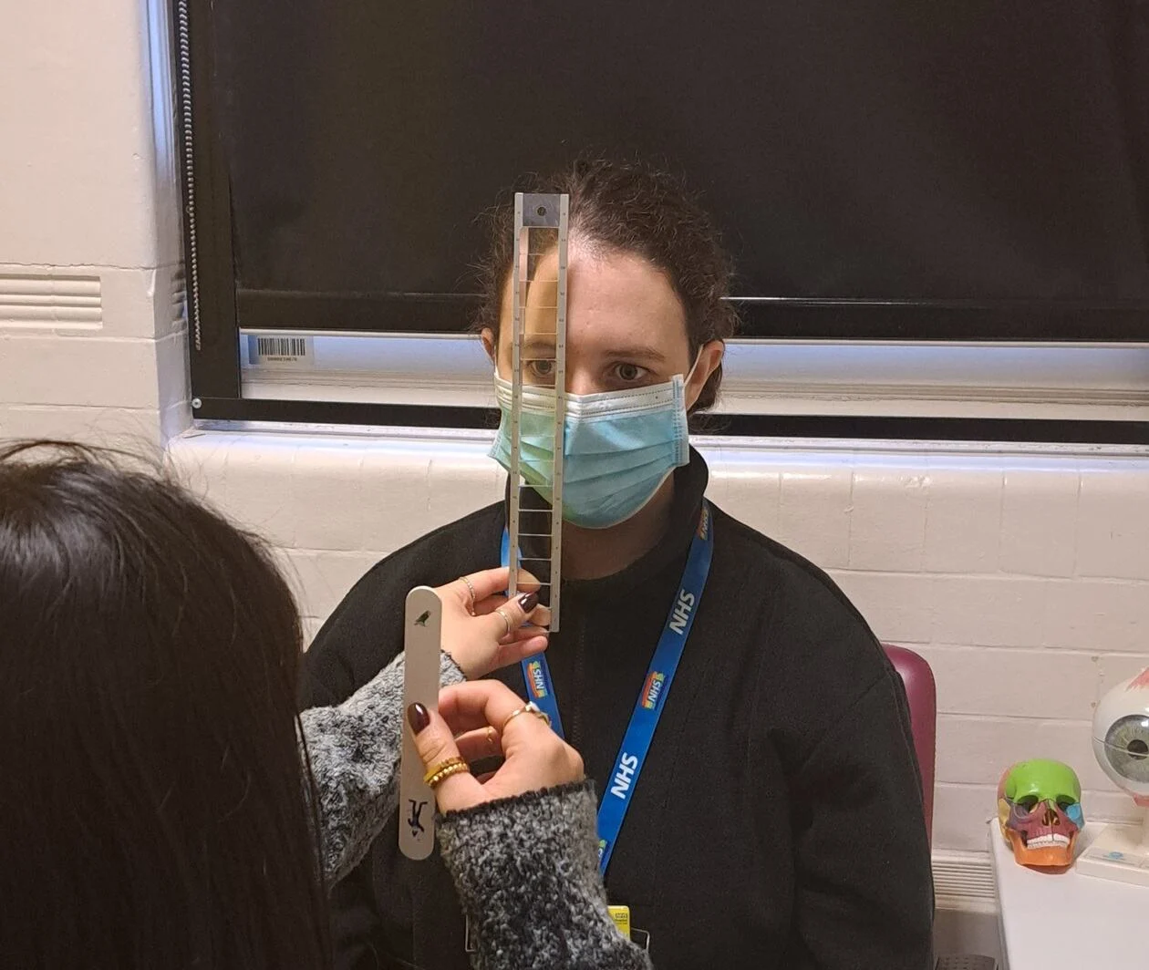
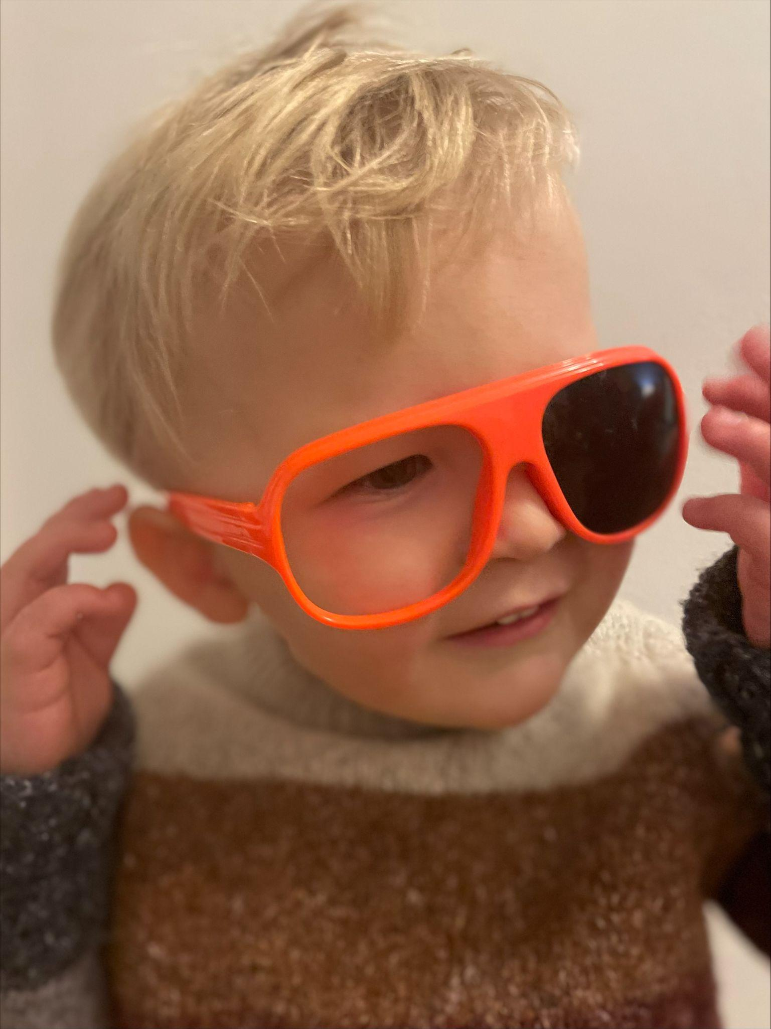
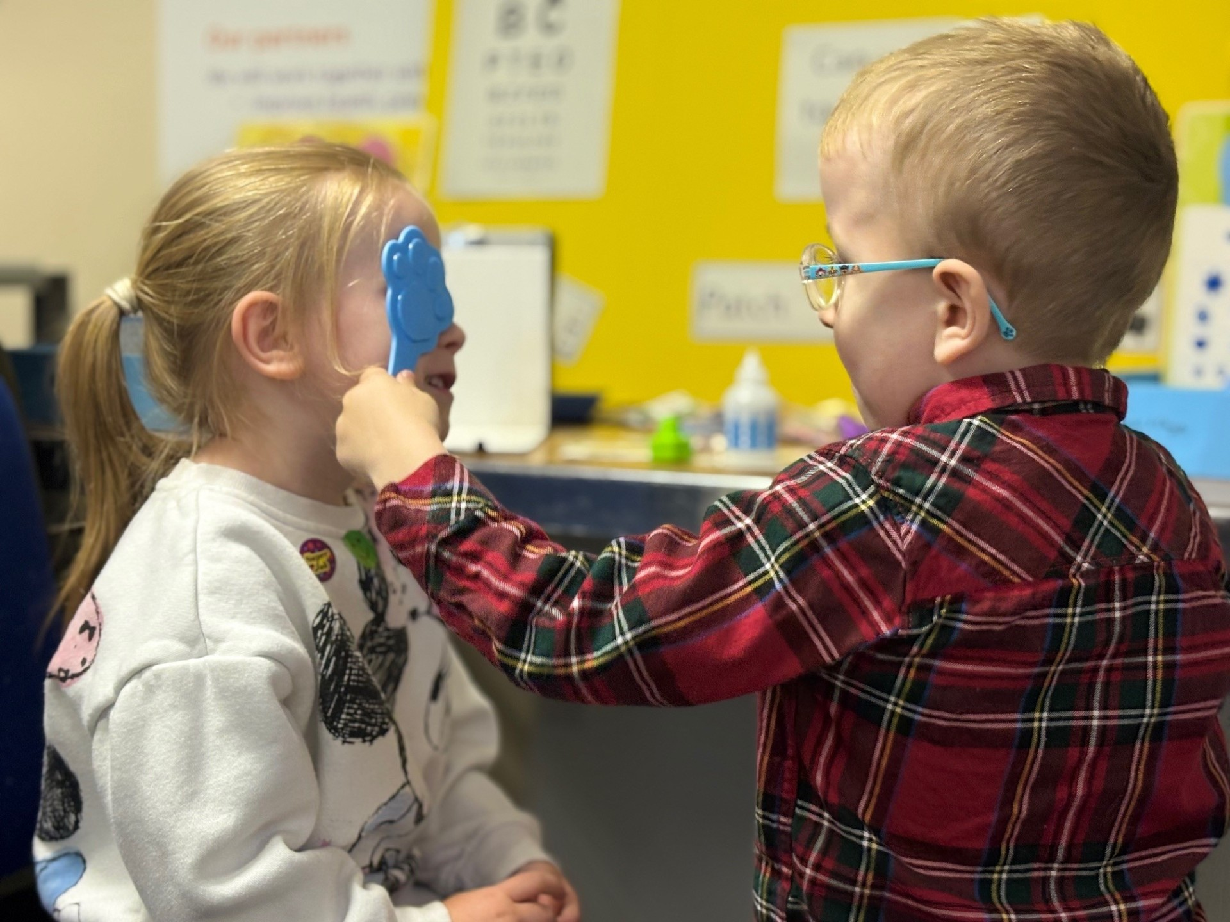
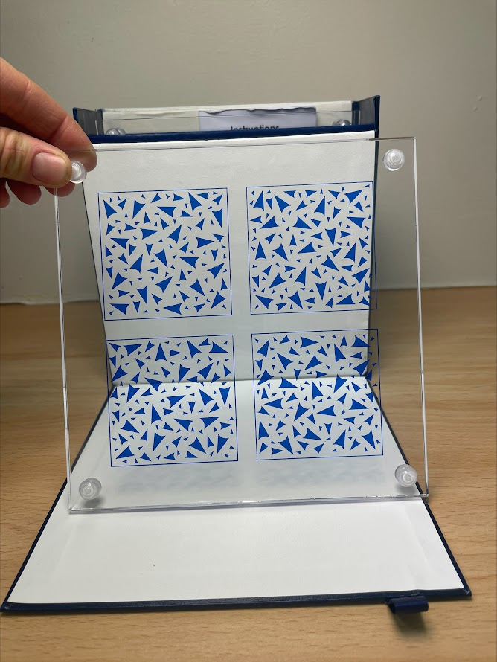
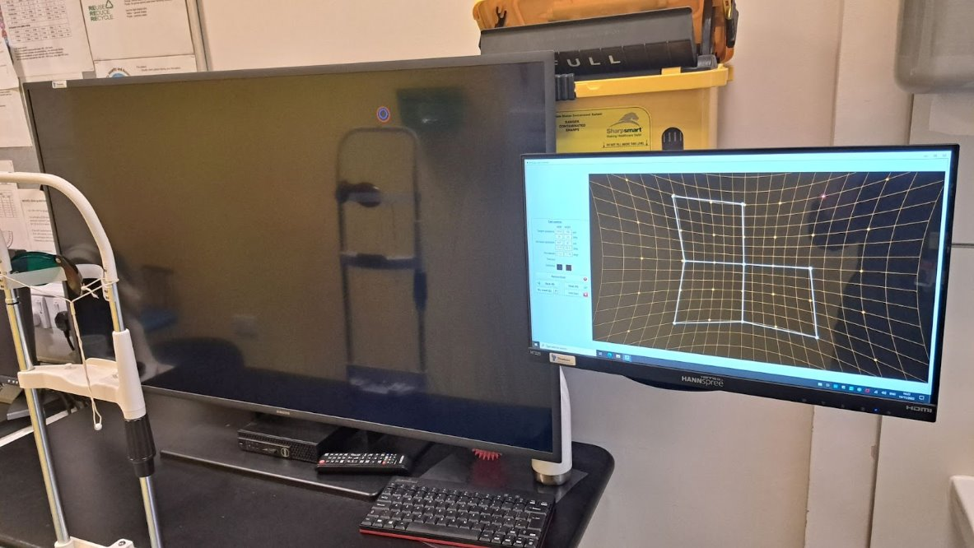
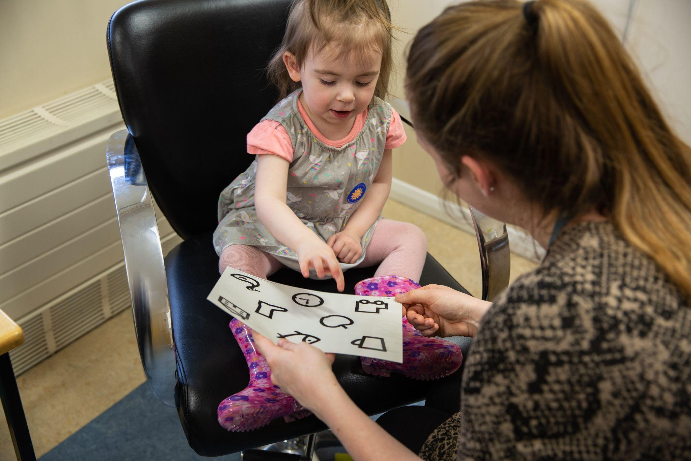
Orthoptic Testing
Notes:
This is a small example of some of the tests an orthoptist might use in clinic to assess eye movements and 3D vision, as well as vision testing in some of our younger patients.
One aspect of orthoptics which is exciting is adapting these tests for each patient’s abilities to understand how they see the world, which helps form an accurate diagnosis and treatment plan.

Slide 10
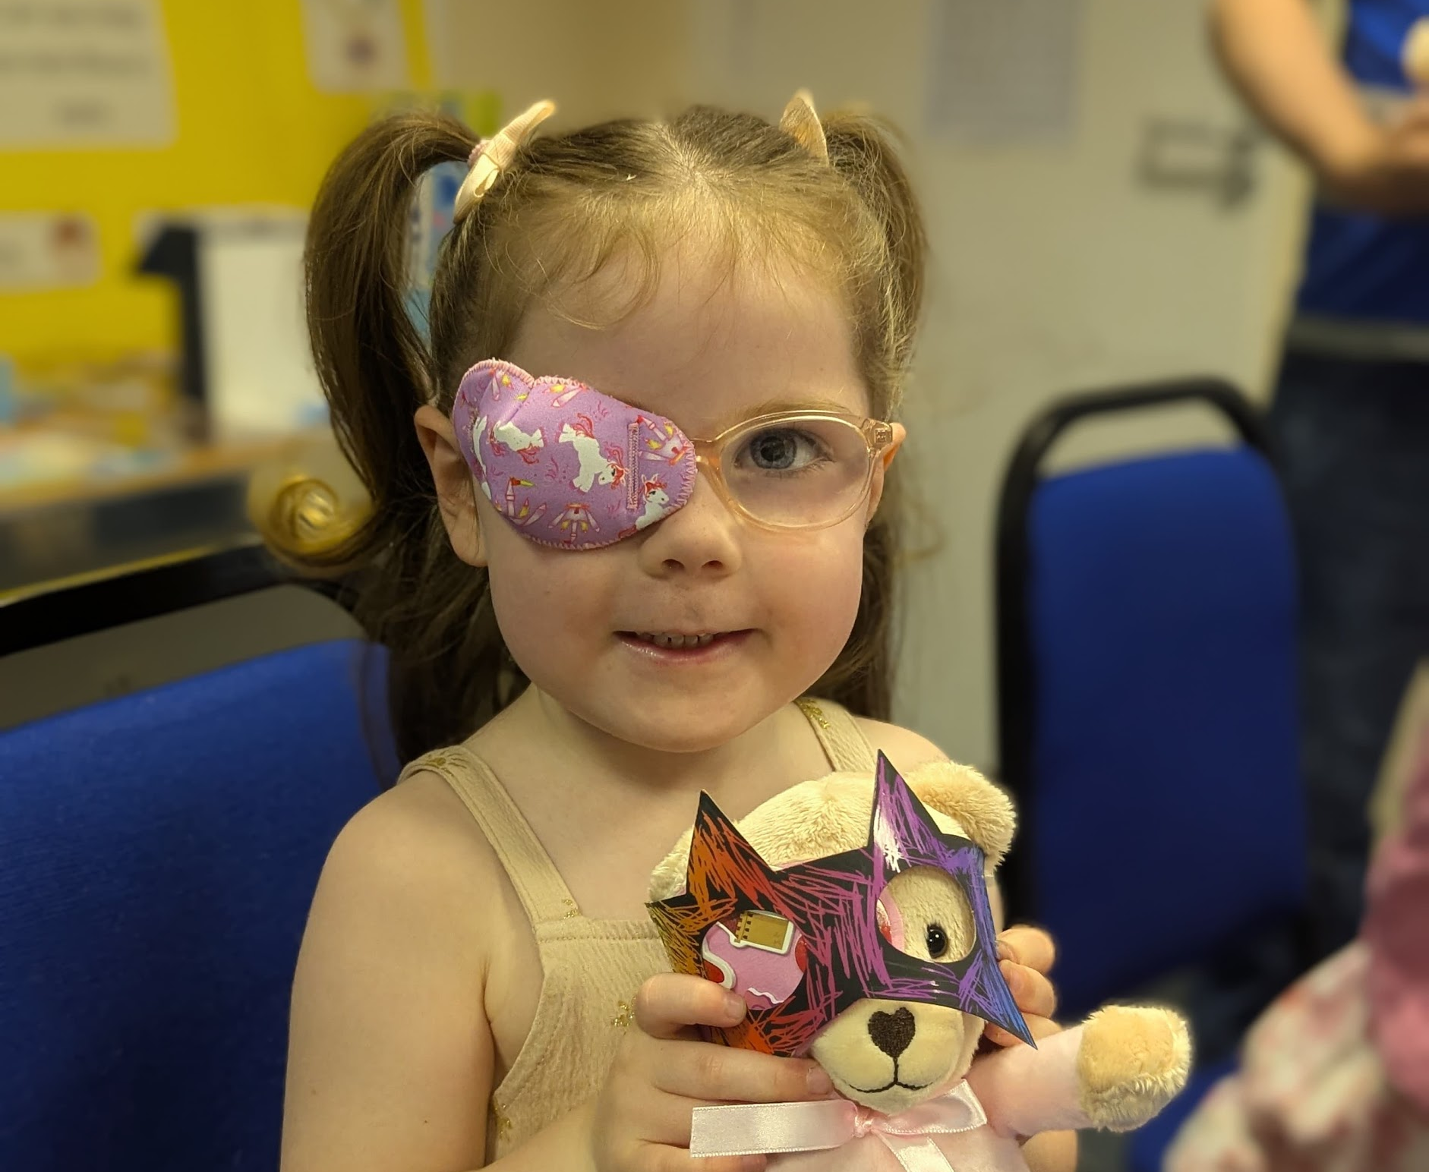
Orthoptic Treatment
Notes:
Here are a few examples of management plans Orthoptists use. For instance, a child may undergo patching treatment to improve vision in their weaker eye, or an adult with double vision may benefit from prism lenses or occlusion to manage the condition. We might also recommend eye exercises to alleviate symptoms.

Slide 11
What is Orthoptics?
Summary
An Orthoptist is the expert in diagnosis and management of eye movement systems and sensory adaptations of the brain to visual experience. They might treat a child’s vision by giving eye patching or eye drops, and might manage symptoms of double vision in an adult with exercises or prisms. An Orthoptist is able to identify a complex neurological problem just by testing eye movements!
No two days are the same and they work closely with other eye care professionals as part of a multidisciplinary team.
Notes:
I hope that’s given you a good introduction to Orthoptics. Take a moment to read through this summary. Does anyone have any questions so far?

Slide 12
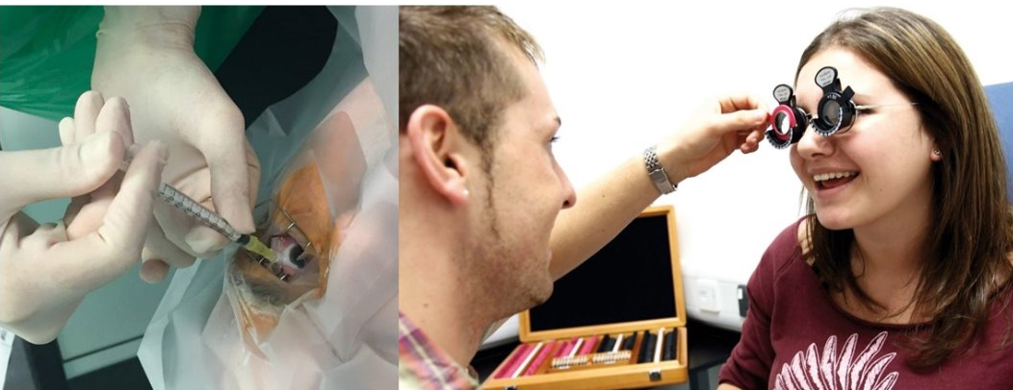
Orthoptic Careers
Core Orthoptics
Medical Exemptions​
Advanced Clinical Practice ​
Healthcare Management and Leadership​
Secondments and Fellowships​
Teaching and Research​
Extended Roles: Neuro-ophthalmology, Medical Retina, Glaucoma, Low Vision, Special Educational Needs, School Screening etc.
Notes:
What we’ve discussed so far is considered core Orthoptics, but there are also many opportunities to specialise and grow your career. With increasing demand in ophthalmology, you can specialise in areas like neuro-ophthalmology, medical retina, glaucoma, low vision, and special educational needs. You can even reach advanced clinical practice, where you work at the same level as specialised doctors in clinics. There are also roles in healthcare management, leadership, research, teaching, and even international work. The variety of options means there’s always room to grow and develop within Orthoptics.

Slide 13
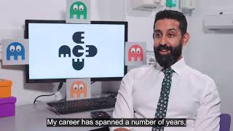
Notes:
See this video on Orthoptic Careers

Slide 14
Routes into Orthoptics
Undergraduate or postgraduate degrees
Option of foundation year prior to undergraduate degree at Liverpool and Sheffield University for mature students
Apprenticeship route is due to become available next year
You could be eligible for a training grant of £5,000 each year of study from the government Learning Support Fund
Notes:
Here are some of the institutions offering undergraduate and postgraduate courses in Orthoptics.
University of Liverpool and Sheffield offer 3-year undergraduate courses.
GCU offers a 4-year undergraduate course.
UCL and Liverpool offer 2-year pre-registration postgraduate courses for those who have already completed a degree.
Some universities, like Sheffield and Liverpool, offer foundation years to help mature students transition into the course.
There is also an Orthoptic apprenticeship route in the pipeline.
Given the high demand for Orthoptists in the NHS, there’s a learning support fund available to eligible students each year.

Slide 15
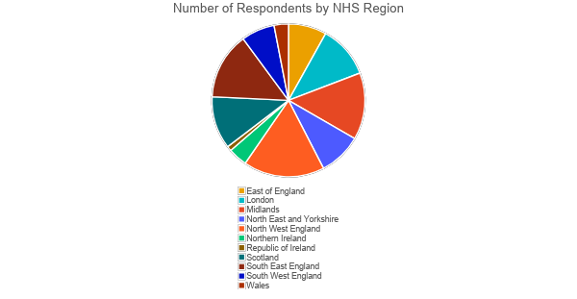
Recruitment Survey
Survey ran from 28th February 25-16th April 25
99 Trusts responded to the Survey
Limited data for RoI (1), Wales (3) and NI (4)
Data taken from LOOP presentation by Greg Richardson
Notes:
A recruitment survey was sent out to all heads of department via BIOS at the end of February. It asked questions around whether departments had vacancies, at which bands, and how many times people failed to recruit. It also aimed to look at the number of applicants departments received per vacancy. It then asked around whether people used any incentives to recruit and what they had tried and worked

Slide 16
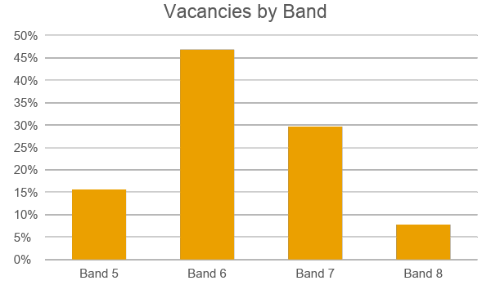
Vacancies by Banding
Most vacancies were recruiting band 6
Band 7 roles are the most difficult to recruit to
Data for band 8s was limited, as fewer posts advertised
Notes:
Here is information about banding. Most of the vacancies were for Band 6 positions. Band 7 roles were the most difficult to recruit for. Data for Band 8 positions was limited, as fewer posts were advertised.

Slide 17
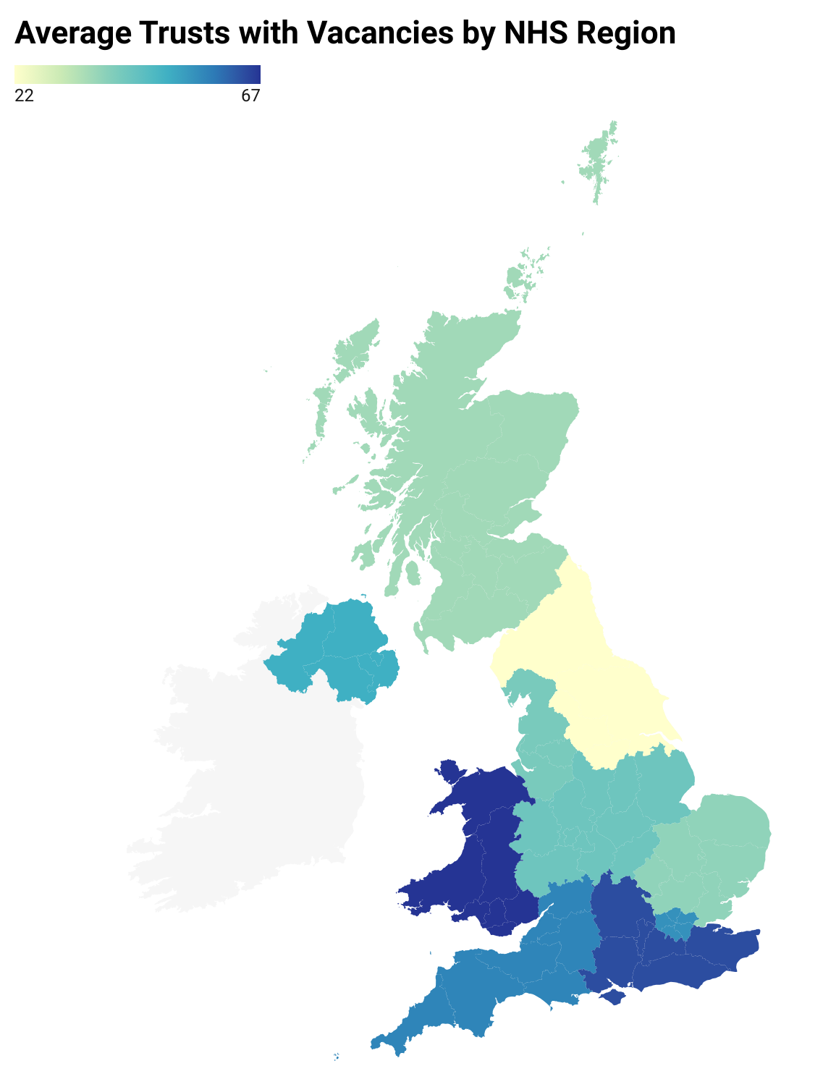
Trusts with Vacancies by Region
52% of Trusts reported having at least one vacancy
Many Trusts reported more than one
Region | Vacancies?
Wales | 67%*
South East England | 64%
South West England | 57%
London | 55%
Northern Ireland | 50%*
Midlands | 43%
North West England | 41%
East of England | 38%
Scotland | 36%
North East and Yorkshire | 22%
Republic of Ireland | Not enough data
Notes:
Here is some information about the percentage of Trusts per region that had vacancies. 52% of Trusts reported having at least one vacancy and many Trusts reported more than one

Slide 18
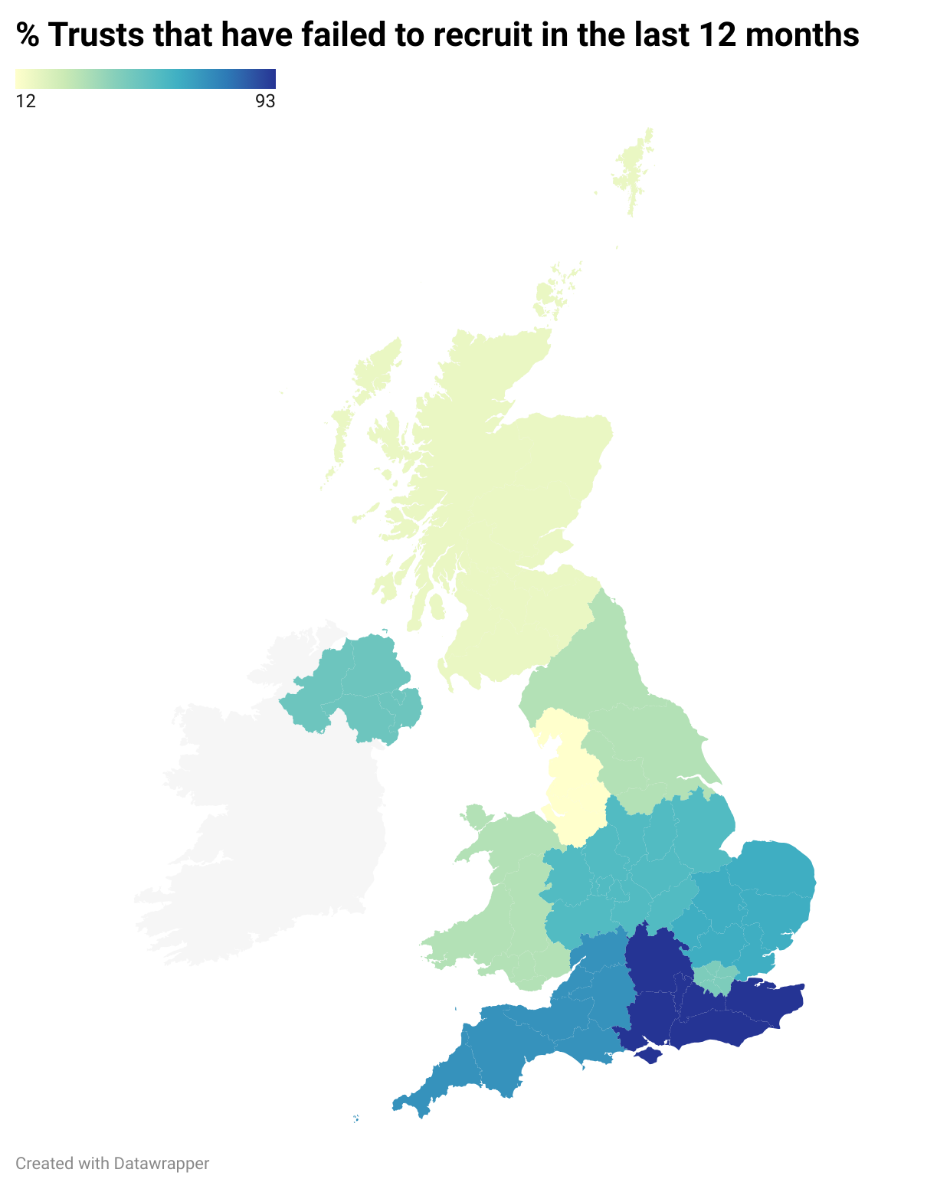
Trusts that failed to recruit by Region
Region | Failed to recruit? | How often?
South East England | 93% | 4
South West England | 71% | 9
East of England | 63% | 3
Midlands | 57% | 3
Northern Ireland | 50%* | 4
London | 45% | 3
North East and Yorkshire | 33% | 2
Wales | 33%* | 1
Scotland | 18% | 2
North West England | 12% | 2
Republic of Ireland | Not enough data | Not enough data
Notes:
Here is some information on the failure to recruit in the different regions. South England had the most challenges, with up to 9 reposts without recruitment.

Slide 19
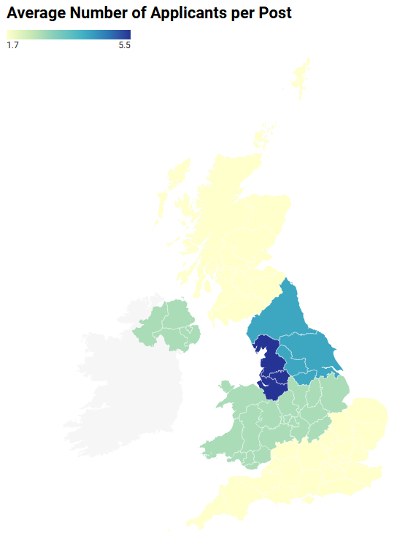
Current Orthoptics Education Providers
Data taken from upcoming BIOS Workforce Report (2025)
HEI | Programme | Entry Criteria | Duration | Planned Recruitment
University of Liverpool | BSc (ug) | BBB | 3 years | 48
University of Liverpool | MSc (pg) | 2:2 (ug degree) | 2 years | 20
University of Sheffield | BMed Sci (ug) | BBB | 3 years | 48
University College London | MSc (pg) | 2:2 (ug degree) | 2 years | 20
Glasgow Caledonian University | BSc (ug) | BBB | 4 years | 20
Notes:
Here is some information on the current orthoptic education providers and how they are distributed throughout the UK.

Slide 20
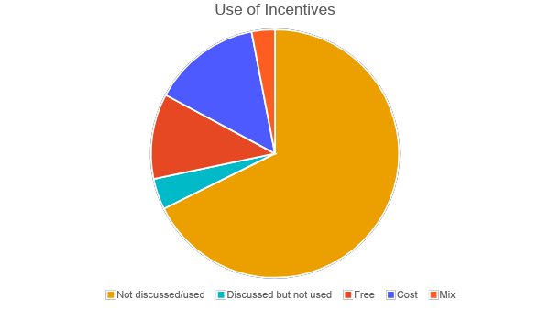
Incentives
2/3rds of respondents had not discussed use of incentives
5% had discussed but not used
11% used free incentives
14% used incentives that incurred cost
3% used a mixture
Notes:
This shows what kind of incentives were used to aid recruitment. 2/3rd of departments did not use incentives as part of their recruitment process.

Slide 21
Free incentives
Flexible working
9 day fortnights
Extended hours 4 days per week
Annex 21
Suitable for development posts
Amending job specs
Impact on core orthoptics
Student engagement
Career talks
Job application support
Interview technique
Notes:
These are examples of free incentives used, such as Annex 21 - band progression run-throughs

Slide 22
Incentives with costs incurred
Welcome bonus
Various
£1000 to £5000 offered
Relocation costs
Various
£1000 up to £8000
Recruitment and Retention Premia
5% RRP to all Orthoptists
20% uplift for those staying in post > 2 years
Education Funding
Offered as part of a regional project
Notes:
These are some examples of incentives used with costs incurred

Slide 23
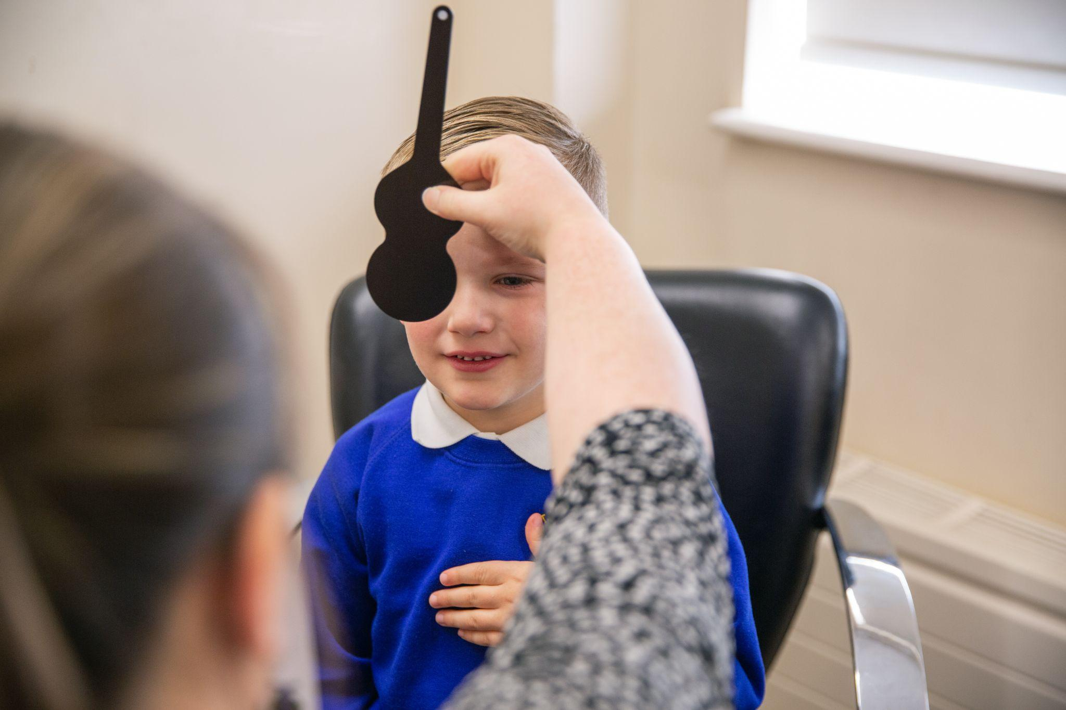
Summary
Recruitment is challenging for such a small allied health profession
Significant challenges in Southern England and Wales
We must raise the profile of orthoptics and support local visibility effort
We need to consider incentives to recruit in areas of struggle
When the apprenticeship becomes available, could this be a solution for low-visibility areas?
Notes:
Recruitment is particularly challenging for such a small allied health profession, with significant difficulties observed in Southern England and Wales. To address this, we must raise the profile of orthoptics and support local visibility efforts. Additionally, it's crucial to consider offering incentives to recruit in areas where there is greater struggle. When the apprenticeship program becomes available, it could potentially serve as a solution for areas with low visibility.

Slide 24
Want to find out more?
Visit our website: https://www.orthoptics.org.uk/
Contact us: Visibilityleads@orthoptics.org.uk
Contact your local orthoptic department for discussion
Complete our free online FutureLearn course
Notes:
If you’re keen to learn more, we offer a free 3-week Orthoptics course on FutureLearn. We also encourage you to contact your local Orthoptic department for further discussion. Visit the BIOS website or contact us for further details.

Slide 25
Contact: visibilityleads@orthoptics.org.uk
Thank you.
Notes:
Thank you! Please scan this QR code to visit the BIOS page for further information. Any questions?

