Slide 1
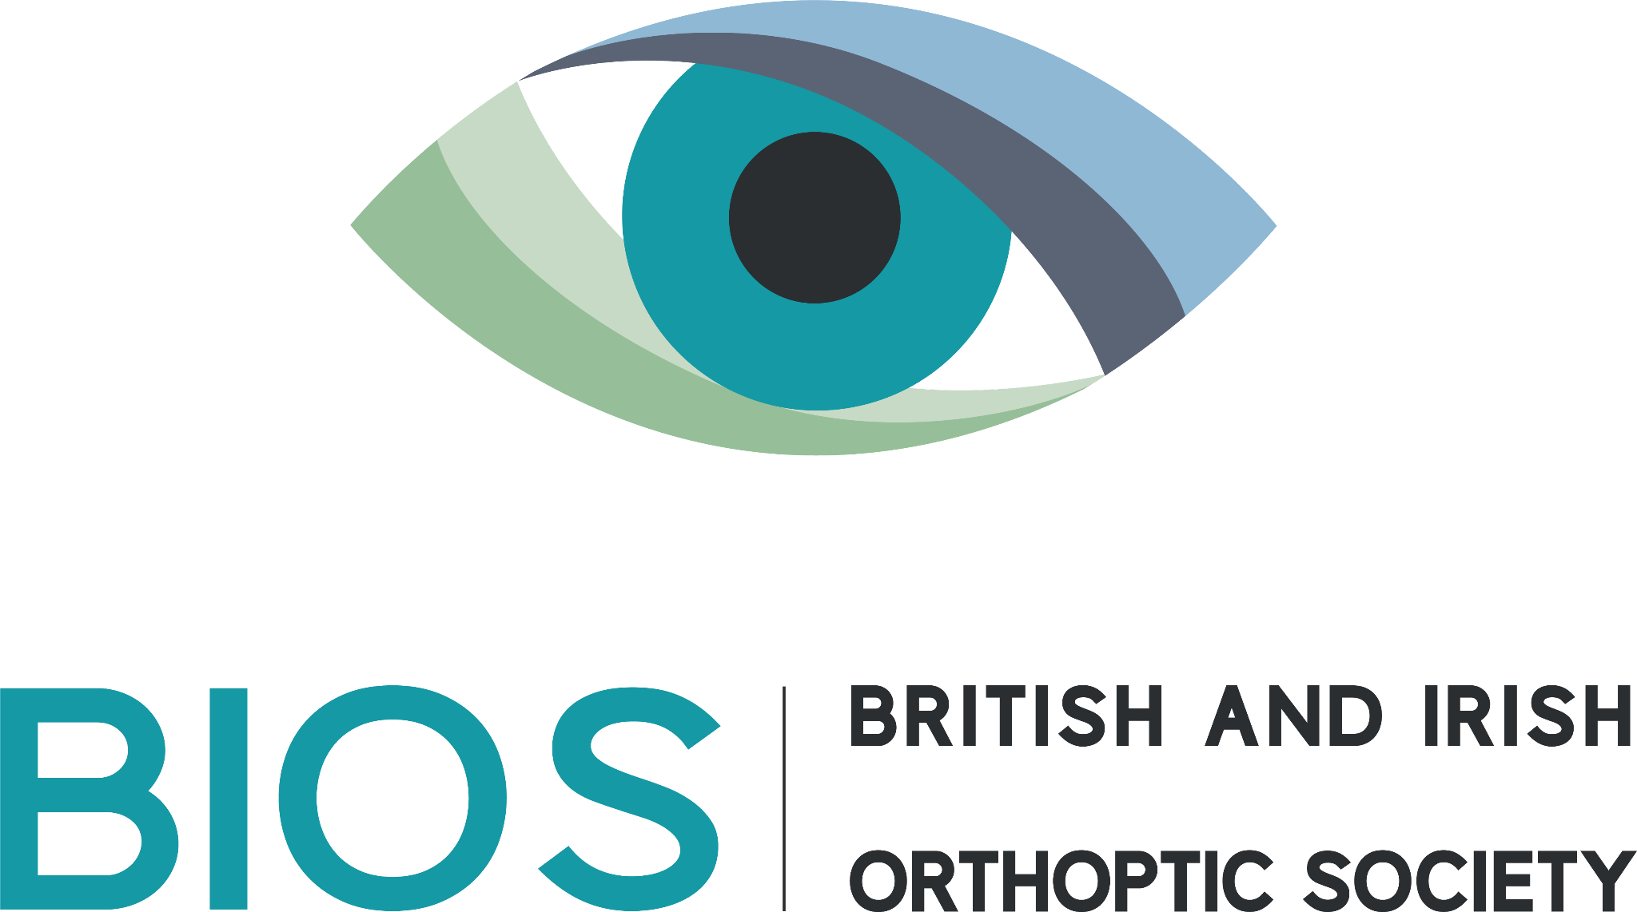
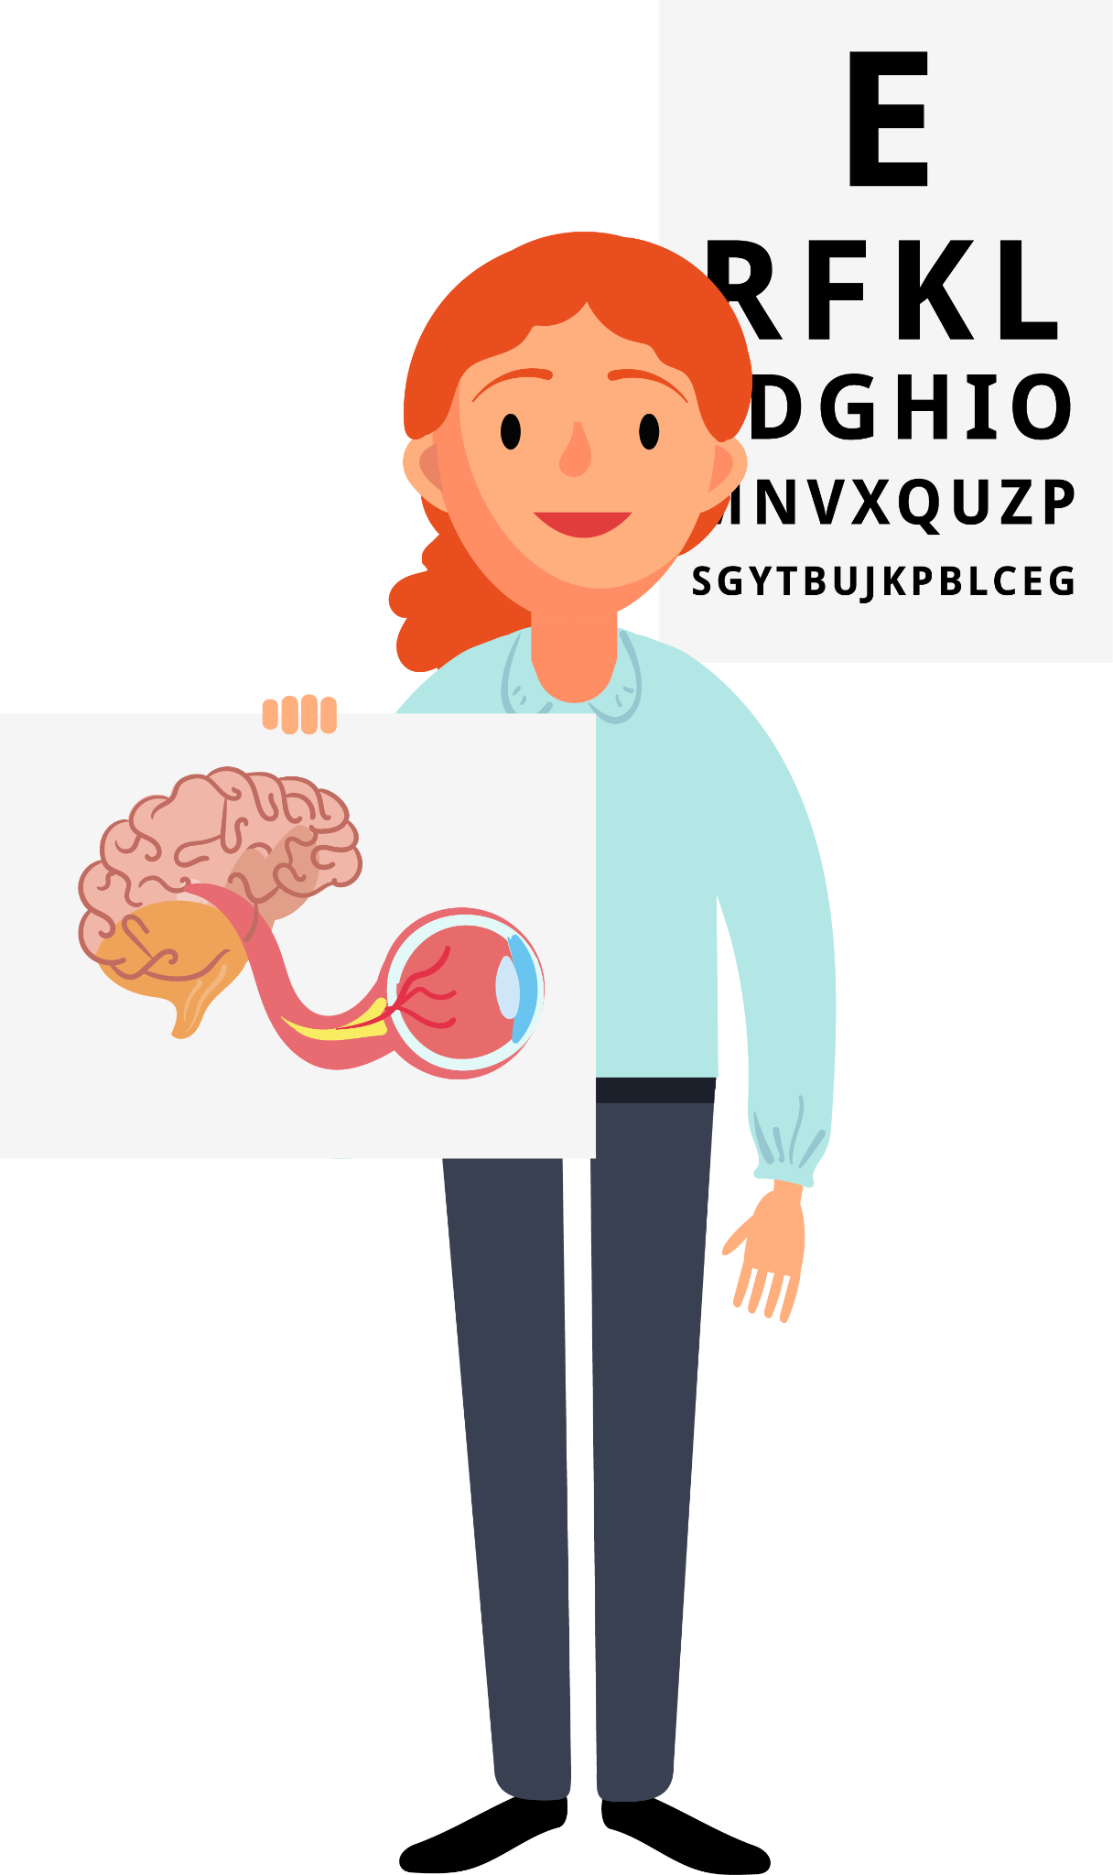
Orthoptics
Key Stage 3 & 4
Notes:
Hi! My name is… And this is our mascot Orb (short for Orblith) A glowing, spherical object or entity that projects or absorbs light I’m an Orthoptist at… Today, I’m going to tell you about a super interesting job called Orthoptics!

Slide 2
What is Orthoptics?
Teeth?​
​
Feet?​
​
Bones?​
​
Eyes?
Notes:
Raise your hand… what do you think Orthoptics is? Is it about teeth, feet, bones, or eyes?

Slide 3
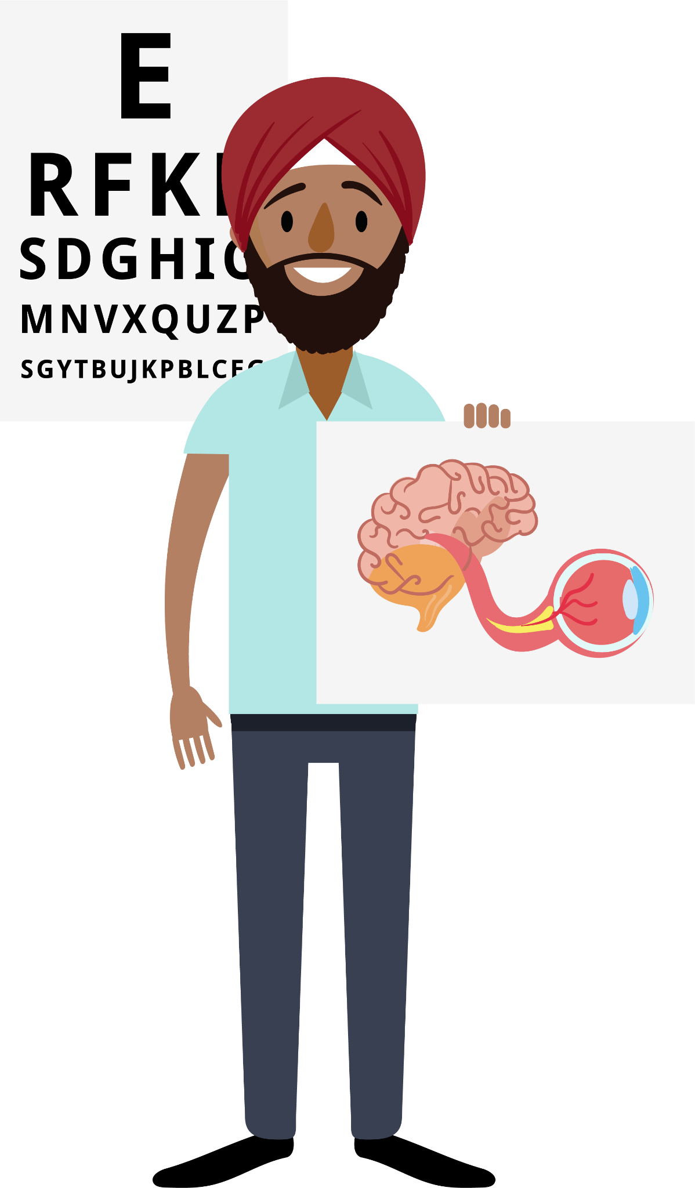
What is Orthoptics?
Teeth?​
​
Feet?​
​
Bones?​
​
Eyes!
Notes:
So, what is Orthoptics? Orthoptics is all about eyes! It’s a job that focuses on making sure our eyes work properly. It comes from the Greek word for "straight eyes". Orthoptists help make sure your eyes move the right way and work well with your brain.
This is our mascot Oxi (Short for Oxivion) A futuristic system blending oxygen and vision, such as imaging technologies.

Slide 4
Notes:
There are lots of health jobs, and Orthoptics is one of them. Working as an Orthoptist is really cool because you get to help people see better, which makes a big difference in their lives. It's a job that lets you meet lots of different people and helps them every day!

Slide 5
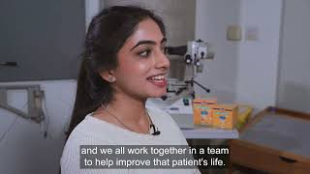
Notes:
I’m just going to show you a short video here

Slide 6
Which one are we?
Notes:
In the video, you might have heard about Optometrists and Ophthalmologists. They all work with eyes, but they do different things:
Opticians help you pick glasses.
Optometrists check your eyes for problems and give you glasses if needed.
Ophthalmologists are doctors who treat serious eye problems.
Orthoptists are different – they help treat things like strabismus (eye misalignment), vision development or double vision.

Slide 7
Reduced vision ​
Nystagmus ​ (wobbly eyes)​
Strabismus​ (eye misalignment)​
Field defects ​
Notes:
Orthoptists help babies, children, and adults. For babies and children, they help with problems like strabismus (eye misalignment) or if their vision is not developing properly. For adults, they treat double vision, visual field problems or eye movement problems. These can all have lots of causes and it is the orthoptist job to find out why and help fix it!
Orthoptists mostly work in hospitals but sometimes work in schools or special clinics too!

Slide 8
What do you think?
What do you think happens when a young child develops strabismus (a turn in the eye)?
Notes:
Imagine a child has strabismus (where one of their eyes turns). What do you think they might experience?
Would they see double?
Would their vision be different from someone with straight eyes?
How would we help them?
If they have strabismus, they don’t see double because the brain ignores the turned eye. This can lead to weak vision in that eye. Orthoptists might treat this with patching (covering one eye) or special eye drops. This forces the weak eye to be used and get stronger, and magically grow vision! If this happened to an adult, they would get double vision and their vision would be the same as before as their vision has already developed.

Slide 9
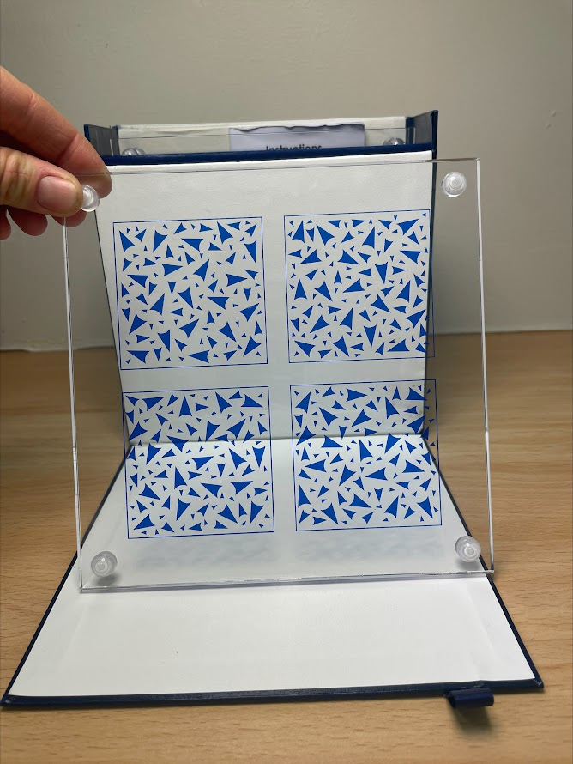
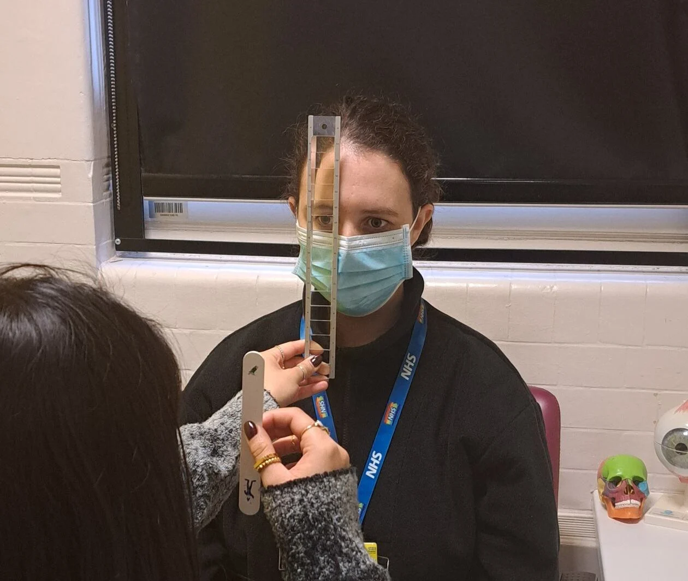
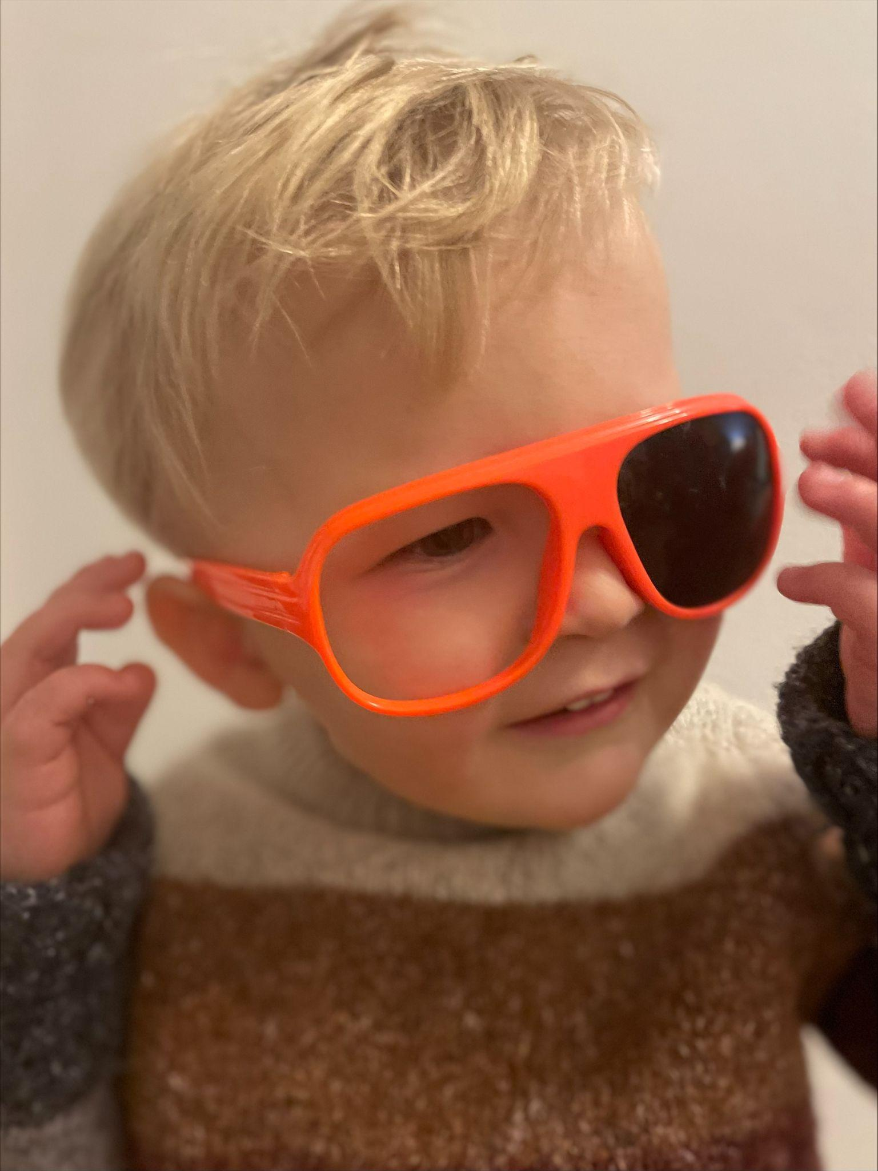
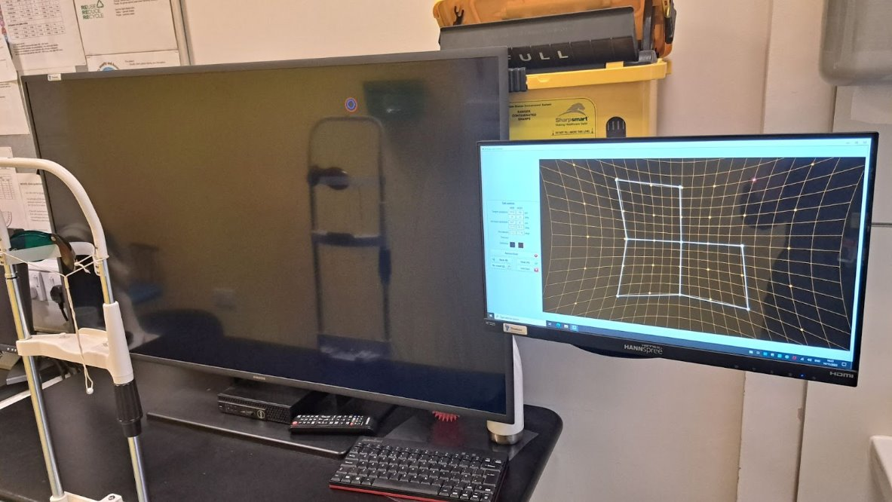
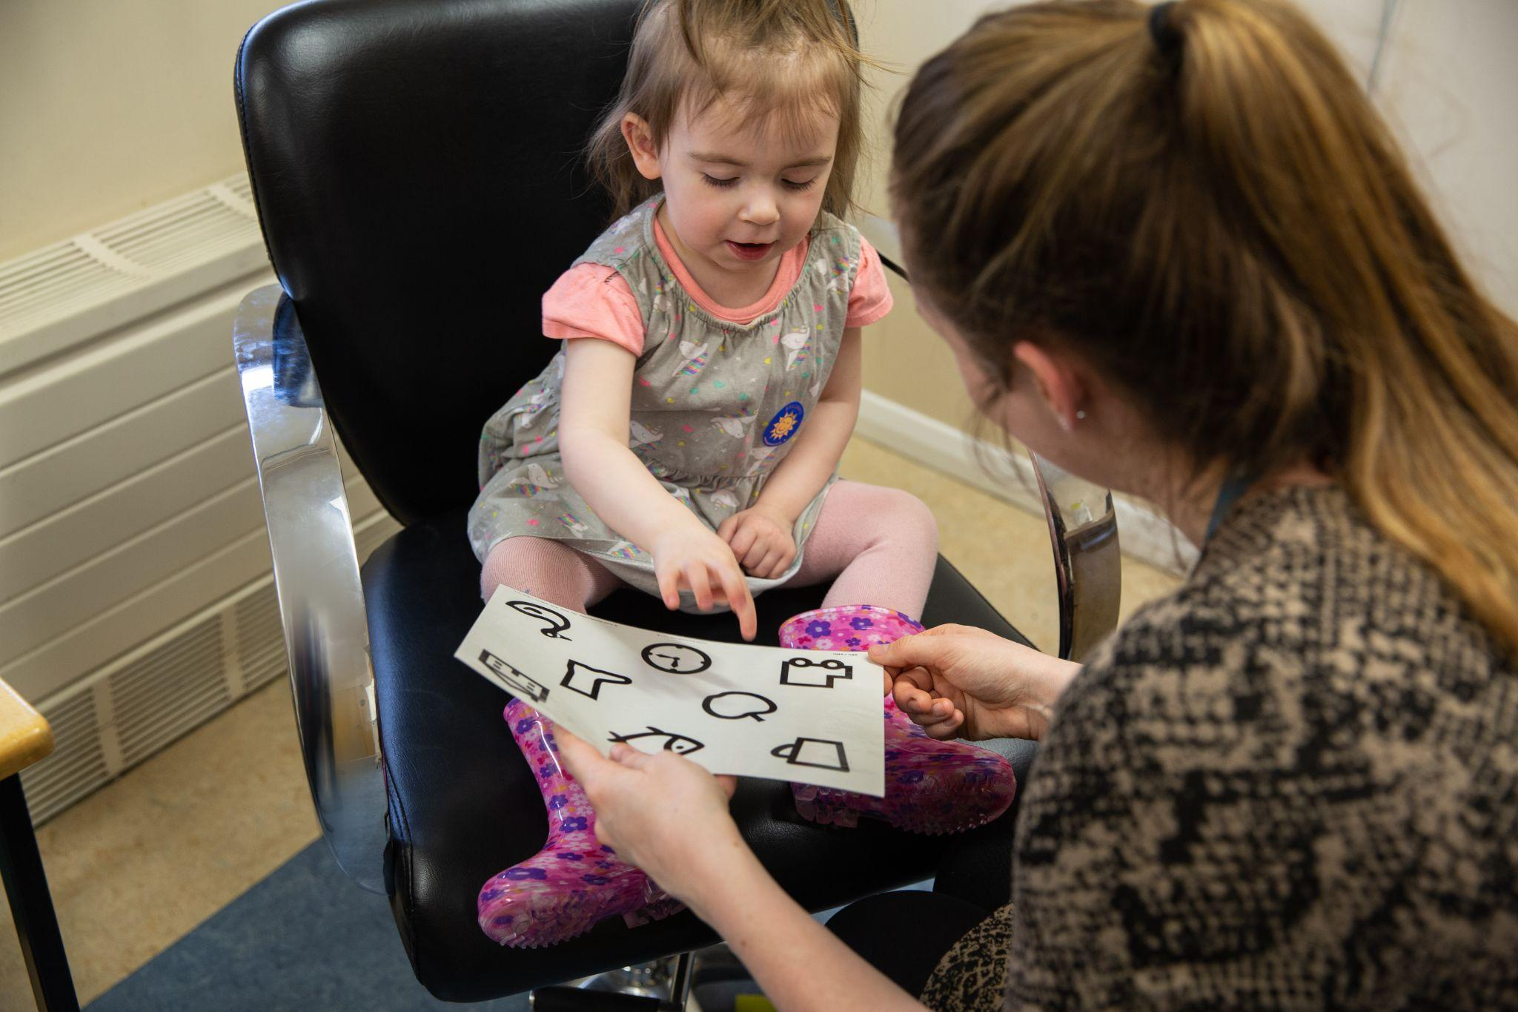
Orthoptic Testing
Notes:
Orthoptists use special tests to check how well someone’s eyes are working together. These tests help them understand how to treat problems and help people see better. Some of these include 3D vision games!

Slide 10
Orthoptic Treatment
Notes:
Here are some ways Orthoptists help people:
Patching a child’s eye to make it stronger.
Prisms (which bend light) can be stuck onto glasses to fix double vision.
Eye exercises to make your eye muscles stronger.

Slide 11
What is Orthoptics
Any questions?
Notes:
That’s a quick look at what Orthoptics is all about! Does anyone have any questions so far?

Slide 12
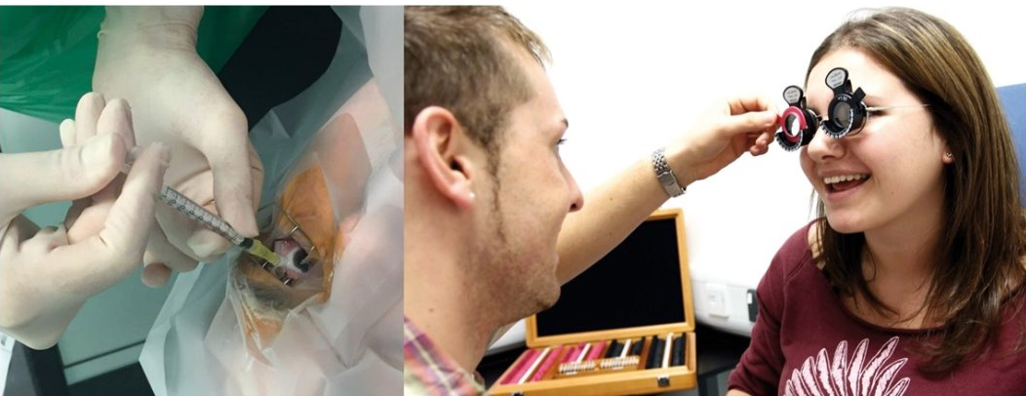
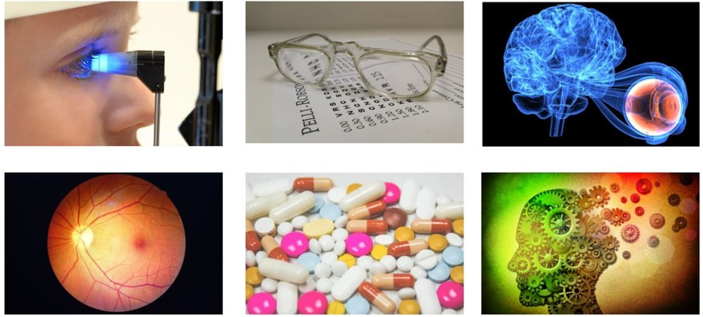
Orthoptic Careers
Core orthoptics
Extended roles and specialising
Healthcare management and leadership​
Teaching and research​
Notes:
What we have discussed so far is usually referred to as core orthoptics, however, Orthoptists are also further specialising and extending their skills within the eye world.
As an Orthoptist, there are lots of exciting paths you can take. You can help people with different eye problems, and even train to do the same work as a specialist doctor and give medicines. You can work in hospitals, schools, or even work in other countries. With orthoptics, you can become a teacher, researcher or lead a team. There are always new things to learn and ways to grow in this job, so it’s never boring!

Slide 13
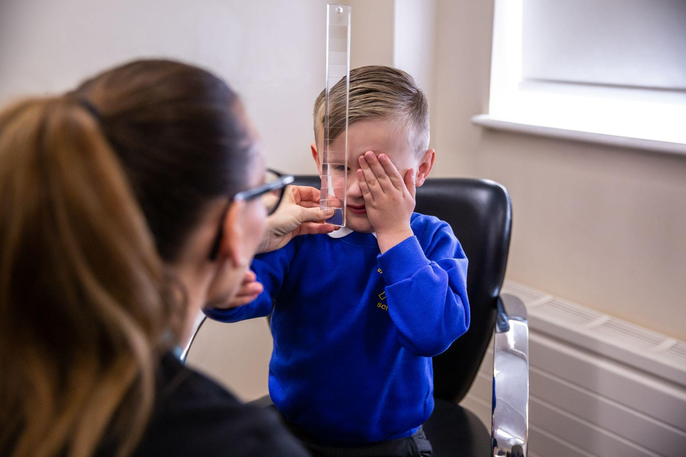
Transferable skills
Problem-solving
Being good with people
Being curious about science
Notes:
If you like helping people, working with science, and solving problems, this could be the perfect job for you!

Slide 14
How do you become an Orthoptist?
Work hard in subjects like science
Have an interest in how the body works
There are different ways to train and start your career in Orthoptics, like going to University, or even learning on the job
Notes:
To become an Orthoptist, you need to finish school and get good grades, especially in subjects like science. Having an interest in how the body works and helping people is really important. Once you’ve done well in school, there are different ways to train and start your career in Orthoptics, like going to University, or even learning on the job.

Slide 15
Contact: visibilityleads@orthoptics.org.uk
Thank you
How do I become an Orthoptist?
Notes:
Thank you! Scan this QR code to find out more about becoming an Orthoptist. Any questions?

