Slide 1
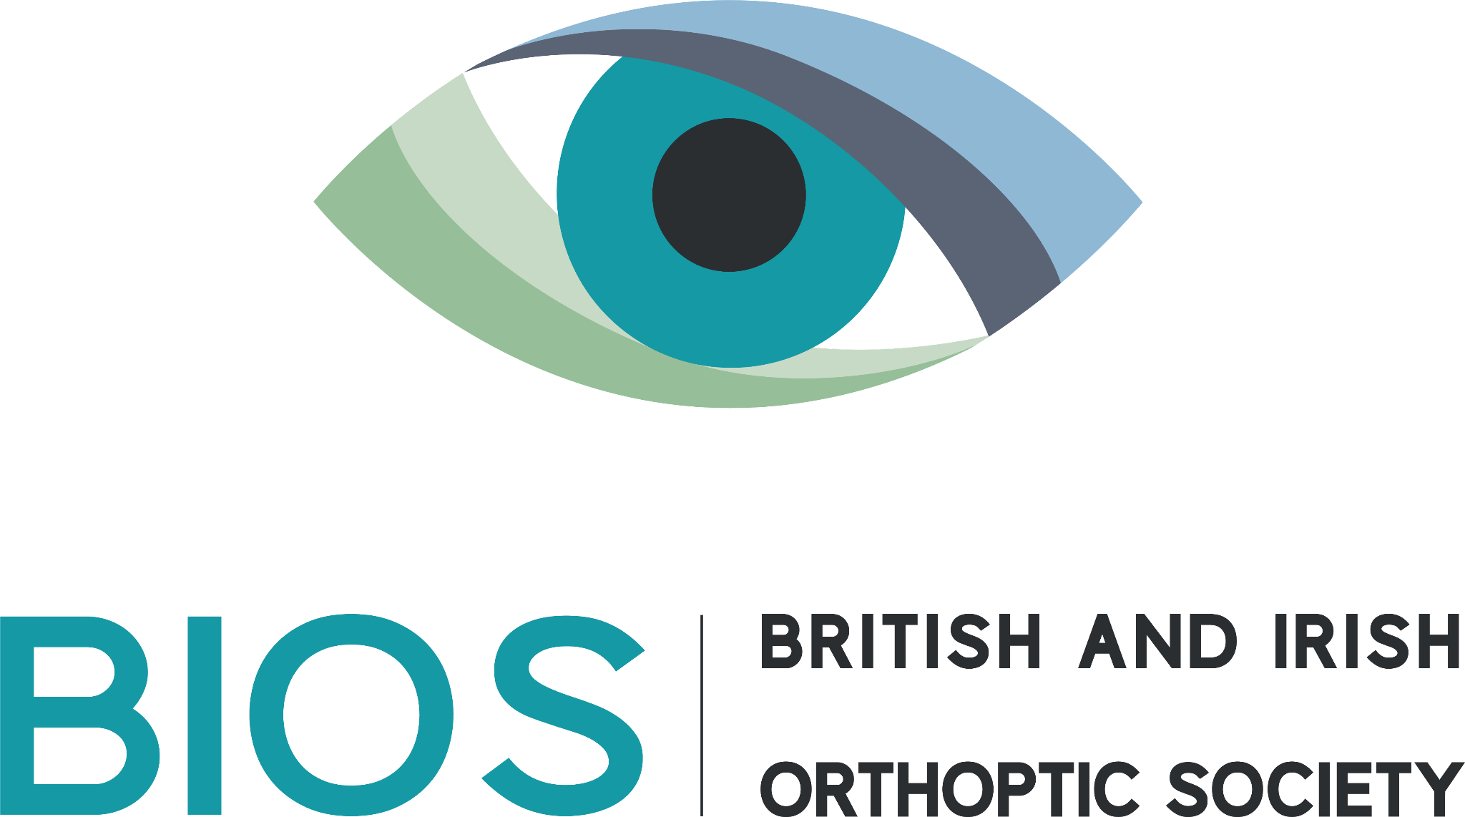
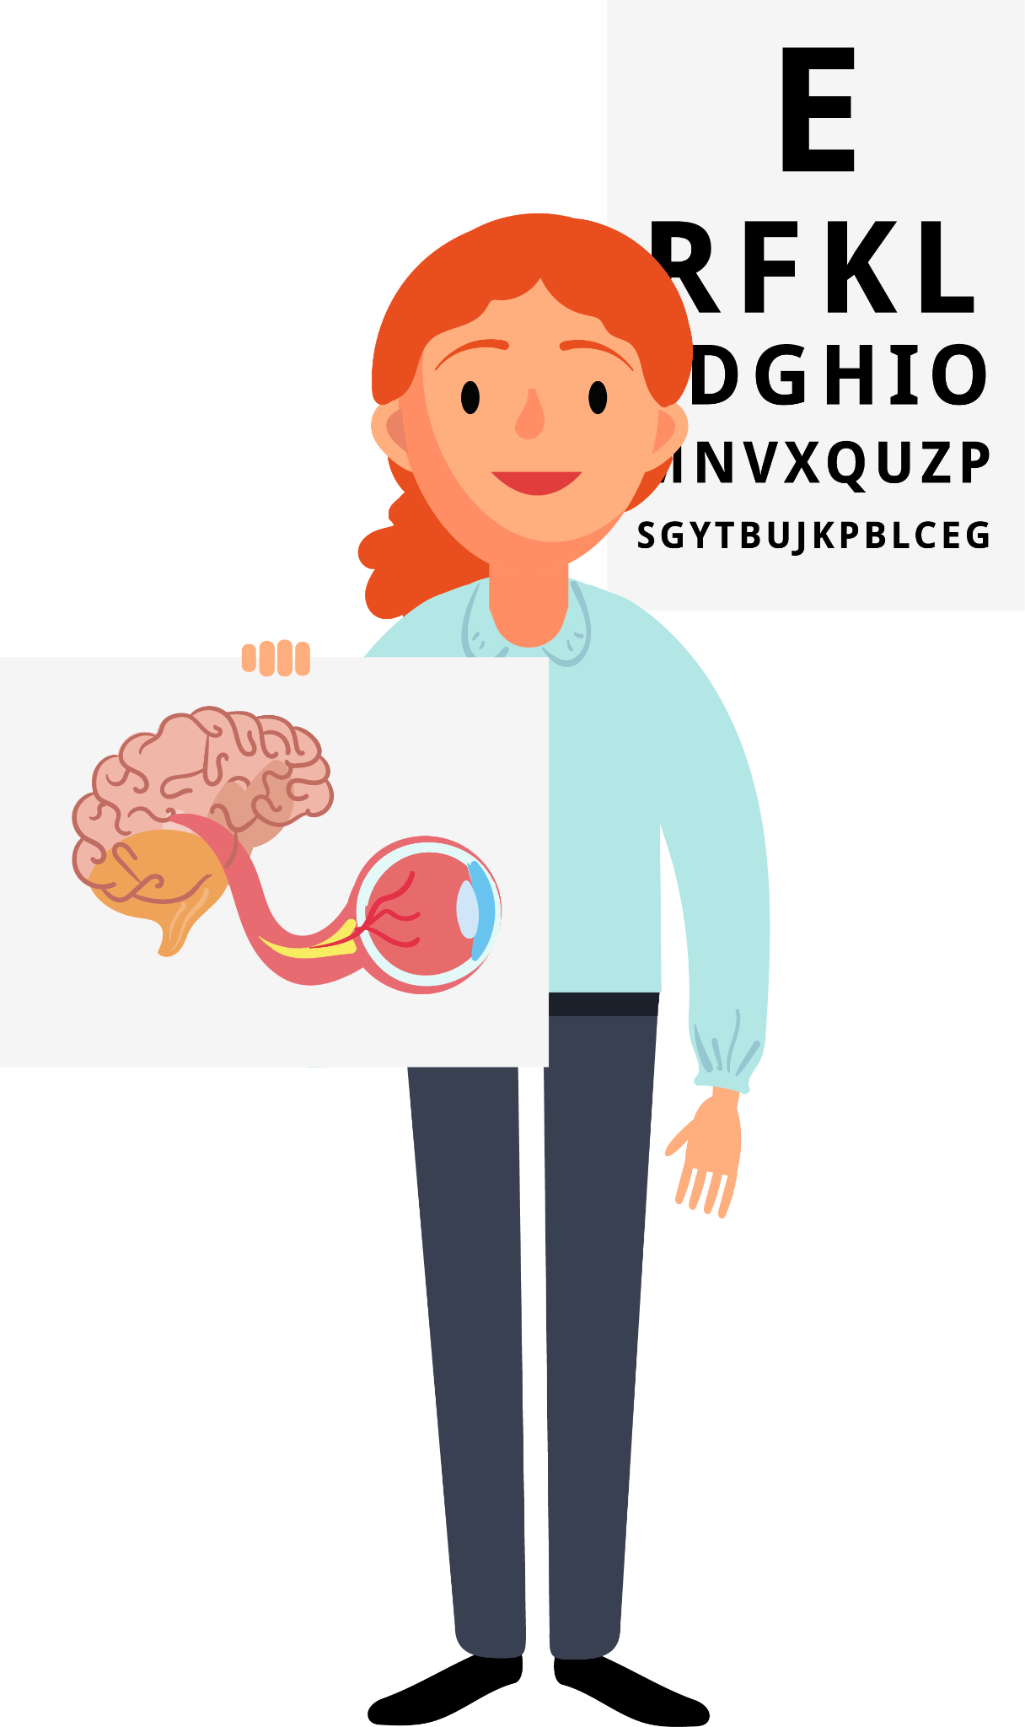
Orthoptics
Key Stage 1 & 2
Notes:
Hi! My name is… And this is our mascot Orb (short for Orblith) A glowing, round object that projects or absorbs light I’m an Orthoptist at… Today, I’m going to tell you about a super interesting job called Orthoptics!

Slide 2
What is Orthoptics?
Teeth?​
​
Feet?​
​
Bones?​
​
Eyes?
Notes:
Raise your hand… what do you think Orthoptics is? Is it about teeth, feet, bones, or eyes?

Slide 3
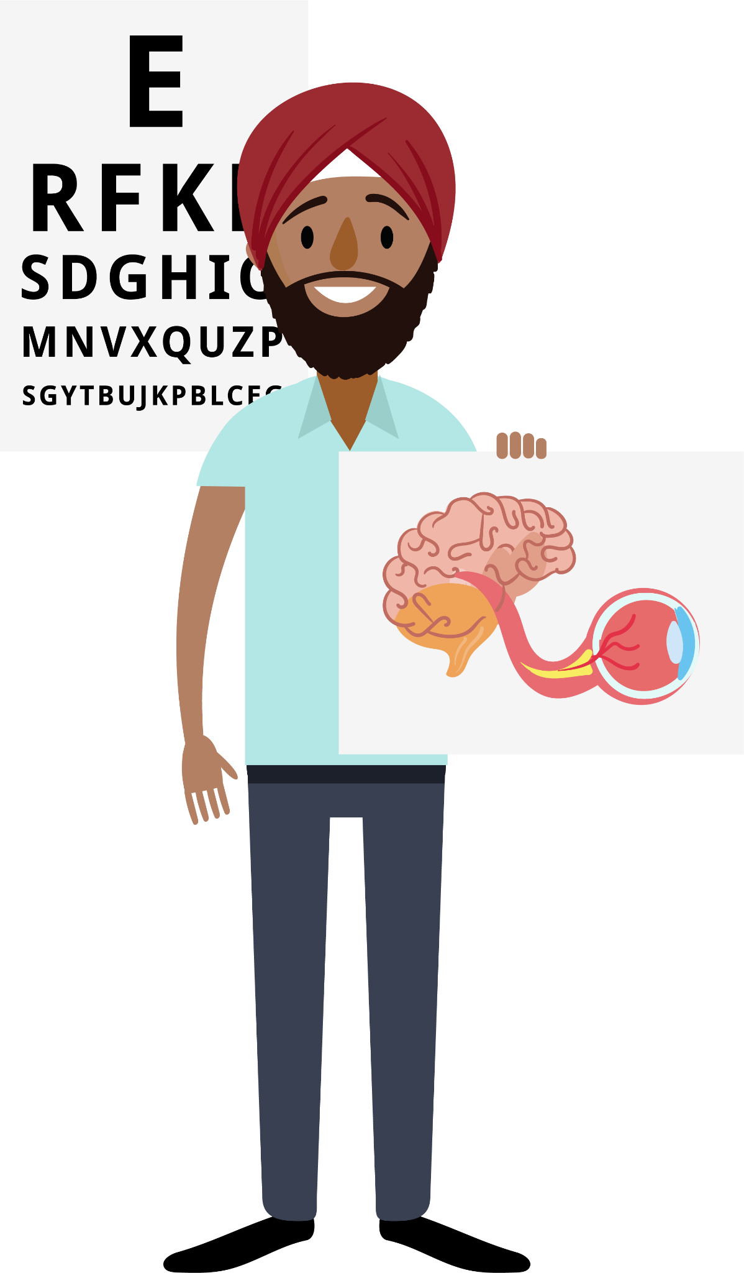
What is Orthoptics?
Teeth?​
​
Feet?​
​
Bones?​
​
Eyes!
Notes:
So, what is Orthoptics? Orthoptics is all about eyes! It’s a job that focuses on making sure our eyes work properly. It comes from the Greek word for "straight eyes". Orthoptists help make sure your eyes move the right way and work well with your brain.
This is our mascot Oxi (Short for Oxivion) A futuristic system blending oxygen and vision, such as imaging technologies.

Slide 4
Healthcare Careers
Notes:
There are lots of health jobs, and Orthoptics is one of them. Working as an Orthoptist is really cool because you get to help people see better, which makes a big difference in their lives. It's a job that lets you meet lots of different people and helps them every day!

Slide 5
Which one are we?
Notes:
You might have heard about Optometrists and Ophthalmologists. They all work with eyes, but they do different things:
Opticians help you pick glasses.
Optometrists check your eyes for problems and give you glasses if needed.
Ophthalmologists are doctors who treat serious eye problems.
Orthoptists are different – they help treat things like strabismus (eye misalignment), vision development or double vision.

Slide 6
Reduced vision ​
Nystagmus ​ (wobbly eyes)​
Strabismus​ (eye misalignment)​
Field defects ​
Notes:
Orthoptists help babies, children, and adults. For babies and children, they help with problems like strabismus (eye misalignment) or if their vision is not developing properly. For adults, they treat double vision, visual field problems or eye movement problems. These can all have lots of causes and it is the orthoptist job to find out why and help fix it!
Orthoptists mostly work in hospitals but sometimes work in schools or special clinics too!

Slide 7
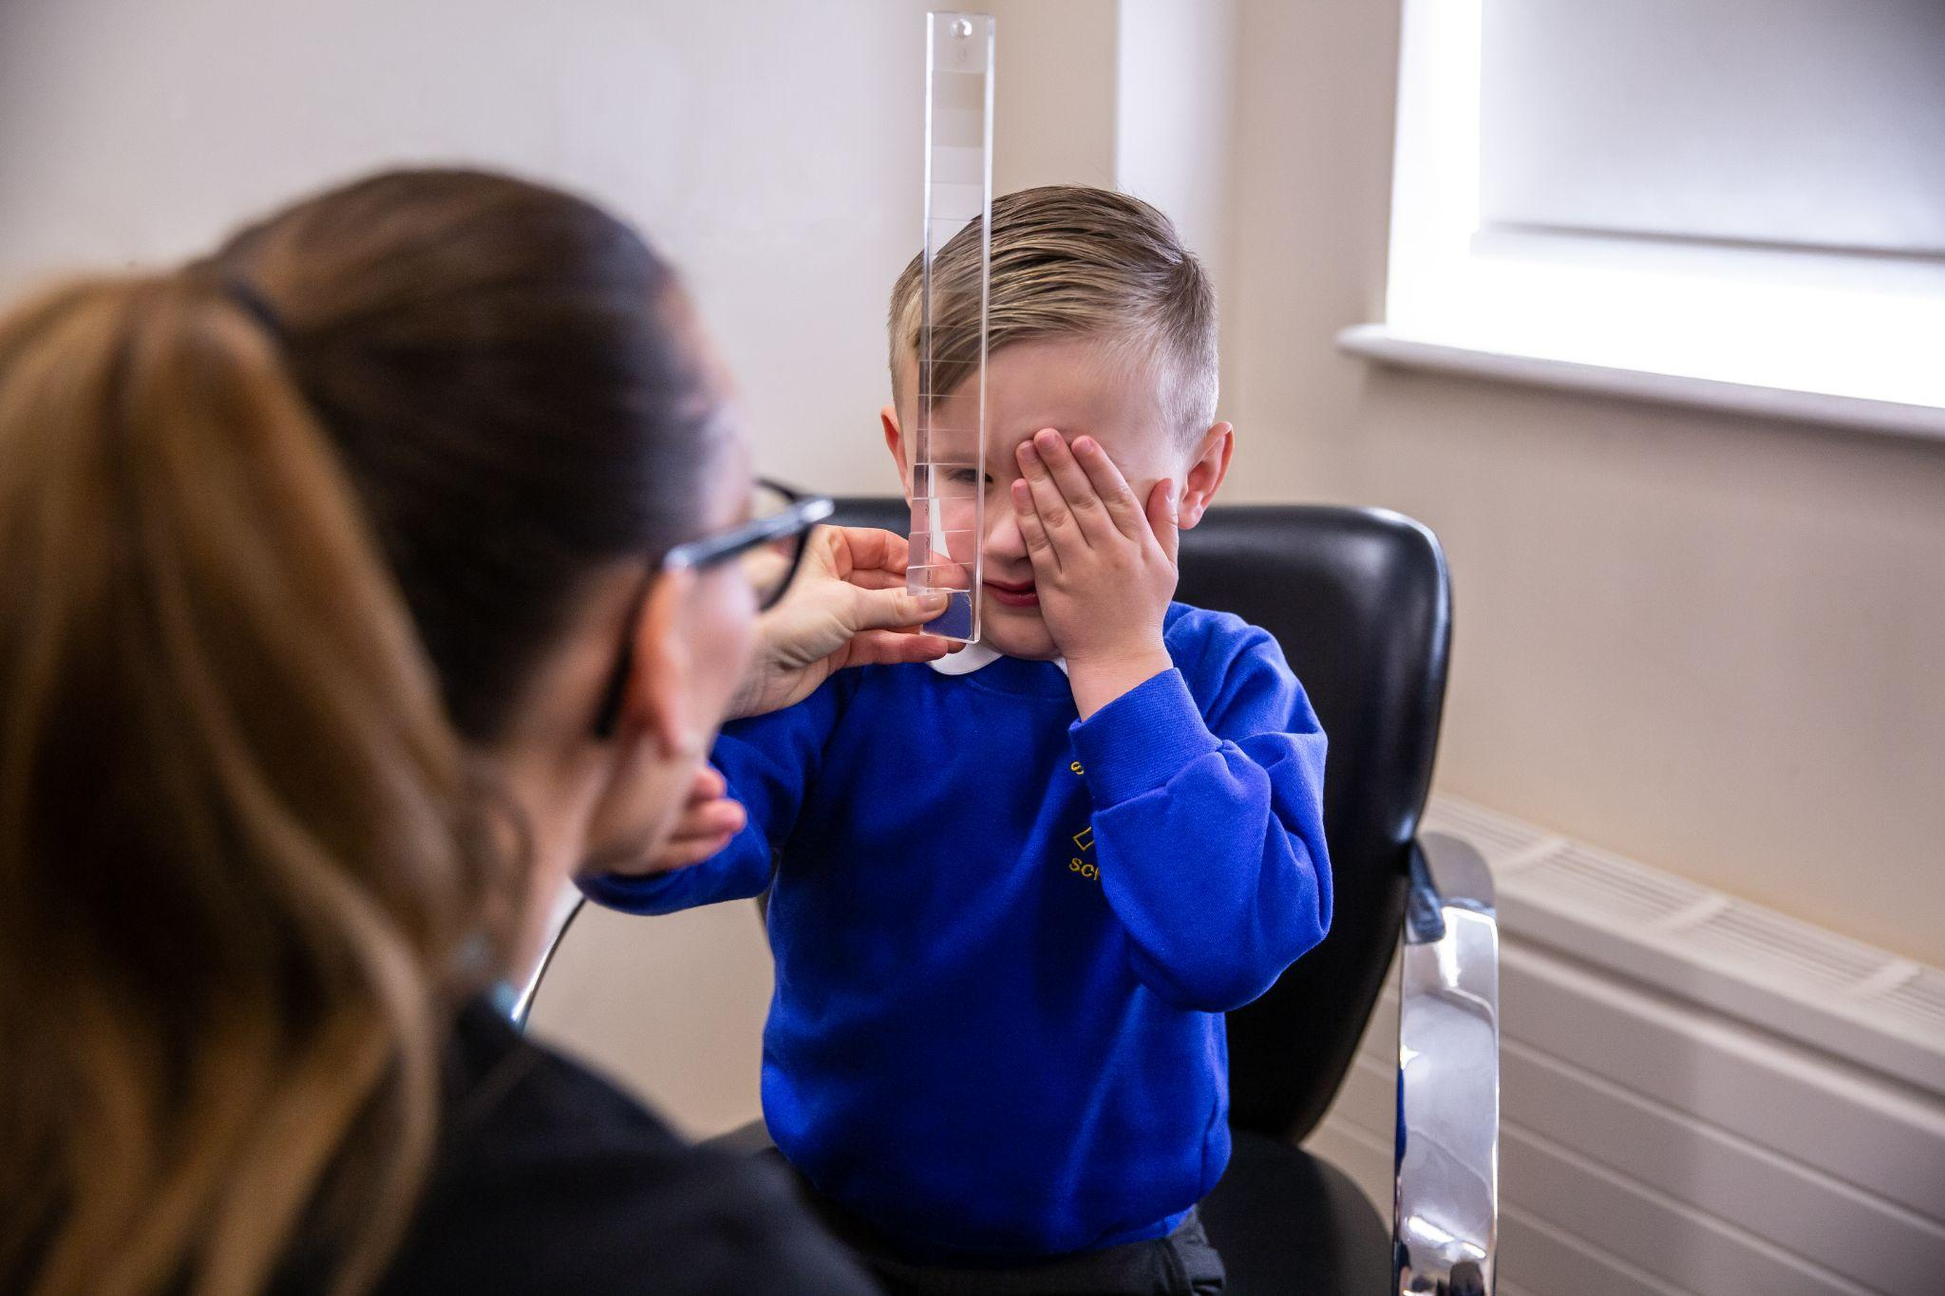
The magical power of eyes!
What do you think happens when a young child develops strabismus (a turn in the eye)?
Notes:
Imagine a child has strabismus (where one of their eyes turns). What do you think they might experience?
Would they see double?
Would their vision be different from someone with straight eyes?
How would we help them?
If they have strabismus, they don’t see double because the brain ignores the turned eye. This can lead to weak vision in that eye. Orthoptists might treat this with patching (covering one eye) or special eye drops. This forces the weak eye to be used and get stronger, and magically grow vision! If this happened to an adult, they would get double vision and their vision would be the same as before as their vision has already developed.

Slide 8
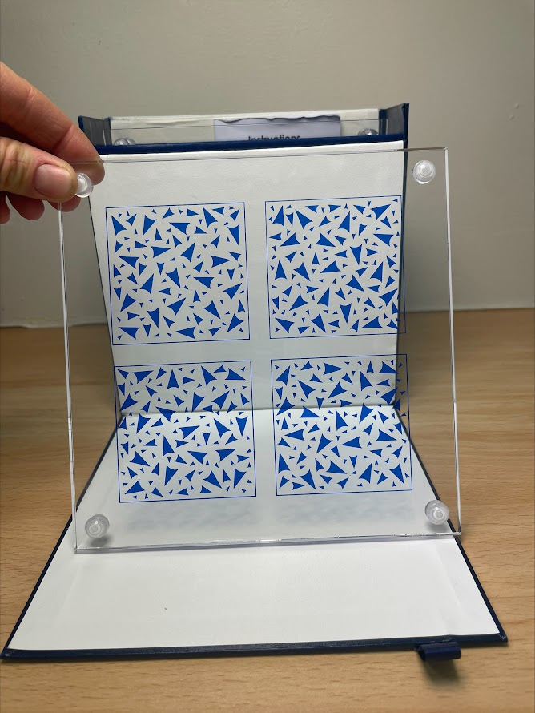
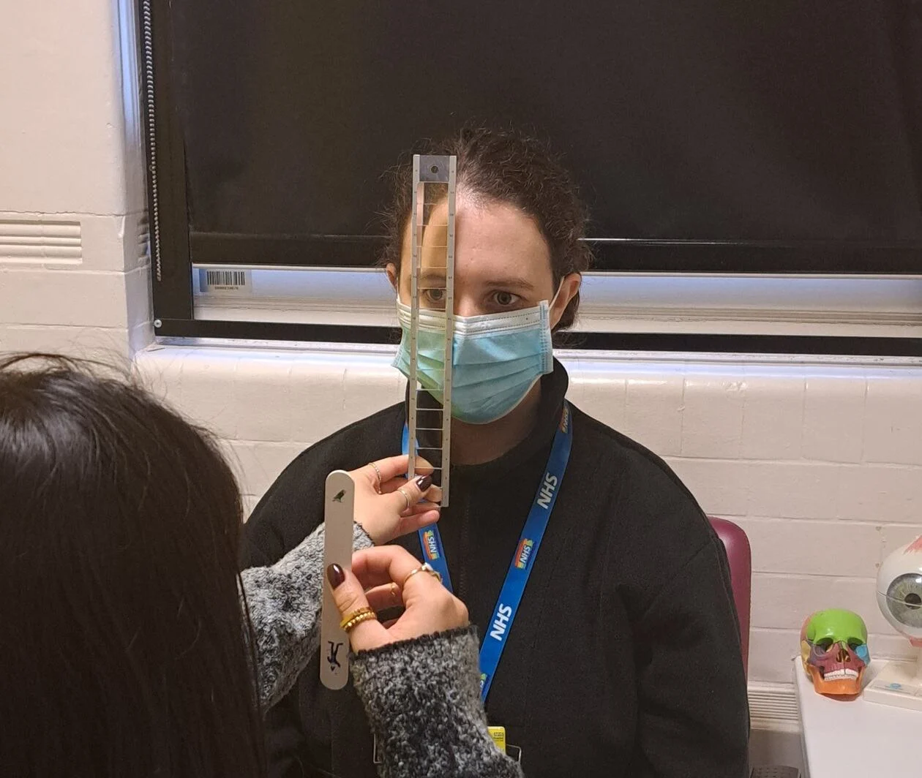
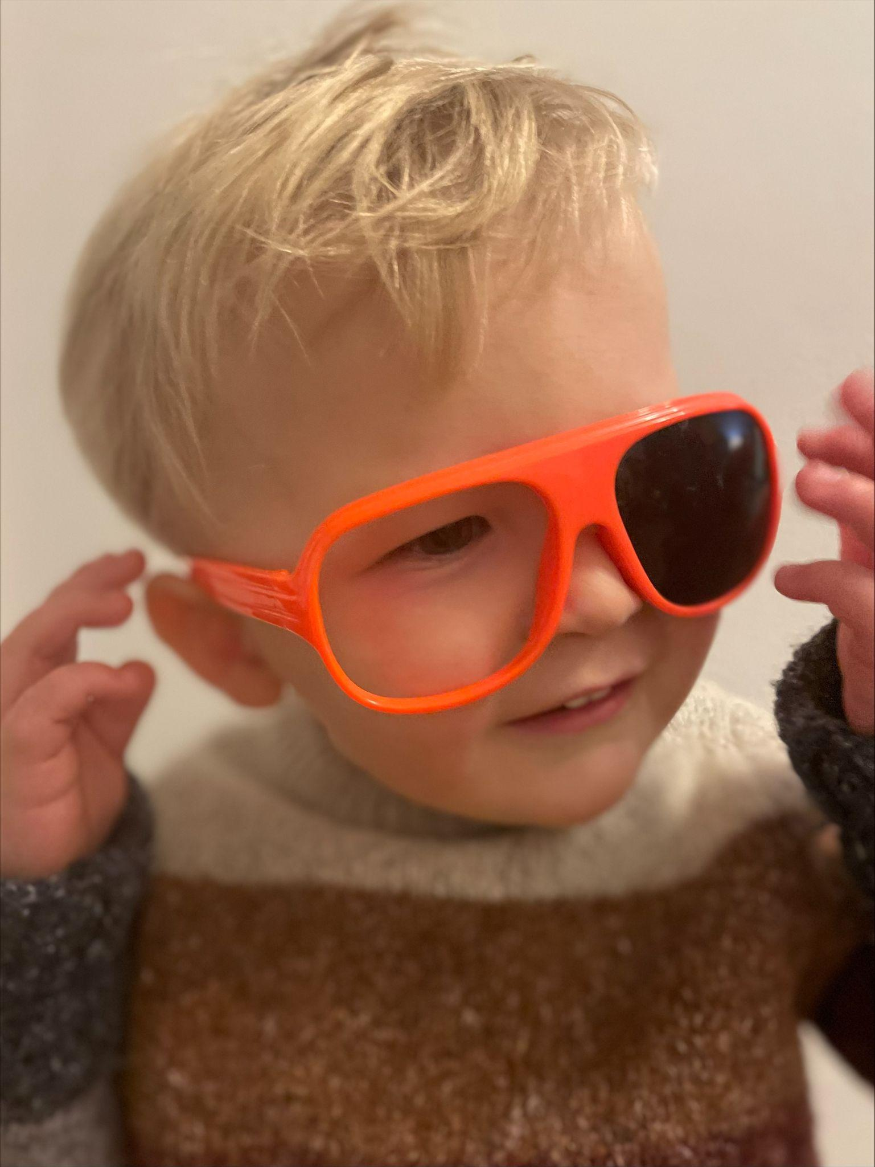
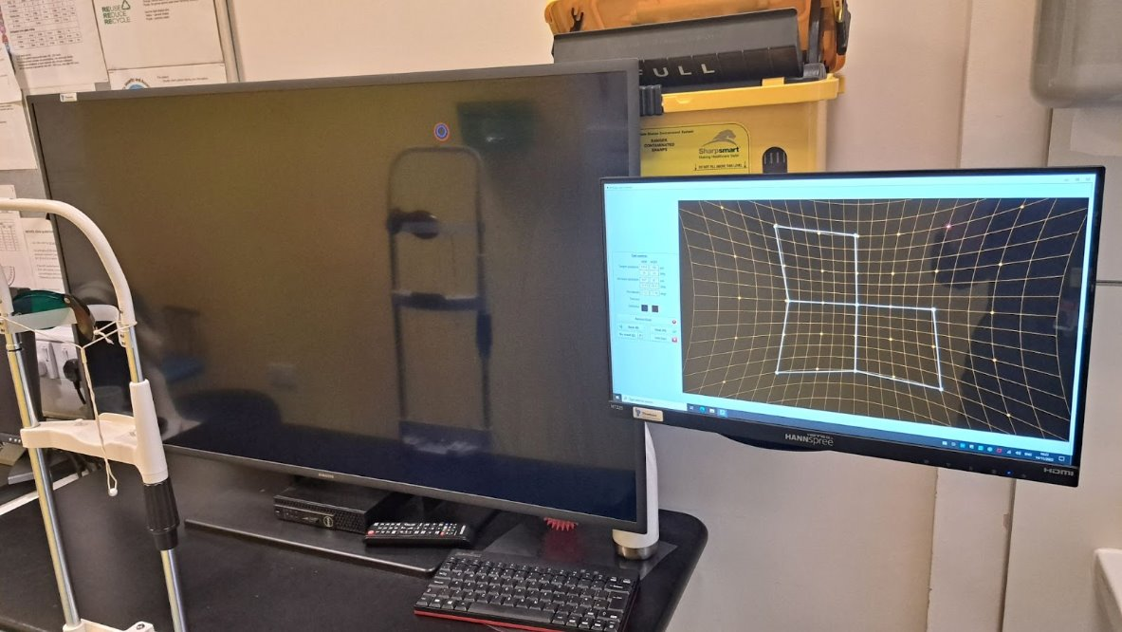
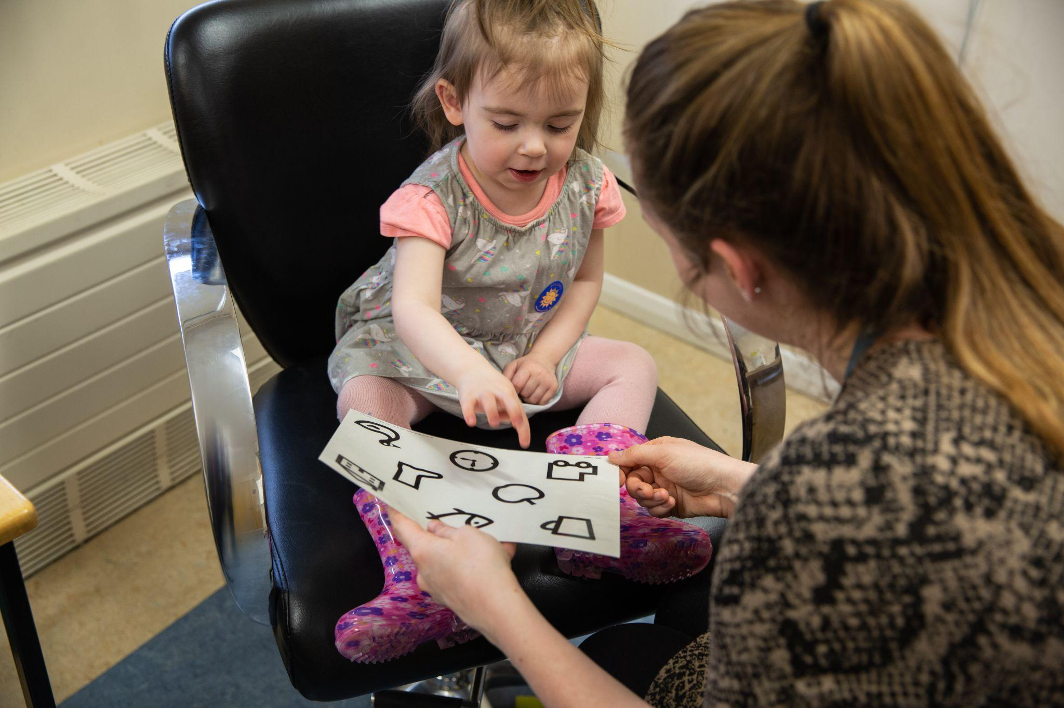
Orthoptic Testing
Notes:
Orthoptists use special tests to check how well someone’s eyes are working together. These tests help them understand how to treat problems and help people see better. Some of these include 3D vision games!

Slide 9
Orthoptic Treatment
Notes:
Here are some ways Orthoptists help people:
Patching a child’s eye to make it stronger.
Prisms (which bend light) can be stuck onto glasses to fix double vision.
Eye exercises to make your eye muscles stronger.

Slide 10
Contact: visibilityleads@orthoptics.org.uk
Thank you
How do I become an Orthoptist?
Notes:
Thank you!
Any questions?

