Slide 1
A guide to your child’s Orthoptic journey
The British and Irish Orthoptic Society

Slide 2
What is an Orthoptist?
Orthoptists are registered Allied Health Professionals regulated by the Health and Care Professions Council (HCPC) in the UK and CORU will be the regulator in the Republic of Ireland.
You child may see them working in a hospital setting or out in the community.
They often go into schools to test children around the age of 5.

Slide 3
Why might your child be seeing an Orthoptist?
Orthoptists are trained specialists in diagnosing and providing non-surgical management of disorders of eye movements and associated vision defects.
Your child may be seeing them for numerous reasons. For example:
If they have strabismus, this is when one eye is misaligned.
If they have amblyopia, this is reduced vision in one eye.
If they have a condition which affects how their eye move.
If they have a condition which affects the eye such as glaucoma or a cataract.

Slide 4
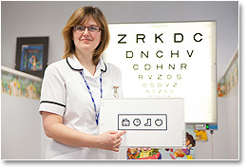
Vision Screening
In your area your child should be automatically enrolled into a vision screening programme which is led by Orthoptists.
They should be screened at school when they are aged 4-5 years old.
If your child is found to have any eye related problems that need a follow-up an appointment will be booked for you and your child to attend the nearest Orthoptic clinic.

Slide 5
When you arrive at the appointment
You should check in at the reception and take a seat in the waiting room.
You will be then called in by the Orthoptist who will be performing some tests.
The Orthoptist you see may be Male or Female.

Slide 6
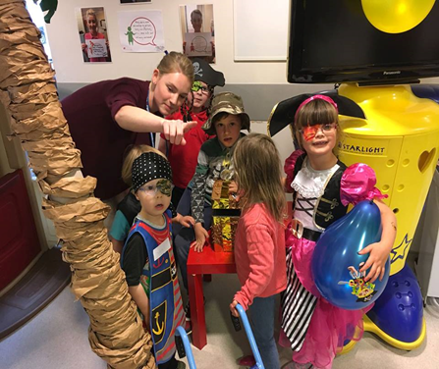
The Waiting Area
There are often thing to keep your child entertained whilst you wait.
For example, they can:
Play with toys
Watch TV
Read a book
Draw or colour in pictures
Play with other children and make new friends

Slide 7
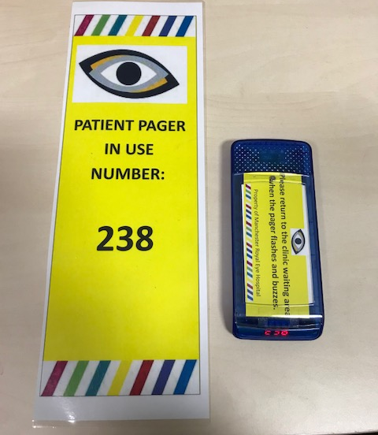
The Waiting Area
Sometimes the waiting area may get busy.
If this is the case you may be able to ask for a pager so that you can wait in a quieter area or go get a drink whilst you are waiting.
If your child needs reasonable adjustments, for example, if they have autism, the department will try to accommodate any requests you have.

Slide 8
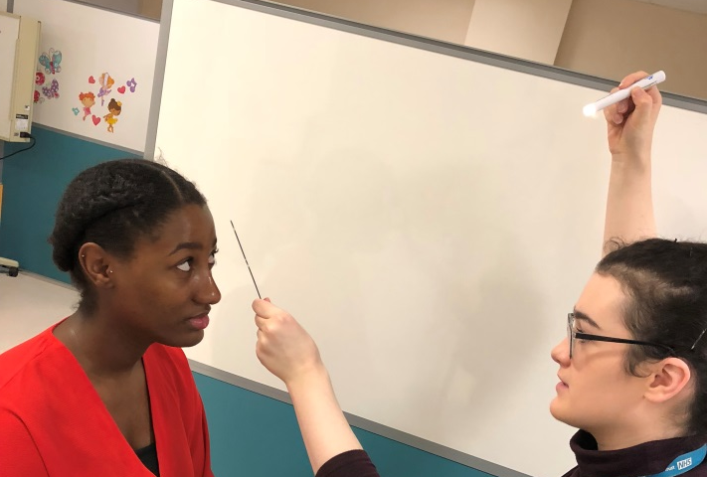
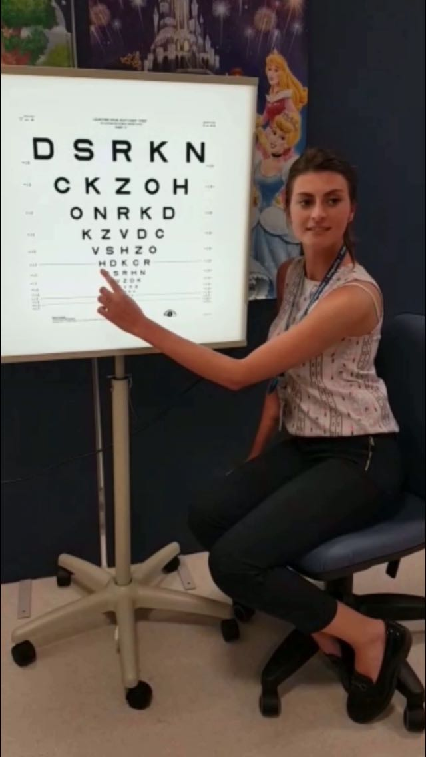
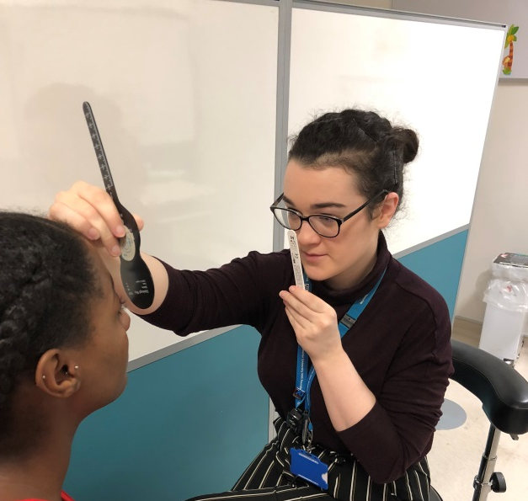
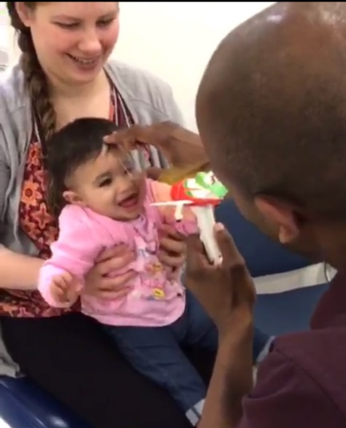
The Orthoptic Assessment
At the appointment we will check your child’s vision, check their is no strabismus, look at their eye movements and check if both their eyes are working together as a pair.

Slide 9
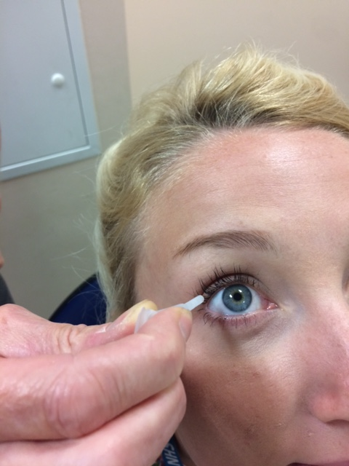
Eye Drops
At their appointment we may need to instil some eye drops into your child’s eyes.
They will make your child’s pupil big so that we can take a look at the back of their eye.
They do sting for a couple of seconds and they may make your child’s vision slightly blurry, however, this is only temporary.

Slide 10
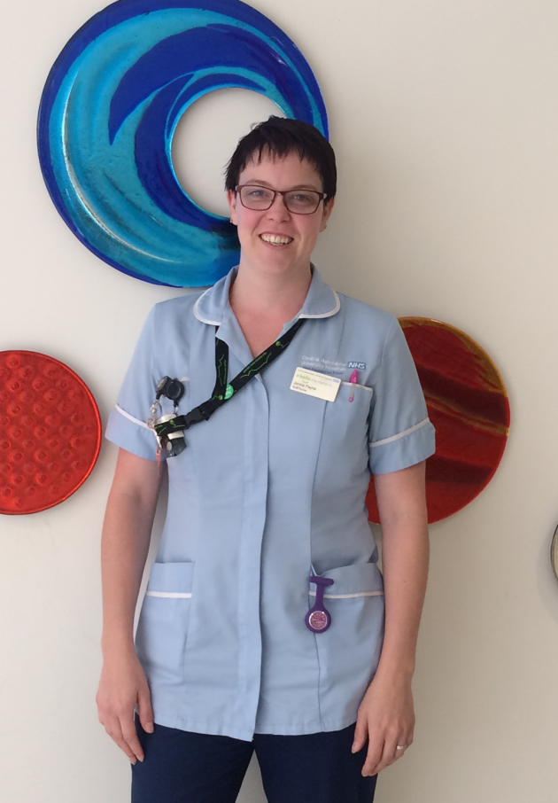
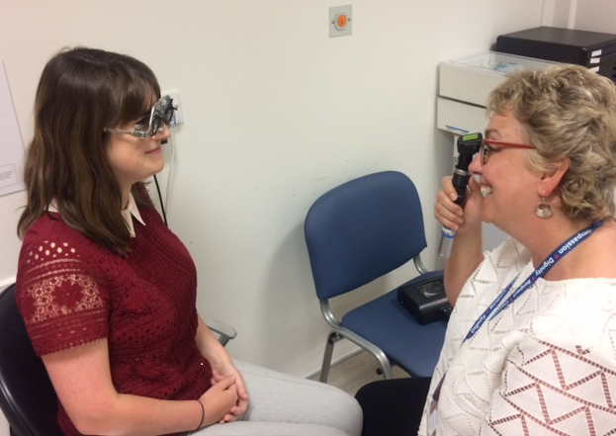
Other Professionals
Usually your child will just see the Orthoptist, however, your child may also see a Nurse or an Optometrist at their appointment.
The Nurse may check you child’s vision or perform some other tests with them.
The Optometrist will look into your child’s eye with equipment to see if they need glasses.

Slide 11
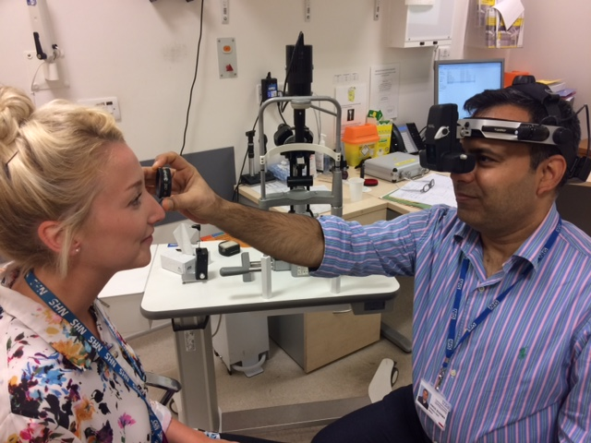
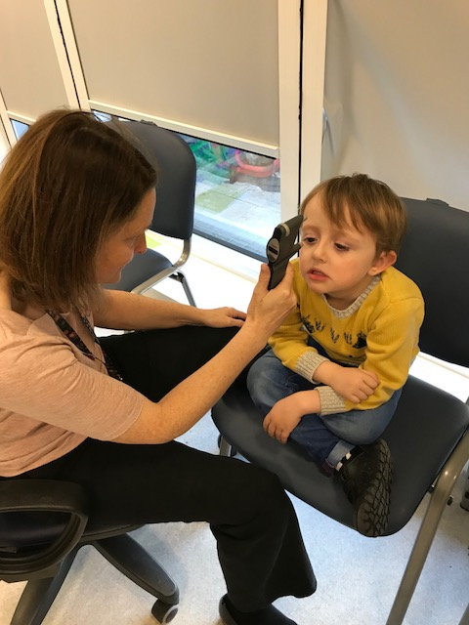
Other Professionals
Your child may also see a doctor. The doctor will perform a wide range of tests to help them diagnose any conditions they are suspecting. For example, they may use a lens to look at the back of the eye and use equipment to check the pressure in your child’s eye.

Slide 12
Summary
Treatment – at the end of your appointment the Orthoptist will discuss and agree with you a treatment plan that is best for your child.
They may arrange a follow-up appointments.
Changing the appointments – it may be necessary for you to change an appointment because of unforeseen circumstances. If this is the case please telephone the department as far in advance as possible to re-arrange your appointment.
We hope that this has provided you with some more information about what to expect at your appointment with the Orthoptist.

